Slide 1
The Enigma Series
Executive Summary and Overview
Part I: The Money Enigma
Part II: The Inflation Enigma
Part III: The Velocity Enigma
Gervaise R.J. Heddle
December 2014

Slide 2
Index
Section Slide
Executive Summary 3
The Money Enigma – Overview 27
The Inflation Enigma – Overview 47
The Velocity Enigma – Overview 95

Slide 3
Executive Summary
Economics is not a young science. Nearly two hundred and forty years have passed since the publication of Adam Smith’s “Wealth of Nations”, regarded by many as the first modern work of economics. Despite this passage of time, economics still struggles with issues that are fundamental. What is the nature of money? What is the role of money in the determination of the price level? What are the primary causes of inflation?
The Enigma Series seeks to provide a new perspective on these issues by challenging some of the core fundamentals upon which current economic theory is built. More specifically, The Enigma Series develops alternative theories regarding both the nature of money and the process of price determination.

Slide 4
The Problem with
Theories of Inflation
It is the view of The Enigma Series that modern economics has failed to develop satisfactory theories regarding the nature of money and price determination. Current theories do not accurately describe what money is or how it derives its value. Furthermore, current economic theories provide a one-sided and therefore misleading view of microeconomic price determination. Most notably, it is the view of The Enigma Series that every price is a function of two sets of supply and demand (i.e., supply and demand for both items being exchanged).
These failures have led to an inevitable result: an inability to develop comprehensive models of inflation that can fully incorporate the critical and misunderstood role of money.

Slide 5
A New Perspective on
Money and Inflation
The Enigma Series develops the theory that money only has value as an asset because it is a liability of society. More specifically, it is argued that money is a long-duration, special-form equity instrument issued by society to fund certain public activities. In simple terms, money is a proportional claim on the output of society. As a consequence, the market value of money is primarily determined by very long-term (30 year) expectations regarding the future path of both real output and the monetary base.
The market value of money is the denominator of every “money price” in the economy: as the market value of money falls, the price level rises. Therefore, the price level also depends upon long-term expectations regarding the future of real output and money.

Slide 6
A Brief Overview of
The Enigma Series
The Enigma Series is comprised of three discussion papers. Each paper develops one of the three “core propositions” listed below.
  The Money Enigma: Money is a financial instrument: its value as an asset is derived solely from the liability that it represents. More specifically, money is a proportional claim on the output of society (i.e., money is a special-form equity instrument).
  The Inflation Enigma: Every price is a relative expression of two market values. Supply and demand for money determines the market value of money, the denominator of every “money price” in the economy.
  The Velocity Enigma: Money is a long-duration asset. The market value of money is driven primarily by expectations of the future path of the “real output/base money” ratio.

Slide 7
The Money Enigma
“Proportional Claim Theory”
The first paper in the series, The Money Enigma, argues that money derives its value solely from its status as a financial instrument. Most discussions of money focus on the “asset nature” of money: this narrow perspective obfuscates the true nature of money. Money (the monetary base) only has value as an asset because it is a liability of society.
The view of The Money Enigma is that money (base money) is a proportional claim on the output of society. Money is a financial instrument issued by government, as trust and trustee, on behalf of society. More specifically, money is a special-form equity instrument of society that represents, to its possessor, a variable entitlement to the future output of society.

Slide 8
The “Liability Nature” of Money and the Functions of Money
Focusing on the “liability nature” of money provides a much clearer path to defining what money is and what it is not. The Money Enigma argues that money is a direct, proportional claim on the output of society. Most of the assets that economists classify as “money”, such as banking deposits, are merely claims to money: they are claims to a claim on the output of society.
More importantly, by understanding the liability that base money represents, we avoid the circular logic associated with most discussions regarding the demand for money. In particular, money does not derive its value from the functions it performs, rather, money can only perform its functions because it has value as a financial instrument (as a proportional claim on output).

Slide 9
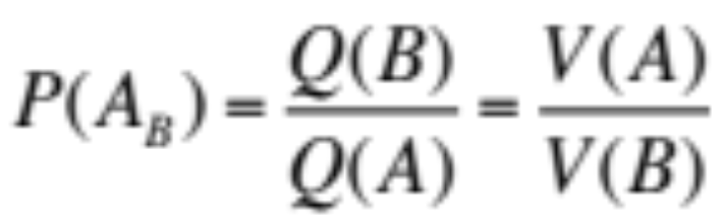
The Inflation Enigma: Price is a Relative Expression of Market Value
The Money Enigma concludes by arguing that the price of money is not the interest rate. Rather, supply and demand for money determines the market value of money, the denominator of every “money price” in the economy.
The Inflation Enigma picks up this discussion by arguing that every price is a relative expression of two market values. Let’s assume we have two goods being exchanged (goods A and B). By measuring the market value of both goods in “absolute terms”, denoted as V(A) and V(B) respectively, the price of good A in B terms can be stated as:

Slide 10
“Price” versus “Market Value”
It is the contention of The Enigma Series that “price” and “market value” are not the same thing. A good can possess the property of “market value” and we can measure this market value in terms of a theoretical and invariable measure of market value (just as a tree can possess the property of length and we can measure that property in terms of an invariable measure such as feet and/or inches). But this is not a “price”.
The “price” of a good, in terms of another good, depends upon the market value of both goods. In a barter economy, the price of apples in terms of bananas depends on both the market value of apples and the market value of bananas. Similarly, in a money-based economy, the “money price” of a good depends on both the market value of the good and the market value of money.

Slide 11
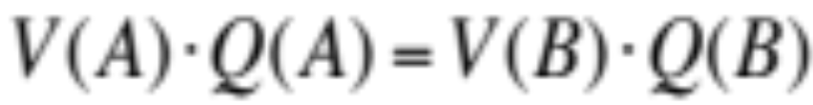
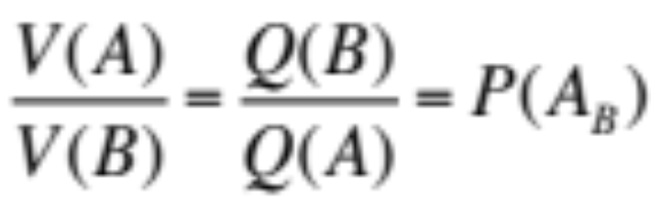
Price Determination:
The General Principle
In simple terms, trade involves the exchange of two baskets of equal market value. If we have two goods (A & B) and if we measure the market value of each good in terms of a theoretical and invariable measure of market value, denoted V(A) and V(B), then trade occurs such that:
If good A is twice as valuable as good B, then two units of B must be offered for one unit of A. This ratio of quantities exchanged is the “price” of good A in terms of good B and is determined by the relative market value of the goods.

Slide 12
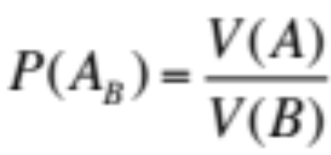
Price is Determined by Two Sets of Supply and Demand
Traditional microeconomic analysis implies that price is determined by supply and demand for only one of the goods being exchanged. The second paper in the series, The Inflation Enigma, argues that every price is better understood as a function of two sets of supply and demand.
Market Value
(EV)
Market Value
(EV)
“GOOD A”
“GOOD B”
S
S
V(A)
V(B)
D
D
Q(A)
Quantity
Q(B)
Quantity

Slide 13
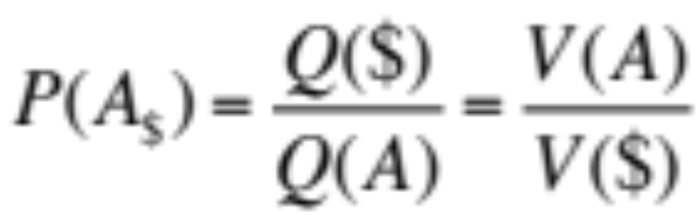
Price Determination in a
Money-Based Economy
The Inflation Enigma extends this principle to “money prices”. In order to perform its key role as a medium of exchange, money must possess the property of market value: if money did not possess “market value” then we would not accept it in exchange.
The market value of money varies considerably over time. If the market value of money falls, then, all else remaining equal, we must offer more units of money for the same number of units of a particular good. Hence, the price of that good in money terms (the ratio of exchange) must rise.

Slide 14
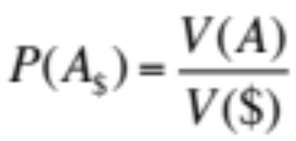
Every “Money Price” is Determined by Two Sets of Supply and Demand
We can apply the general theory to the determination of “money prices”. Supply & demand for good A determines the market value of good A, V(A). Supply & demand for money determines the market value of money, V($). The money price of good A is equal to the ratio of the two market values.
Market Value
(EV)
“GOOD A”
Market Value
(EV)
“MONEY”
S
Supply
V(A)
V($)
Demand
D
Q(A)
Quantity
Q($)
Base Money

Slide 15
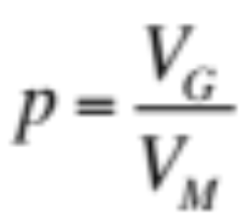
The Ratio Theory of the Price Level
The Inflation Enigma further extends this concept to a macroeconomic level. The “Ratio Theory of the Price Level” states that the general price level p can be expressed as a ratio of two market values:
    Where p is the general price level of the economy
    V_{G} is the “general value level” of the economy
    V_{M} is the absolute market value of money
The general value level V_{G} is a hypothetical measure of overall market values (as measured in “units of economic value”) for the set of goods and services that comprise the “basket of goods”.

Slide 16

The Goods-Money Framework
Ratio Theory can be illustrated using the “Good-Money Framework”. Aggregate supply and demand for goods/services determines the equilibrium general value level V_{G} and real output q. Supply and demand for money determines the absolute market value of money V_{M} .
“LEFT SIDE: GOODS”
“RIGHT SIDE: MONEY”
General Value Level (EV)
Value of Money (EV)
AS
Supply
V_{G}
V_{M}
AD
Demand
q
Real Output
M
Base Money

Slide 17
Money is a Long-Duration Asset
The key problem with the right side of the Goods-Money Framework is that supply and demand analysis is a “second best” tool for analyzing the determination of the equilibrium absolute market value of money. Why? Because money is a long-duration asset. An increase in the monetary base may have little or no impact on the absolute market value of money if that increase is expected to be temporary in nature. Rather, the absolute market value of money is primarily determined by the expected long-term future path of the output/money ratio.
Therefore, in order to better understand the determination of the absolute market value of money, we need to build a valuation model for money: the “Discounted Future Benefits Model”.

Slide 18
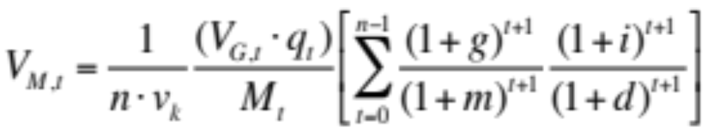
The Velocity Enigma:
The Discounted Future Benefits Model
The final paper in the series, The Velocity Enigma, combines the concepts developed in the first two papers of The Enigma Series to develop the following “valuation model” for money:
If money is a financial instrument (a proportional claim on the output of society) and if we can measure the market value of money in terms of an invariable measure of market value (“units of economic value”), then it should also be possible to build a “valuation model” for money just as we can build a discounted future cash flow model for a share of common stock.

Slide 19
The Value of Money &
Long-Term Expectations
Without going into every detail at this stage regarding the derivation of the formula below, we can make an important initial observation regarding what it implies.
The long-term expected growth rates of real output and base money are denoted as “g” and “m” respectively. Just as the price of a share of common stock will fall if the market lowers its expectations of long-term earnings per share growth, so the market value of money will fall if the expected long-term growth rate of “real output per unit of base money” falls.

Slide 20
The Price Level, the Velocity of Money and Foreign Exchange Rates
Adapting the standard “discounted future benefits model” to money is a non-trivial task that involves an extended discussion of the terms of the implied “Moneyholders’ Agreement” and an analysis of the role of intertemporal equilibrium in the determination of the current market value of money (intertemporal equilibrium analysis is used to create a probability distribution for the expected future benefits of money).
The end result, the Discounted Future Benefits Model for Money, can be used to create expectations-based solutions for the price level, the velocity of money and foreign exchange rates. The next few slides review the expectations-based models for the price level and velocity that are derived from our valuation model.

Slide 21
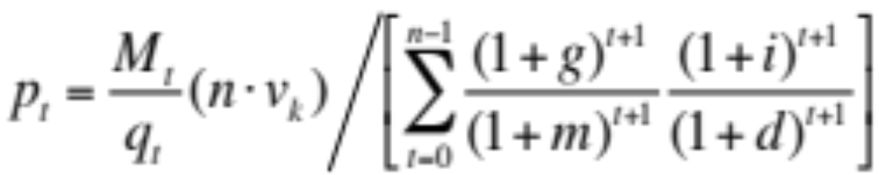
The End Goal:
A Model for the Price Level
By applying Ratio Theory to the Discounted Future Benefits Model, we obtain the following solution for the price level:
The price level can be considered to be composed of a “baseline component” and an “expectations component”. The baseline component should look familiar. The baseline component implies that the price level depends on current levels of money supply M_{t} and real output q_{t} , as long-term empirical evidence suggests, and the initial velocity of money at “announcement date”, v_{k} (a constant).
Baseline Component
Expectations Component

Slide 22
The “Expectations Component”
Readers will not be familiar with the second component in the price level model, the “expectations component”:
The expectations component indicates that the price level depends upon long-term expectations. More specifically, the price level will rise if one (or more) of the following occurs: expected long-term output growth (g) falls; expected long-term base money growth (m) rises; expected (risk-adjusted) nominal investment returns (i) fall; and/or the real discount rate applied to future consumption (d) rises.
Baseline Component
Expectations Component

Slide 23
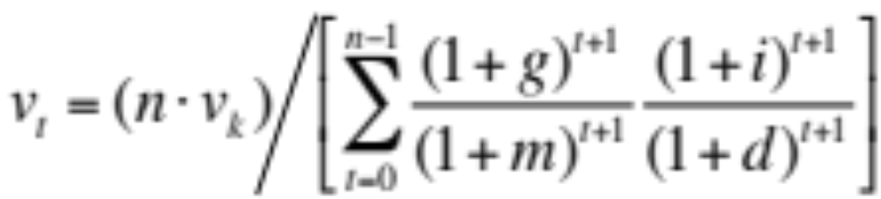
A Solution for
The Velocity of Money
We can also use the valuation model for money (the “Discounted Future Benefits Model”) to solve for the velocity of money:
The velocity of money is anchored by the initial velocity of money v_{k} (the velocity of money at the time the implied Moneyholders’ Agreement came into effect). Although we need to be careful not to interpret this “constant growth” version of the model too literally, we can say that changing expectations regarding the long-term growth rates of real output and base money are a major factor in determining the velocity of money.

Slide 24
Monetary and Fiscal Policy
Transmission Mechanisms
The Velocity Enigma concludes by challenging some of the traditional notions regarding monetary and fiscal policy transmission mechanisms. In particular, it is argued that lower interest rates shift both the aggregate demand and aggregate supply curves to the right (largely negating the relevance of the output gap). This can create a dangerous confidence game: the significant increase in output fuels confidence regarding long-term growth prospects and the view that the increase in the monetary base is largely “temporary”, thereby somewhat “artificially” supporting the value of money and containing inflationary pressures.
It is also argued that “excessive” levels of government debt play a critical role in shaping expectations regarding the future path of the “money/output” ratio and hence the value of money.

Slide 25
The Risk of Severe Inflation
The primary aim of The Enigma Series is develop theories of money and inflation, not make predictions. However, the theories developed in these papers do highlight the very real risk of a severe and sudden increase in the inflation rate.
In the case of the United States, a massive increase in the monetary base has had little impact on the value of the US Dollar because the increase in the monetary base has been regarded as “temporary”. However, if market confidence falters and the market believes that real output growth will only be sustained by maintaining or further increasing current levels of base money, then the market value of the dollar could decline significantly and easily overwhelm any deflationary pressures in the goods/services market (the decline in V_{M} will overwhelm the decline in V_{G} ).

Slide 26
Moving Forward
In summary, The Enigma Series develops a set of alternative ideas regarding the nature of money and price determination. Taken together, these ideas represent a powerful, alternative platform for economic analysis that can be used to challenge many of the core tenets of modern macroeconomics.
The next three sections provide an extended summary of each of the three papers that comprise The Enigma Series: The Money Enigma, The inflation Enigma and The Velocity Enigma. Some readers may find it helpful to read each of these summaries before they progress to the papers themselves, although others may prefer to begin by simply downloading and reading the first paper in the series, The Money Enigma.

Slide 27
The Money Enigma
An Overview of Part I of The Enigma Series

Slide 28
The Money Enigma
Introduction
The key goal of The Enigma Series is to develop a theory regarding the nature of money and the role money plays in the determination of the price level. The Money Enigma, the first paper in the series, focuses on the nature of money.
The Money Enigma seeks to answer the question “why does money have value?” The paper explores why rational economic agents are prepared to accept money in exchange for goods, labor and other assets. More specifically, the paper seeks to explain how money derives its value. It is the view of The Enigma Series that money derives its value solely from its status as a financial instrument. Money is issued under an implied contract: it is an asset to its holder and a liability of society.

Slide 29
Traditional Definitions of Money
Focus on its “Asset Nature”
Milton Friedman, in answer to the question “What is money?” states: “Money is whatever is generally accepted in exchange for goods and services – accepted not as an object to be consumed but as an object that represents a temporary abode of purchasing power...” (Friedman, 1994).
Friedman’s comments focus almost entirely upon the “asset nature” of money. To its holder, money is an asset and is a temporary abode of purchasing power. But a lot of assets are a “temporary abode of purchasing power”. What makes money unique is its “liability nature”. Friedman’s definition of money focuses on only half the picture: it is a “half-truth” that does more to blur the true nature of money than to explain it.

Slide 30
Two Sides of the Same Coin:
Money as an Asset and Liability
It is the contention of this paper that money only has value as an asset (money acts as a temporary abode of purchasing power) because it is a liability of society. Money is a financial instrument issued by government, as trust and trustee, on behalf of society. Money is a proportional claim on the future output of society: in essence, money is a special-form equity instrument of society that represents, to its possessor, a variable entitlement to the future output of society.
The asset and liability nature of money are, quite literally, two sides of the same coin. Fiat money has no intrinsic value: it is not a “real asset”. Fiat money is a financial instrument and its value is determined solely by the liability that it represents.

Slide 31
Every Asset Falls Into
One of Two Buckets
Every asset is either a real asset or a financial instrument. Real assets derive their value from their physical properties. Financial assets derive their value contractually: their value as an asset is determined by the nature of the liability they represent to the issuer.
LAND & STRUCTURES
COMMODITIES
LIVESTOCK
PRECIOUS METALS
STOCKS
BONDS
MORTGAGES
FIAT MONEY
“REAL ASSETS”
“FINANCIAL INSTRUMENTS”

Slide 32
Money as a Liability of Society
Money derives its value as an asset from its status as a financial instrument (it has value because it is someone’s liability). Money is a liability of society (issued on behalf of society by government as trust and trustee) and an asset to its holder.
MONEYHOLDERS’ AGREEMENT
FINANCIAL INSTRUMENT
SOCIETY
{GOVERNMENT
AS TRUST &
TRUSTEE}
MONEYHOLDER
ASSET
MONEY
LIABILITY

Slide 33
Money as a Proportional Claim on the Output of Society
Money is created by society in order to fund certain public activities. Society authorizes government to issue claims on the future output of society. Money represents a proportional claim to that future output.
AUTHORIZES
SOCIETY
“BENEFICIARY”
PRODUCES
FUTURE ECONOMIC OUTPUT OF SOCIETY
TO ISSUE CLAIMS ON
GOVERNMENT
“THE TRUST”
GOVERNMENT
LIABILITIES
“LEGAL LIABILITY”
“ECONOMIC LIABILITY”

Slide 34
Money as a Financing Option
The ability to issue proportional claims against future output is a useful financing tool for any society and an attractive financing option for the political leaders of many societies. Indeed, money is a critical financing tools at times of national emergency (at time of war, society may not be able to issue “fixed” claims on output (govt. debt) or the cost of such claims may be prohibitive).
The money financing option is made more attractive by the long-duration nature of money. Large quantities of money can be issued in a short period of time with very little impact on its value if (i) the issuance is believed to be temporary in nature, and/or (ii) people believe the issuance will have a significant positive impact on the long-term real output growth of society.

Slide 35
Money vs Common Stock
The exact nature of the proportional claim and the long-duration nature of money are complex subjects that are discussed in the final paper, The Velocity Enigma. However, we can illustrate the basic idea by using a simple analogy: common stock.
Money shares many of the characteristics of traditional equity instruments (common stock). Common stock is a proportional claim on the residual cash flows of a corporation. Money is a proportional claim on the output of society. Both are long-duration assets: much of their present value depends on benefits in the distant future. There are important differences: most notably, money entitles its possessor to a slice, not a stream, of future benefits.

Slide 36
Money Has “Equity Like” Characteristics
The notion that money is a proportional claim on the output of society is one that will only be able to be empirically tested by extending the concept to develop an expectation based solution for the price level: such a model is developed in The Velocity Enigma using the Discounted Future Benefits Model for money.
However, the notion that money has “equity like” characteristics is explored in The Money Enigma. In general terms, equity instruments are financial instruments with a variable entitlement to a set of benefits, no term and a junior status. The behavior of the price level over long periods of time suggests that money has the characteristic of being a variable entitlement to output. The short-term evidence suggests that money is a long-duration asset.

Slide 37
The Supply of Money:
Money is the Monetary Base
Focusing on the liability nature of money provides a much clearer path to defining what is money and what is not money. The view of The Money Enigma is that money is a direct claim on the output of society. Most of the assets that economists classify as “money”, such as banking deposits, are merely claims to money: they are claims to a claim on the output of society.
Money, as defined by this paper, is comprised solely by the monetary base. The monetary base is different from other forms of “money” in that it is solely created by the government. Nearly all other forms of “money” (broad money) are credit instruments and are not direct claims on the output of society. This contrast is highlighted by the next two slides.

Slide 38
Financial Instrument #1
Physical Cash
Physical cash is “money” (currency is one subset of the monetary base). Money is an equity instrument. Money is a liability of society, issued on its behalf by government. Cash entitles its holder to a proportional claim on the output of society.
MONEYHOLDERS’ AGREEMENT
EQUITY
INSTRUMENT
SOCIETY
{GOVERNMENT
AS TRUST &
TRUSTEE}
MONEYHOLDER
ASSET
CASH
LIABILITY

Slide 39
Financial Instrument #2
A Bank Deposit
A bank deposit is a financial liability (a “debt instrument”), not an equity instrument. A bank deposit is a liability of a bank (not society). The deposit holder effectively lends their “money” to the bank and receives a “deposit” (a claim to that money in the future).
DEPOSIT AGREEMENT
DEBT
INSTRUMENT
DEPOSIT
HOLDER
BANK
ASSET
DEPOSIT
LIABILITY

Slide 40
Banks Create Credit, Not Money
The two financial instruments just presented are different in almost every important aspect. One is an equity instrument, the other is a debt instrument. One is a liability of society, the other is a liability of a commercial bank. Commercial banks create credit: financial instruments that represent a claim on money. Banks don’t create direct claims on the output of society.
It is the view of The Enigma Series that these two completely different financial instruments play very different roles in the determination of the price level (and other important economic variables such as real output). Lumping them into the same category, “money”, fundamentally compromises any effort to develop a theory of inflation before it even begins.

Slide 41
The Demand for Money
If the monetary base represents the supply of money, then what determines the demand for money? Most discussions regarding the demand for money start with a circular argument (although the circularity of the argument is rarely acknowledged).
In simple terms, money demand theories generally begin from the perspective that the demand for money (its value) is derived from its usefulness as a medium of exchange and store of value. The problem is that money can only perform it functions as a medium of exchange and store of value because there is demand for it (no demand, no functions). Proportional claim theory breaks this circularity of logic: demand for money is derived solely from its nature as a proportional claim on output.

Slide 42
The Bedrock Beneath the
Functions of Money
The functions of money all rest on a two-layered foundation. Money can only perform the functions that it does because it is an asset that has “market value”. In turn, money’s value as asset is derived contractually from the liability it represents to society (an equity instrument and proportional claim on the output of society).
STORE OF
VALUE
MEDIUM OF
EXCHANGE
UNIT OF
ACCOUNT
ASSET WITH MARKET VALUE
EQUITY INSTRUMENT OF SOCIETY

Slide 43
Liquidity Preference Theory starts with Incorrect Assumption
In summary, the causality between the value of money and the functions of money runs only one way. Money can only perform the three functions that are so closely associated with it because it has market value due to the implied contractual relationship that exists between society and the money holder. Money does not derive its value from its functions.
If the demand for money is derived from its status as a financial instrument and not from its functions, then the first and most fundamental assumption used by Keynes to develop his liquidity preference theory is incorrect. Keynes’ entire thesis rests on the proposition that demand for money is derived either from its role as a medium of exchange or its role as a store of value.

Slide 44
Demand for any Asset Depends on Discounted Future Benefits
The fact that liquidity preference theory relies on a circular argument as its starting point is “problematic”, but the real issue with liquidity preference theory is the unconventional approach it uses to determine the demand for a financial instrument (money).
Finance theory states that the demand for any asset depends upon the discounted future benefits that someone in the possession of that asset may reasonable expect to receive from it. Money is not an exception to that rule. Money is a financial instrument (a proportional claim on the output of society) and the value of money depends on the discounted future benefits someone in the immediate possession of money expects to receive from its use in the future.

Slide 45
A Discount Rate for an Asset is Not the “Price” of an Asset
The unorthodox “asset valuation” methodology of liquidity preference theory leads to a number of erroneous conclusions. In particular, it is the view of The Money Enigma that the interest rate is not the price of money.
Keynes argues that the interest rate is a measure of the relative attractiveness of money as a store of value (the interest rate is the “opportunity cost” of money). Even if we accept this premise, the opportunity cost of holding an asset is reflected in its valuation model as the discount rate for that asset: the discount rate for an asset is not its price. We can use our analogy of money vs common stock: the interest rate impacts the discount rate for common stock, but it is not the price of common stock.

Slide 46
Money Has its Own
Unique Market Value
Liquidity preference theory leads to another logically impossible conclusion. If you accept the fundamental tenet of proportional claim theory, namely that money is a special-form equity instrument of society, then liquidity preference theory implies that the price of the equity of society (money) is the same as the price of the debt of society (government bonds).
Ultimately, the major problem with liquidity preference theory is that it breaches a simple principle: every unique asset has its own unique market value. Money has its own unique market value and a set of its own prices, none of which are “the interest rate”. The market value of money and its role in price determination is discussed at length in the second paper, The Inflation Enigma.

Slide 47
The Inflation Enigma
An Overview of Part II of The Enigma Series

Slide 48
The Inflation Enigma
An Introduction
“Inflation” is nothing more than the evolution of prices over time. Microeconomics tells us that the price of a good is determined by supply and demand for that good. Clearly, this principle can be easily extrapolated to the price of any number of goods (the “basket of goods”). So surely, the evolution of the general price level over time can not be that complicated: it is simply a matter of changes in supply and demand for a wide variety of goods? And yet, inflation remains an enigma.
There is a good reason that macroeconomic models of price determination (inflation) have limited success: it is because current microeconomic models of price determination provide a partial and one-sided view of the price determination process.

Slide 49
The Price of a Good is a
Ratio of Two Market Values
The fundamental problem with most microeconomic theories of price determination is that they fail to distinguish between “price” and “market value”. The common view in economics is that the price of a good is its “market value”: but the price of a good is a relative expression of the market value of a good.
The price of a good is a ratio of two market values. The price of a good is determined by two sets of market forces: supply and demand for the good itself, and supply and demand for the “measurement good”. Supply and demand for a good can determine its market value, but, in and of itself, it can’t determine its price: its price depends upon on the market value of the good itself and the market value of the other good being exchanged.

Slide 50
The Measurement of Market Value:
Absolute vs Relative
Every good has the property of “market value”. The market value of a good is determined by supply and demand for that good. We can measure that market value in absolute terms (in terms of a universal and invariable measure of market value) or in relative terms (in terms of a variable measure of market value).
Typically, we measure the market value of a good in relative terms, that is, in terms of the market value of another good: this is the “price” of the good. However, the price of the good can only be determined if we know both the market value of the good itself and the market value of the “measurement good”. In other words, supply and demand for a good determines its market value, but does not, in and of itself, determine its price.

Slide 51
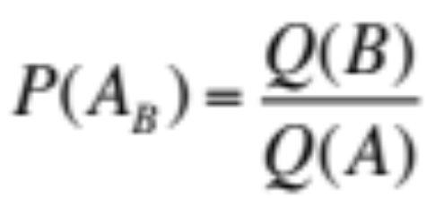
Price as a Ratio of
Two Quantities Exchanged
In order to explain this concept, it helps to go back to basics. Let’s answer the following question: what is the “price” of a good?
In simple terms, a “price” is a ratio of two quantities exchanged: a quantity of one good as exchanged for a certain quantity of another good. In mathematical terms, if we let the quantity of good A be Q(A) and the quantity of good B be Q(B), then the price of good A in terms of good B, denoted P(A_{B}), is described by:
As a general rule, we express prices in money terms. In the equation above, good B would normally be “money”.

Slide 52
Price as a Ratio of
Two Market Values
How is this ratio of two quantities exchanged determined? Is the ratio of exchange determined solely by supply and demand for good A? Or is the ratio of exchange determined solely by supply and demand for good B? The answer is neither. The price of good A in B terms is determined by the market value of both goods. In mathematical terms:
The market value of good A, which we can measure in absolute terms as V(A), is determined by supply and demand for good A. Similarly, the market value of good B, denoted in absolute terms as V(B), is determined by supply and demand for good B.

Slide 53
The Principle of Trade Equivalence
In an efficient market, the ratio of two quantities exchanged (the price of one good in terms of another) will always be the reciprocal of the absolute market value of the two goods (the market value of the goods as measured in absolute terms).
Let’s assume you want to trade good A for good B. What quantity of good B do you require in order to give up a certain quantity of good A? It depends on the relative market value of the two goods. Why? Because in a free and efficient market, economic agents will only exchange goods if the total market value of the two bundles of goods being exchanged are equal:

Slide 54
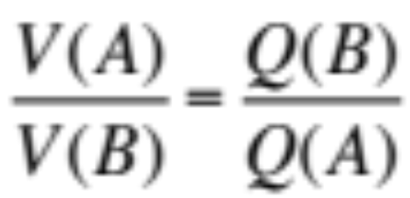
Ratio of Quantities is the Reciprocal of the Ratio of Market Values
In simple terms, if good A is twice as valuable as good B (value in this context is “market value”, ie. the value of the good as determined by market forces), then for every unit of A you give up, you would expect twice as many units of B in exchange.
We know that the price of good A in terms of good B is, by definition, equal to the second term in the equation above. Therefore:

Slide 55
“Units of Economic Value”: An Invariable Measure of Market Value
In order to measure the market value of a good in absolute terms, we need a universal and invariable measure of market value. Classical economists spent a lot of time looking for a good that possessed this quality (the labor theory of value), but there is no good that possesses the quality of invariable market value.
However, this doesn’t prevent us from creating a theoretical measure of market value that is an invariable measure of market value. For lack of a better term, we will call this invariable measure “units of economic value”. Just as an “inch” is an invariable measure of length, so a “unit of economic value” is an invariable measure of market value. The market value of any good can be measured in terms of “units of economic value”.

Slide 56
Absolute vs Relative Market Value
In our price equation, both the market value of good A, denoted V(A), and the market value of good B, denoted V(B), are measured in terms of “units of economic value”. We must measure the market value of each good in the same terms in order to be able to compare them.
In this sense, we can say that V(A) represents the absolute market value of good A (the market value of good A in terms of an invariable unit of measure, “units of economic value”). In contrast, P(A_{B}) represents the relative market value of good A (the market value of good A in terms of the market value of good B).

Slide 57
Expressing Supply and Demand in “Absolute” Market Value Terms
The market value of a good is determined by supply and demand for that good. Typically, supply and demand for a good is expressed in terms of relative market value (price is on the y-axis). In essence, it is assumed that the market value of the measurement good (good B) is constant, allowing us illustrate how changes in supply and demand for the primary good (good A) impact the relative market value of good A, or P(A_{B} ).
However, by expressing the market value of both goods (A and B) in “absolute” terms (in terms of a theoretical and invariable measure of market value, “units of economic value”), we can illustrate how changes in supply and demand for either good will impact not only the absolute market value of each of the respective goods but also the relative market value of the two goods.

Slide 58
Supply and Demand in Terms of
Units of Economic Value
Supply and demand for good A determines the equilibrium market value of good A, which is measured in terms of an invariable measure of market value (“units of economic value” or “EV”) and denoted as V(A). Similarly, supply and demand for good B determines the market value of good B, V(B).
Market Value
(EV)
Market Value
(EV)
“GOOD A”
“GOOD B”
S
S
V(A)
V(B)
D
D
Q(A)
Quantity
Q(B)
Quantity

Slide 59
Using the Model to Determine the Price of A in B Terms
We can use this simple framework to analyze the impact of changes in supply and demand for either good upon the price of A in B terms. As discussed, the price of A in B terms, or “P(A_{B} )”, is equal to the ratio of V(A) divided by V(B): if V(A) rises, the price rises, if V(B) rises, the price falls.
Market Value
(EV)
Market Value
(EV)
“GOOD A”
“GOOD B”
S
S
V(A)
V(B)
D
D
Q(A)
Quantity
Q(B)
Quantity

Slide 60
An Increase in Demand for Good A
Let’s analyze two scenarios. In the first scenario, there is an increase in demand for good A (the demand curve for good A shifts to the right). An increase in demand for A leads to higher market value for A. V(A) rises while V(B) is constant and the price of A in B terms rises {P(A_{B} ) = V(A)/V(B)}
Market Value
(EV)
Market Value
(EV)
“GOOD A”
“GOOD B”
S
S
V(A)₁
V(B)
V(A)₀
D₁
D
D₀
Q(A)₀
Q(A)₁
Quantity
Q(B)
Quantity

Slide 61
An Increase in Demand for Good A in both EV and Price Terms
Our first scenario is easily demonstrated by traditional supply and demand analysis. On the left hand side, market value is expressed in EV terms. On the right hand side, market value is expressed in price terms (the price of A in terms of good B): this is the “traditional” view.
Market Value
(EV)
Price
(in B terms)
“GOOD A”
“GOOD A”
S
S
V(A)₁
P(A_{B})₁
V(A)₀
P(A_{B})₀
D₁
D₁
D₀
D₀
Q(A)₀
Q(A)₁
Quantity
Q(A)₀
Q(A)₁
Quantity

Slide 62
Why Did Traditional Analysis Work for First Scenario?
In this first scenario, traditional supply and demand analysis provides the right answer. Why? Because traditional supply and demand analysis assumes that the market value of the measurement good (good B) is constant. In this scenario, it just so happens that the market value of good B is constant, therefore traditional supply and demand analysis gets the right result.
But what happens when the market value of good B is not constant? Traditional supply and demand analysis struggles to explain changes in price due to a change in the market value of the measurement good because its perspective is so “one-sided”. However, we can use our alternative version of supply and demand analysis to illustrate what happens.

Slide 63
An Increase in Demand for Good B
In our second scenario there is an increase in demand for good B (the demand curve for good B shifts to the right). The equilibrium market value of good B rises. The market value of good A is constant. Therefore, the price of A in B terms, or “P(A_{B} )”, falls: {P(A_{B} ) = V(A)/V(B)}
Market Value
(EV)
Market Value
(EV)
“GOOD A”
“GOOD B”
S
S
V(B)₁
V(A)
V(B)₀
D₁
D
D₀
Q(A)
Quantity
Q(B)₀
Q(B)₁
Quantity

Slide 64

Why Did the Price Fall?
Let’s think about what just happened. There was no change in the supply and demand for good A (as measured in “units of economic value” terms) and yet the price of good A fell. Why did the price fall? Because price is a relative expression of two market values. All else equal, the price of good A as measured in terms of good B will fall if the market value of good B rises:
So, how can we represent this scenario in traditional supply and demand format (with price on the y-axis)? If the market value of the measurement good (good B) rises, then what happens to the supply and demand curves for good A in B terms?

Slide 65
Impact on Good A of an Increase in Demand for Good B
In our second scenario there is an increase in demand for good B. The equilibrium market value of good A is constant. However, the price of A in B terms falls. Why? As the market value of good B rises, the supply and demand curves for good A (as expressed in B terms) both shift lower.
Market Value
(EV)
Price
(in B terms)
“GOOD A”
“GOOD A”
S
S₀
S₁
P(A_{B})₀
V(A)
P(A_{B})₁
D₀
D
D₁
Q(A)
Quantity
Q(A)
Quantity

Slide 66
Price Determination in a Barter Economy (No Money)
The principle that price is a ratio of two market values applies to every price in the economy. In essence, the prices that we see around us every day are the physical manifestation (the visible portion) of a matrix of directly unobservable market values.
We will use a number of examples to explore this concept. In our first example, we will consider price determination in a two good barter economy with no money. If the two goods in our economy are apples and bananas, then what determines the apple price as measured in banana terms (remember, there is no “money”)? Is it supply and demand for apples or supply and demand for bananas? The answer is both. The price of a good in terms of another good depends on the market value of both goods.

Slide 67
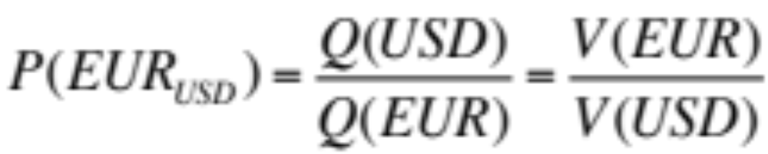
Foreign Exchange Rate Determination
We will also consider a more modern example: foreign exchange rate determination. Every foreign exchange rate represents the price of one currency in terms of another currency. Consider the USD/EUR rate? Is this “price” determined by supply and demand for US Dollars or supply and demand for Euros? Again, the answer is both.
Supply and demand for US Dollars determines the market value of the US Dollar V(USD). Similarly, supply and demand for Euros determines V(EUR). The USD/EUR exchange rate is then equal to:

Slide 68
The Money Price of Goods
Ultimately, the point of these examples is to explain the general principle that the price of one good in terms of another is determined by the ratio of their market values. We can then apply this principle to the determination of “money prices”.
The money price of a good (the price of a good in terms of money) is determined by the following ratio:
Supply and demand for the good determines the market value of the good V(A). Supply and demand for money determines the market value of money V($) (not the interest rate!).

Slide 69
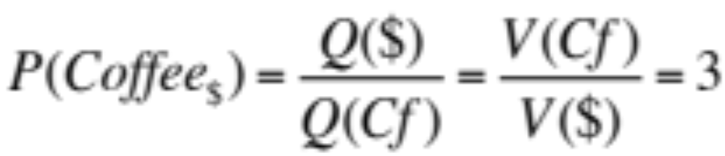
The Price of a Cup of Coffee
In very simple terms, when you exchange a quantity of dollar bills for a quantity of a good (say one cup of coffee), the idea is that you are exchanging two “baskets” of equivalent total market value.
If the market value of one cup of coffee, as measured in absolute terms, is three times that of the market value of one dollar bill, then trade will only occur if you offer three dollar bills for that cup of coffee. Therefore, the price of coffee, in dollar terms, is equal to:

Slide 70
Supply and Demand for Money
It is the view of The Enigma Series that supply and demand for money, where “money” is defined as the monetary base (see The Money Enigma), determines the market value of money. The market value of money is the denominator of every money price in the economy. Economics has struggled with this concept because the market value of money is not directly observable (you can’t observe market values in the absolute). The market value of money can only be observed in a relative context, as a “price” (a fact that is true of all market values).
Supply and demand for money does not determine “the interest rate”, although the manner in which newly created money is used (to buy government debt) does influence the interest rate.

Slide 71
Every Money Price is Determined by Two Sets of Supply and Demand
We can extend the general theory to the determination of “money prices”. Supply & demand for good A determines the market value of good A, V(A). Supply & demand for money determines the market value of money, V($). The money price of good A is equal to the ratio of the two market values.
Market Value
(EV)
“GOOD A”
Market Value
(EV)
“MONEY”
S
Supply
V(A)
V($)
Demand
D
Q(A)
Quantity
Q($)
Base Money

Slide 72
Towards a Model of Inflation
The second part of The Inflation Enigma (Part B) focuses on extending the microeconomic theory developed in the first part (Part A) and building macroeconomic tools that can be used to explain the nature of price level determination.
While the notion that price is a relative expression of two market values is a useful tool in a microeconomic context, it is fundamental in a macroeconomic context. It is the view of this paper that a comprehensive theory of inflation must build upon the principle that every money price in the economy is a function of two market values. More specifically, supply and demand for money determines the market value of money which, in turn, is the denominator of every money price in the economy.

Slide 73
The Ratio Theory of the Price Level
Part B of The Inflation Enigma begins by deriving the “Ratio Theory of the Price Level”. Ratio Theory states that the general price level p can be expressed as a ratio of two market values:
    Where p is the general price level of the economy
    V_{G} is the “general value level” of the economy
    V_{M} is the absolute market value of money
The general value level V_{G} is a hypothetical measure of overall market values (as measured in “units of economic value”) for the set of goods and services that comprise the “basket of goods”.

Slide 74
Ratio Theory as a Starting Point for Our Analysis of Inflation
In essence, Ratio Theory states that a rise in the price level can be due to either (i) a rise in the overall absolute market value of goods V_{G} or (ii) a fall in the absolute market value of money V_{M} . This theory has many implications and can be used to highlight the overly simplistic nature of the typical “inflation vs deflation” debate. For example, the common view that a decline in aggregate demand “must be deflationary” completely ignores the role of the market value of money.
It should be noted that Ratio Theory is not a theory of inflation per se, but rather a starting point for analysis. The Inflation Enigma begins the process of explaining the principle factors that drive each of the two key variables (V_{G} and V_{M} ).

Slide 75
Price Level Determination:
Long Run versus Short Run
In order to simplify the analysis of price level determination, The Inflation Enigma separates the analysis into two buckets: price level determination in the long run and price level determination in the short run.
Ultimately, the long run determination of prices is just an aggregated path of short run processes. It would be preferable not to distinguish between the long run and short run because the fundamental price level determination process is the same in both cases. However, in order to fully understand the short run process, we need to develop a more comprehensive model of the price level. This more comprehensive model is constructed in the last paper in the series, The Velocity Enigma.

Slide 76
Price Level Determination in the Long Run
When measured over very long periods of time, changes in the price level are strongly correlated to changes in the ratio of base money to real output. This is the long run application of the quantity theory of money, an economic phenomenon for which there is strong empirical support (King, 2001).
The reason quantity theory works in the long run, but not in the short run, is because money is a long-duration, special-form equity instrument. In the short run, the value of a long-duration equity instrument is highly sensitive to shifts in expectations. However, when measured from point to point over long periods of time, most of the change in the value of such an instrument is determined by the historic change in the output/base money ratio (the earnings/share ratio), not shifts in future expectations.

Slide 77
The Value of a Long-Duration Asset:
Long Term versus Short Term
We can highlight this point by think about the pricing of a long-duration, proportional claim: common stock. Imagine a stock with a P/E ratio of 20 and earnings of $1 per share. Over the next two years, earnings rise to $1.25 per share, but the P/E ratio falls to 16 (lower growth expectations). Over the next eighteen years, earnings rise to $10 per share while the P/E ratio remains at 16.
Over the first two years, the stock price performance seems to have nothing to do with EPS: EPS rises 25% ($1 to $1.25) but the share price doesn’t change (stays at $20). But measured over the entire twenty year period, the share price does track earnings per share, at least roughly: the stock price rises 8x (to $160) while EPS is up 10x. Over long periods of time, changes in EPS tend to overwhelm changes in expectations (which are reflected in the P/E multiple).

Slide 78
A Simplified Analysis of the
Market Value of Money
In the short-term, the value of money may seem to have nothing to do with the output/money ratio. However, when measured over long periods of time, the market value of money is driven primarily by the ratio of real output to base money. Proportional claim theory states that money represents a variable entitlement to the output of society. If we can ignore or minimize the impact of changing expectations (which we can if discussing changes over very long periods of time), then we should expect that the market value of a proportional claim to the output of society should rise as real output rises and falls as the monetary base increases.
These notions can be further illustrated by merging Ratio Theory with the quantity theory of money to create the Simple Model for the Market Value of Money (see next slide).

Slide 79
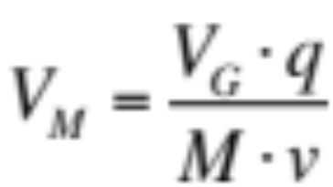
The Simple Model for the
Market Value of Money
Ratio Theory and the Equation of Exchange are used to derive the “Simple Model for the Market Value of Money”:
The Simple Model states that the absolute market value of money V_{M} can be expressed as a function of four variables:
  The general value level V_{G} , a hypothetical measure of overall absolute market values for the “basket of goods”;
  Real output q;
  The monetary base M; and
  The velocity of base money v.

Slide 80
Basic Implications of
The Simple Model
The Simple Model provides further, albeit very limited, insight into the market value of money. All else equal, the absolute market value of money is positively related to both the general value level and real output. As expected, the market value of money is negatively related to the number of claims issued, the monetary base: as the number of outstanding claims increases, the proportional entitlement of each claim falls.
In the long run, if the velocity of money is relatively stable, then the market value of money is primarily determined by the ratio of real output to the money base. Since the value of money is the denominator in the price level, the price level is primarily determined by the ratio of money base to real output.

Slide 81
Price Level Determination in the Short Run
One of the primary implications of the Simple Model is that, in the long run, the general value level V_{G} is irrelevant to the determination of the price level. Why? Because any rise or fall in the value of goods V_{G} is reflected in the value of money V_{M} . (With velocity stable, a rise in V_{G} leads to a rise in V_{M} and there is no change in the price level which is a ratio of the two). Long-term, only real output and base money matter.
However, in the short run, changes in the general value level are not automatically reflected in the market value of money. Money is a long-duration asset and it will often “look through” what are perceived to be temporary adjustments in the general value level. Therefore, we need a model to analyze both variables.

Slide 82
A Two-Market Model for
Price Level Analysis
In order to help us analyze short-term movements in the price level, we will introduce a basic two-market model called the “Goods-Money Framework”.
The Goods-Money Framework proposes that (1) the equilibrium general value level V_{G} is determined by aggregate demand and aggregate supply in the market for goods/services and (2) the equilibrium absolute market value of money V_{M} is determined by supply and demand for the monetary base. The key implication of the Goods-Money Framework is that the price level is determined, in a stylized sense, by two sets of supply and demand, it is not determined solely by aggregate supply and demand as represented in traditional Keynesian analysis.

Slide 83
The Goods-Money Framework
Aggregate supply and demand for goods/services determines the equilibrium general value level V_{G} and real output q. Supply and demand for money determines the market value of money V_{M} .
“LEFT SIDE: GOODS”
“RIGHT SIDE: MONEY”
General Value Level (EV)
Value of Money (EV)
AS
Supply
V_{G}
V_{M}
Demand
AD
q
Real Output
M
Base Money

Slide 84
The Left Side of the Framework
LEFT SIDE OF
THE FRAMEWORK
The Left Side of the Framework is a short run model of aggregate demand and aggregate supply, where both functions are expressed in terms of the general value level and real output.
The intersection of aggregate demand and aggregate supply determines equilibrium levels of real output and the general value level.
“GOODS/SERVICES”
General
Value
Level
(EV)
Aggregate
Supply
V_{G}
Aggregate
Demand
q
Real Output

Slide 85
The Right Side of the Framework
The Right Side of the Framework is the market for money. The supply of money (the monetary base) is fixed. Demand for money is plotted in terms of the absolute market value of money.
The intersection of supply and demand for money determines, in the first instance, the equilibrium absolute market value of money.
THE RIGHT SIDE OF
THE FRAMEWORK
“MONEY”
Value of
Money (EV)
Supply
V_{M}
Demand
fn{V_{G} ,q, v}
M
Base Money

Slide 86

Example One: Increase in
Aggregate Demand
LEFT SIDE OF
THE FRAMEWORK
Let’s briefly consider two basic examples. In this example, the aggregate demand curve shifts to the right. Equilibrium levels of real output q and the general value level V_{G} both rise.
All else equal, the rise in V_{G} will lead to a rise in the price level:
“GOODS/SERVICES”
General
Value
Level
(EV)
Aggregate
Supply
V_{G,2}
V_{G,1}
AD₂
AD₁
q₁
q₂
Real Output

Slide 87
Example Two: Increase in Demand For Money
In this second example, there is an increase in the demand for money. The demand curve for money moves to the right. The equilibrium absolute market value of money V_{M} rises.
All else equal, the rise in V_{M} will lead to a fall in the price level:
THE RIGHT SIDE OF
THE FRAMEWORK
“MONEY”
Value of
Money (EV)
Supply
V_{M,2}
V_{M,1}
D₂
D₁
M
Base Money

Slide 88
Interpreting the Goods-Money Framework
Superficially, the implications of the Goods-Money Framework may seem obvious. A basic reading would suggest that excess aggregate demand always leads to a rise in the value of goods V_{G} and the price level, or that an increase in base money always leads to a fall in the value of money V_{M} and a rise in the price level. Unfortunately, it is just not that simple.
The main problem with this simple analysis is twofold. Firstly, a change in the left side of the framework may (or may not) impact the value of money V_{M} . If V_{G} and q both rise, then this may or may not lead to an increase in the value of money depending upon whether the shift in the value of goods and real output is perceived to be temporary or permanent.

Slide 89
Reaction to a Perceived “Temporary” Increase in Aggregate Demand
Aggregate demand rises, but the rise is perceived to be temporary. Output and general value level rise. Money is a long-duration asset: there is no change in long-term expectations and hence negligible change in V_{M} . The end result is the price level rises (p = V_{G} /V_{M} ).
General Value Level
Value of Money
AS
Supply
V_{G,1}
V_{G,0}
V_{M}
“No Change”
AD₁
D₀ = D₁
AD₀
q₀
q₁
Real Output
M
Base Money

Slide 90
What Happens to the Value of the Financial Instrument?
In the scenario on the previous page, an increase in aggregate demand that is perceived to be temporary has no impact on the value of money. Why? Because money is a long-duration financial instrument. The value of a long-duration equity instrument is determined primarily by expectations regarding the distant future. If those expectations are largely constant, then the value of money doesn’t change.
The net result in this scenario is that the price level rises and the velocity of money rises. However, if the increase in both the general value level and real output was perceived to be more permanent in nature, then this should lead to a rise in the value of money, which could offset the rise in the value of goods.

Slide 91
Reaction to a Perceived “Permanent” Increase in Aggregate Demand
Aggregate demand rises and the rise is perceived to be more “permanent” in nature. The value of money rises as it discounts the higher future levels of output (V_{G} q) that will be claimed by each unit of money. The end result is little change in the price level: the rise in V_{G} is offset by the rise in V_{M}.
General Value Level
Value of Money
AS
Supply
V_{G,1}
V_{M,1}
V_{G,0}
V_{M,0}
AD₁
D₁
AD₀
D₀
q₀
q₁
Real Output
M
Base Money

Slide 92
The Market for Money: Supply and Demand a “Second Best” Tool
The second major problem with a superficial interpretation of the Goods-Money Framework is that it suggests that the value of money will fall if the money supply curve shifts to the right (the monetary base increases). Again, it isn’t that simple. Supply and demand analysis is a “second best” solution for analyzing the market for money. The better model for analyzing the market value of money is the discounted future benefits model developed in The Velocity Enigma.
Money is a long-duration financial instrument. An increase in the monetary base may have little or no impact on the value of money if that increase is perceived to be temporary. What matters are long-term expectations of the output/money ratio.

Slide 93
The Right Side of the Framework
An entire section of The Inflation Enigma is devoted to discussing the Right Side of the Goods-Money Framework (the market for money). In particular, we begin to discuss the practical implications of the notion that money is a long-duration financial instrument. Namely, that in the short-term, the market value of money is highly sensitive to changing expectations regarding the long-term path of important economic variables (most notably, real output and money).
The Inflation Enigma can only scratch the surface of these issues. In order to fully understand the determination of the market value of money, we need the Discounted Future Benefits Model that is developed in the final paper, The Velocity Enigma.

Slide 94
“Sticky Wages” Explained by Rational Expectations
The last section of The Inflation Enigma discusses the Left Side of the Goods-Money Framework. In particular, it focuses on the derivation of the aggregate demand and aggregate supply functions as expressed in terms of the general value level and contrasts this model with the traditional AD/AS model.
It is argued that the slope of both functions is largely due to expectations of cyclicality and mean reversion in the general value level (a property that is not present in the price level). It will be argued that these expectations of mean reversion in the general value level can also be used to explain why wages are (or at least appear to be) “sticky” in an efficient market with no nominal rigidities.

Slide 95
The Velocity Enigma
An Overview of Part III of The Enigma Series

Slide 96
The Velocity Enigma
An Introduction
The Velocity Enigma combines the issues discussed in The Money Enigma (the nature of money) with the issues discussed in The Inflation Enigma (the basic nature of price determination) to develop a more comprehensive model of the price level.
If money is a financial instrument (a proportional claim on the output of society) and if we can measure the market value of money in terms of an invariable measure of market value (units of economic value, or “EV”), then it should also be possible to build a “valuation model” for money just as we can build a discounted future cash flow model for a share of common stock. We can then use this valuation model to develop expectations-based solutions for both the price level and the velocity of money.

Slide 97
Two Sides of the Same Coin
As discussed in The Money Enigma, money is a financial instrument: it derives its value “contractually”. In order to understand the “asset nature” of a financial liability, we need to understand the exact nature of the liability it represents (they are “two side of the same coin”). In the case of most financial instrument this is a relatively straightforward process: we can read the express written contract that governs the financial instrument (technically, the contact is the financial instrument).
In the case of money, the task is made more difficult by the fact that there is no express contract (or certainly not a meaningful express contract). Rather, non-asset backed fiat money is issued pursuant to an implied contract, the “Moneyholders’ Agreement”.

Slide 98
The Moneyholders’ Agreement
Money derives its value as an asset from its status as a financial instrument (it has value because it is someone’s liability). In order to understand the asset nature of money, we must unravel the contractual terms of the implied “Moneyholders’ Agreement”.
MONEYHOLDERS’ AGREEMENT
FINANCIAL INSTRUMENT
SOCIETY
{GOVERNMENT
AS TRUST &
TRUSTEE}
MONEYHOLDER
ASSET
MONEY
LIABILITY

Slide 99
Need to Understand the Exact Terms of Moneyholders’ Agreement
We begin the process of unraveling the Moneyholders’ Agreement in The Money Enigma. In that paper it is argued that:
  Money is a direct claim on the output of society;
  Money is a proportional claim on the output of society (money represents a variable, not a fixed, entitlement to output);
  Money represents a claim to a slice, not a stream, of future benefits; and, perhaps somewhat counter intuitively,
  Money is a long-duration asset (much of its value depends on claims to be made in the distant future).
While these observations are helpful in general terms, they are not sufficient for us to build a valuation model for money. Rather, we need to try and ascertain the exact terms of the proportional claim.

Slide 100
The Evolution of Money: Shift from Express to Implied Contract
The first step in this process is understanding how the absolute market value of fiat money is set when it is introduced for the first time. The initial value of fiat money (the absolute market value of one dollar) is completely arbitrary: it is a value set by political process.
Traditionally, when a new fiat currency is introduced, its value is set relative to an established measure of market value (most commonly, gold). The initial rate of exchange (dollars for gold) is completely arbitrary: it is whatever society chooses it to be. Historically, fiat money was asset backed (gold backed): money represented an express written contract that entitled the holder to gold. But what happened when this express contract was voided?

Slide 101
Implied Contract Replaces
Express Written Contract
When the express contract is rendered null and void (money is no longer convertible into gold), a new implied contract (the “Moneyholders’ Agreement”) must take its place. This new contract comes into effect on “announcement date”, or t=k.
For the many years prior to announcement date, the absolute market value of money V_{M} has been moving in lockstep with the absolute market value of gold. The absolute market value of money at announcement date V_{M,k} (the day gold convertibility removal is announced) and the monetary base at announcement date M_{k} are critical because they determine and fix the scope of the collective entitlement of money, denoted as E_{k} , under the new implied Moneyholders’ Agreement.

Slide 102
Fixing the Scope of the Collective Entitlement
In order for a financial instrument to be defined and hence, have value, the nature and scope of the collective economic entitlement of the claim must be fixed. In the case of a “variable entitlement” or “proportional claim”, the scope of the collective entitlement of the set of proportional claims must be fixed.
In the case of common stock, the collective entitlement of the outstanding shares of a company is, typically, 100% of residual cash flows: the scope of the collective entitlement is 100% of residual cash flows, not 120% (which is impossible), or 80%. In the case of money, the scope of the collective entitlement, the theoretical entitlement of the entire monetary base to real output, is set at announcement date and fixed at this level.

Slide 103
Scope of the Collective Entitlement is Fixed at Announcement Date
Money is a claim on the output of society: that is the nature of the claim. However, in order for the claim to be defined and have a “predictable” value, the scope of the collective entitlement needs to be determined. This is true of any proportional claim: shares are a claim on 100% of residual cash flows. We can’t calculate the value of shares if the scope (“100%”) is indeterminate.
When money loses its asset backing (at announcement date), the monetary base represents a claim against some percentage of real output. The collective entitlement of the monetary base at that time may be 150% of real output or 20% of real output. This percentage sets the theoretical scope of the monetary base as a claim against real output and is fixed for all future periods.

Slide 104
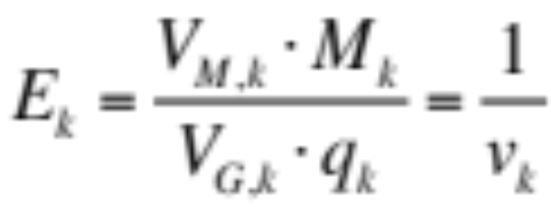
Calculating the Theoretical Scope of the Entitlement
We can calculate the theoretical scope of the monetary base E_{k} as follows. At announcement date, base money is M_{k} , the absolute market value of money is V_{M,k} , the general value level is V_{G,k} and real output for the “defined period” is q_{k}. The scope of the collective entitlement E_{k} is fixed as the percentage of real output that the entire monetary base claimed at the announcement date:
The scope of the collective entitlement for the entire contract period, (the period the implied Moneyholders Agreement is valid), is simply the reciprocal of the velocity of money at announcement date (v_{k}).

Slide 105
The Baseline Proportion &
The Realized Proportion
Once the scope of the collective entitlement is fixed, economic agents can begin to make a critical calculation: the baseline proportion of real output that a unit of money can claim in a given future period. The baseline proportion (“β”) represents the “in principle” or “approximate” proportion of output that a unit of money should claim in a given future period.
The baseline proportion is not the actual or realized proportion of output (“α”) that money will claim in that future period for reasons we shall discuss shortly. However, the expected baseline proportion for a given future period does provide the best unbiased estimate of the expected realized proportion of output that one unit of money might claim in that given future period.

Slide 106
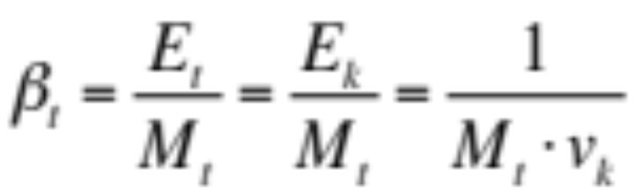
Calculating the Baseline Proportion
Let’s denote the scope of the collective entitlement (the entitlement to real output of the entire monetary base) at time t as E_{t} . As discussed, this scope was fixed at announcement date, therefore E_{t} = E_{k} . If the monetary base at time t is M_{t} , then we can calculate the theoretical or baseline proportion of output that each unit of money can claim at time t as:
The thesis of The Enigma Series is that money is a proportional claim on the output of society. The equation above provides us with our first description of the theoretical or “in principle” proportional claim of one unit of money in a given future period.

Slide 107
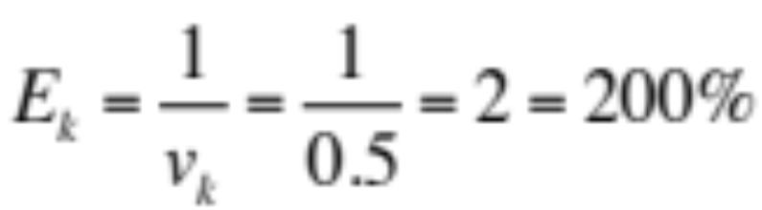
Simple Example:
Scope of Collective Entitlement
Let’s put some numbers around this to explain how the baseline proportion works in practice. Let’s assume that at announcement date there are 1,000 units of base money outstanding, M_{k} = 1,000. Let’s also assume that the velocity of base money at announcement date is v_{k} = 0.5. This implies that, at announcement date, one turn of the monetary base can claim 200% of real output. This is the “scope of the collective entitlement” of base money.
The baseline proportion at announcement date is simply the collective entitlement divided by the money base (see next slide).

Slide 108
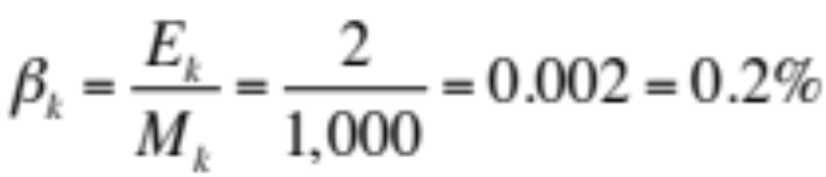
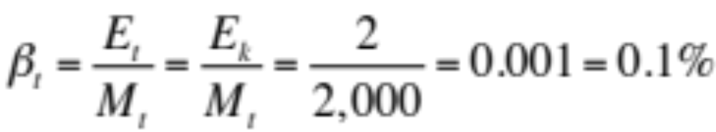
Simple Example:
Baseline Proportion
The baseline proportion at announcement date β_{k} is equal to the the collective entitlement of the monetary base divided by the outstanding monetary base at t=k:
In other words, at announcement date, the theoretical entitlement of each unit of output is 0.2% of real output. Now, let’s roll this forward. Suppose the monetary base has doubled and at current time t, M_{t} = 2,000. The current baseline proportion is equal to:

Slide 109
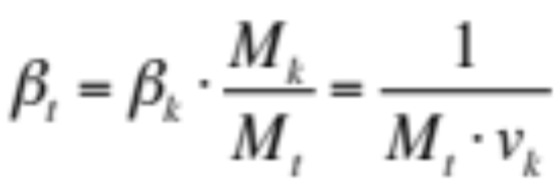
Quantity Theory of Money:
“Baseline”=“Realized” Proportion
In our example, as the monetary base doubles from its level at announcement date, the theoretical proportion of output that each unit of money can claim falls by 50%. In general terms:
The quantity theory of money effectively interprets this “baseline proportion” to be the “realized proportion” of output that money can claim at time t. In other words, the quantity theory of money predicts that the baseline proportion represents not some theoretical or “in principle” proportion of output that money should claim in a given period, but rather the actual proportion of output that it will claim in that period.

Slide 110
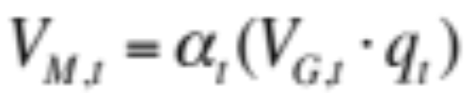
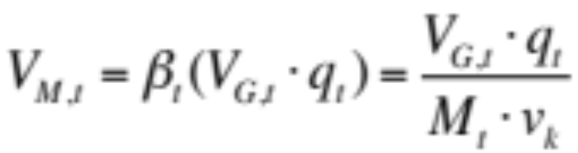
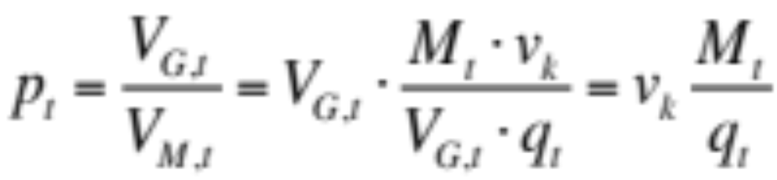
Illustrating the Math Behind
The Quantity Theory of Money
Let’s assume the “realized” or “actual” proportion of real output that a unit of money can claim at time t is denoted as α_{t} . The absolute market value of one unit of money at time t can be calculated as:
In effect, quantity theory assumes that the realized proportion is equal to the baseline proportion (α_{t} = β_{t} ). Therefore:
And:
Note: v_{k} is a constant

Slide 111
Quantity Theory of Money vs Proportional Claim Theory
In essence, the quantity theory of money is a simplistic version of “proportional claim theory”. The quantity theory of money effectively assumes that the baseline proportion in any given period determines the realized proportion of output that a unit of money can claim in that period.
While quantity theory works well over long periods of time, it is a very poor model in the short run. Why? Because the realized proportion and the current baseline proportion will often diverge significantly. Quantity theory can not accurately capture this phenomenon because it fails to recognize the importance of expectations and the role of intertemporal equilibrium in the determination of the absolute market value of money.

Slide 112
Proportional Claim Theory:
Expectations are Critical
The quantity theory of money allows no role for expectations. In contrast, the view of proportional claim theory is that the equilibrium absolute market value of money in the current period depends critically upon expectations of the proportion of output that each unit of money will claim in future periods: it depends upon the future set of “expected realized proportions”.
Furthermore, the “expected baseline proportion” in a given future period provides the best unbiased estimate of the “expected realized proportion” in that future period. Hence, expectations regarding the future path of the baseline proportion are critical in the determination of the absolute market value of money and the realized proportion in the current period.

Slide 113
Expected Baseline Proportion as
Best Unbiased Estimate
The expected baseline proportion in a given future period represents the “in-principle” proportional entitlement to output of one unit of money in that future period. While there is no specific contractual obligation upon society to deliver the baseline proportion of output in any given period, there is an implied contractual agreement between members of society that they will recognize the expected baseline proportion in any given future period as the “in principle” or “approximate” proportional entitlement for each unit of money in that future period.
For this reason, the expected baseline proportion represents the best unbiased estimate of the expected realized proportion for a given future period, particularly for a distant future period.

Slide 114
Expected Baseline Proportion & The Chain of Expected Future Values
The baseline proportion plays a critical role in the determination of the absolute market value of money. In effect, it acts as the critical link between the past, present and future of fiat money.
More specifically, the set of expected baseline proportions (for the n future periods in the “spending horizon”) is determined, in part, by the original value of money (the original baseline proportion) at announcement date. This set of expected baseline proportions provides the best estimate for the set of expected realized proportions. This set of estimates for the realized proportion provides the basis for the chain of expected future values of money which, in turn, determines the equilibrium absolute market value of money in the present period.

Slide 115
The Present Value of Money and the Chain of Expected Future Values
The equilibrium absolute market value of money depends upon a chain of expected future values. When expectations change regarding the future market value of money, it has a cascading effect all the way down along the chain of expected future values until it reaches the present market value of money.
The simple reason for this phenomenon is that any change in the expected future absolute market value of money creates a incentive to act now. In other words, an intertemporal equilibrium (a state of indifference) that previously existed is disturbed. In order to restore intertemporal equilibrium, the current absolute market value of money must adjust to reflect these new expectations. This is best illustrated by example.

Slide 116
Using Examples to Explain
Intertemporal Equilibrium
The second section in The Velocity Enigma, “A Basic Theory of the Velocity of Money”, provides some highly simplified examples of how a change in expectations regarding future levels of the baseline proportion and/or real output may impact the current equilibrium absolute market value of money.
In particular, the section highlights how changes in those variables disrupt a state of intertemporal equilibrium and explain how the market value of money must adjust to restore intertemporal equilibrium. These simplified examples help to explain concepts used in the following sections of the paper. Moreover, they provide some basic insight into the nature of the enigmatic velocity of money.

Slide 117
Impact of Expected Permanent Increase in the Monetary Base
Let’s quickly explore one simple example. Let’s assume that the monetary base has been stable for a long period of time and the market expects it to remain stable. Suddenly, there is a change in policy: in one year from today, the monetary base will double and stay at that level permanently. What is the likely impact on the current absolute market value of money?
The expected baseline proportion in all future periods, beginning one year from now, will fall by 50%. As a result, the expected realized proportion in that set of future periods falls 50%. Therefore, all else equal, the absolute market value of output that each unit of money is expected to obtain in those future periods falls by 50%. What is the impact on the current value of money?

Slide 118
Equilibrium Absolute Market Value of Money Falls
This shift in expectations (an expected permanent increase in the monetary base) disrupts an intertemporal equilibrium. If people expect the value of money (the purchasing power of money) to be significantly lower in future periods, then there is an incentive to spend money now and vendors of goods will be less willing to accept money as payment.
In essence, a deadlock is created where everybody wants to spend money but nobody wants to receive it. How is this deadlock broken? The current absolute market value money must fall to the point that balance is restored (people are indifferent between spending the marginal unit of money now or in any future period).

Slide 119
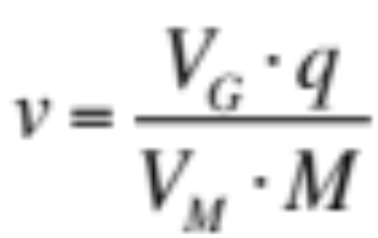
Price Level Rises
Velocity of Money Rises
Despite the fact that there has been no change in the current level of the monetary base, the market value of money falls due an expected permanent increase in the monetary base. If the market value of money falls roughly 50%, then, all else equal, the price level will double. Moreover, the velocity of money must double.
The velocity of money must solve for the change in the absolute market value of the monetary base (V_{M} M) vs the absolute market value of goods (V_{G} q). Note: when the monetary base doubles (in one year), the velocity of money will fall back to its original level.

Slide 120
Temporary vs Permanent Change in the Monetary Base
What would happen in the previous example if the increase in the monetary base was expected to be temporary, not permanent? The simple answer is that there would be very little change in the absolute market value of money. Why? Because the present value of money discounts a long chain of expected future values, only a few of which are impacted by a “temporary” shift in the monetary base.
Now imagine what happens if a “temporary” increase in the monetary base suddenly becomes a “permanent” increase in the monetary base. Suddenly, the absolute market value of money falls and the price level rises. It seems as though there was a “lag” between the increase in the monetary base and inflation.

Slide 121
The “Lag” Between Base Money Expansion and Inflation
The often observed and much discussed lag between base money expansion and inflation is traditionally explained by some form of “inefficient markets” arguments. Traditional monetarists argue that there is a lag between base money expansion and inflation because people don’t understand its ultimate impact on the price level and, short-term, are fooled by “money illusion”.
The view of this paper is that “monetary lag” can be explained by efficient markets and rational expectations. If an increase in the monetary base is perceived to be temporary, then there will be little impact on the value of money and the price level. However, over time, if people realize that the increase is permanent, then the value of money will decline and the price level will rise.

Slide 122
A Valuation Model for Money
While the high level and rather simplified examples regarding the determination of the equilibrium absolute market value of money may be interesting, the ideal outcome from a theoretical perspective is to develop a comprehensive mathematical model for the equilibrium absolute market value of money.
The Velocity Enigma develops a “valuation model” for money by leveraging some of the notions already discussed (specifically, the role of the baseline proportion and the importance of intertemporal equilibrium in determining the equilibrium absolute market value of money) and applying these concepts to a “discounted future benefits” model that one might use to value any financial instrument.

Slide 123
Building the Discounted Future Benefits Model for Money
The Discounted Future Benefits Model for Money attempts to calculate the equilibrium absolute market value for money by discounting the future benefits that someone in the possession of money might reasonably expect to receive from its future use.
Building a discounted future benefits model for money requires a number of special adaptions to the familiar “discounted future cash flow model” used to value most financial instruments. Firstly, the model for money must be expressed in terms of “units of economic value”, not “dollars”. Secondly, money is a claim on real output, not cash flows: the present absolute market value of money depends on the discounted future absolute market value of the real output that it is expected to claim.

Slide 124
Building the Model Requires Creating a Probability Distribution
The third challenge in adapting the standard discounted future benefits model is that money represents a claim to a slice, not a stream, of future output. We can spend money now, in the near future, or invest it and spend it in the distant future. If the value of money could be any one of a number of discounted future values, then how do we determine the current equilibrium value for money?
Mathematically, the question becomes one of probability: what is the probability that the marginal unit of money is spent in any one of the n future periods in the spending horizon? The key to the answer lies in the basic question we are trying to solve: how do we calculate the equilibrium absolute market value for money?

Slide 125
Intertemporal Equilibrium and
The Probability Distribution
“Equilibrium” is a state of indifference where all forces come to rest. It will be argued that if the economy is in a state of intertemporal equilibrium, then the current possessor of money is indifferent between spending the marginal unit of money now or in any of the n future periods in the spending horizon. They are also indifferent between spending the marginal unit of money in one future period or another future period. If someone is indifferent between all n future periods, then the probability that they spend the marginal unit of money in any one of those periods is equal to “1/n”.
This simple probability distribution allows us to weight (1/n) each of the expected discounted future values of money.

Slide 126
Role of Expected Nominal Investment Returns
Another challenge in building the valuation model relates to the role of expected nominal investment returns. All else equal, as the nominal interest rate rises, the expected future benefits received from money rise and hence the present absolute market value of money rises. All else equal, a rise in interest rates increases the demand for money. Liquidity preference theory fails to understand this relationship because it does not appreciate the simple fact that we demand money to use it, not to hold it.
Whereas most assets must be “held” in order to receive the benefits that accrue to them, money does not have to be “held” in order to receive its future benefits. Rather, money can be invested before it is spent. These investment returns must be included in the expected discounted future benefits model.

Slide 127
The Discounted Future Benefits Model for Money
The end result of the analysis in The Velocity Enigma is to produce the following “constant growth” version of the valuation model for the absolute market value of money:
The equilibrium absolute market value of money depends on a large number of factors. Firstly, it depends on the value of money at announcement date: this is carried through the model by v_{k} (the velocity of money at announcement date). Secondly, and not surprisingly, it depends on current levels of real output q_{t} , base money M_{t} and the general value level V_{G,t} .

Slide 128
The Value of Money and the Role of Expectations
In addition to these current period and historical factors, the Discounted Future Benefits Model indicates that the equilibrium absolute market value of money also depends upon expectations.
In particular, the absolute market value of money will rise if expected long-term output growth (g) rises, if expected long-term base money growth (m) falls, if long-term expected (risk adjusted) nominal investment returns on the diversified portfolio of assets (i) rises, or if the real discount rate applied by consumers to their future consumption (d) falls.

Slide 129
The End Goal:
A Model for the Price Level
We can then apply Ratio Theory to the Discounted Future Benefits Model to create an expectations-based solution for the price level:
The price level can be considered to be composed of a “baseline component” and an “expectations component”. The baseline component should look familiar. The baseline component implies that the price level depends on current levels of money supply M_{t} and real output q_{t} , as long-term empirical evidence suggests.
Baseline Component
Expectations Component

Slide 130
An “Expectations Adapted” Quantity Theory of Money?
Readers will not be familiar with the second component in the price level model, the “expectations component”:
This expectations-based solution for the price level can explain why quantity theory works in the long run, but not in the short run. In the long run, the baseline component (the ratio of base money to real output) is the key to price level determination. However, in the short-term, shifts in expectations can easily overwhelm the impact of any change in the money/output ratio.
Baseline Component
Expectations Component

Slide 131
The Important Role of
Very Long-Term Expectations
One of the key conclusions that can not be emphasized enough is that long-term expectations matter to the determination of the absolute market value of money and the price level. The expected rate of base money growth over the next few years is, in and of itself, largely irrelevant to the price level. What matters is perceptions of the expected 30-40 year annualized growth rate in base money and real output.
It has hard to put an exact number on the spending horizon variable (“n”) in our models. Theoretically, it is the average of what adults in our society believe is their remaining life expectancy (life expectancy measured from today). The best guess on this figure is 30-40 years (we are all “optimistic”).

Slide 132
A Solution for
The Velocity of Money
We can also use the discounted future benefits model to create a solution for the velocity of money:
The velocity of money is anchored by the initial velocity of money v_{k} (the velocity of money at the time the implied Moneyholders’ Agreement came into effect). Although we need to be careful not to interpret this “constant growth” model too literally, we can say that changing expectations regarding the long-term growth rates of real output and base money are a major factor in determining the velocity of money.

Slide 133
Foreign Exchange Rate Model
There is one final and rather obvious application for the Discounted Future Benefits Model. We can use it to create a model for foreign exchange rate determination. As discussed in The Inflation Enigma, a foreign exchange rate, in this case the USD/EUR exchange rate, can be calculated as:
We can use the DFB Model to create solutions for each of the V(EUR) and V(USD) terms and substitute them into the equation above. The foreign exchange rate model and a related model for the gold price will be the subject of another paper.

Slide 134
What Causes Inflation?
The final section of The Velocity Enigma begins to reconcile the models developed in The Enigma Series with the views of Keynesianism, Monetarism and Fiscal Theory of the Price Level.
All of these schools of thought have made important observations regarding the nature of inflation which are supported, at least to some degree, by the models developed in these papers. We will use the DFB model and the Goods-Money Framework to show that it is (arguably) the case that “too much demand” can lead to a rise in the price level. “Too much money” is another cause of inflation, but expectations of base money growth play a more critical role than commonly believed. Finally, “too much debt” (excessive government debt) can lead to a rise in the expected future path of the money/output ratio, also contributing to inflation.

Slide 135
Monetary & Fiscal Policy
Transmission Mechanisms
The Velocity Enigma concludes by challenging some of the traditional notions regarding monetary and fiscal policy transmission mechanisms. In particular, it will be argued that lower interest rates shift both the aggregate demand and aggregate supply curves to the right (largely negating the relevance of the output gap). This can create a dangerous confidence game: the significant increase in output fuels confidence regarding long-term growth prospects and the view that the increase in the monetary base is largely “temporary”, thereby somewhat “artificially” supporting the value of money and containing inflationary pressures.
It will also be argued that “excessive” levels of government debt play a critical role in shaping expectations regarding the future path of the money/output ratio and hence the value of money.

Slide 136
End of Executive Summary
First paper in the series: The Money Enigma

