Slide 1
The Velocity Enigma
The Discounted Future Benefits Model for Money and
A Solution for the Velocity of Money and the Price Level
Part III of The Enigma Series
Gervaise R.J. Heddle
December 2014

Slide 2
Abstract
The Velocity Enigma is the final paper in The Enigma Series. The first paper in the series, The Money Enigma, argued that money is a long-duration, special-form equity instrument of society. The second paper in the series, The Inflation Enigma, posited that every price is a ratio of two market values. The Velocity Enigma brings this work together to develop a “valuation model” for money.
The Velocity Enigma explores the nature of the velocity of money and the determination of the price level by developing the “Discounted Future Benefits Model for Money”. This model can be used to create expectations-based solutions for both the price level and the velocity of money and can be used with the Goods-Money Framework to analyze macroeconomic problems. This paper concludes by discussing monetary and fiscal policy transmission mechanisms.

Slide 3
Index
Section Slide
Introduction & Overview 4
The Moneyholders’ Agreement 45
The Velocity of Money: A Basic Theory 97
Valuation Model for Money: Assumptions 130
The Discounted Future Benefits Model 156
Monetary & Fiscal Policy 181

Slide 4
Introduction & Overview
A Brief Overview of The Velocity Enigma

Slide 5
The Velocity Enigma
An Introduction
If money is a financial instrument (a proportional claim on the output of society) and if we can measure the market value of money in terms of an invariable measure of market value (units of economic value, or “EV”), then it should also be possible to build a “valuation model” for money. Just as we can build a discounted future cash flow model for a share of common stock, so we should be able to build a discounted future benefits model for money (where future benefits are measured in EV terms).
Developing an expectations-based model for the absolute market value of money and applying this to the Ratio Theory of the Price Level will allow us to develop expectations-based solutions for both the price level and the enigmatic velocity of money.

Slide 6
Two Sides of the Same Coin
As discussed in The Money Enigma, money is a financial instrument: it derives its value “contractually”. In order to understand the “asset nature” of a financial liability, we need to understand the exact nature of the liability it represents (they are “two side of the same coin”). In the case of most financial instrument this is a relatively straightforward process: we can read the express written contract that governs the financial instrument (technically, the contact is the financial instrument).
In the case of money, the task is made more difficult by the fact that there is no express contract (or certainly not a meaningful express contract). Rather, non-asset backed fiat money is issued pursuant to an implied contract, the Moneyholders’ Agreement.

Slide 7
The Moneyholders’ Agreement
Money derives its value as an asset from its status as a financial instrument (it has value because it is someone’s liability). In order to understand the asset nature of money, we must unravel the contractual terms of the implied “Moneyholders’ Agreement”.
MONEYHOLDERS’ AGREEMENT
FINANCIAL INSTRUMENT
SOCIETY
{GOVERNMENT
AS TRUST &
TRUSTEE}
MONEYHOLDER
ASSET
MONEY
LIABILITY

Slide 8
Need to Understand the Exact Terms of Moneyholders’ Agreement
We began the process of unraveling the Moneyholders’ Agreement in The Money Enigma. In that paper it was argued that:
  Money is a direct claim on the output of society;
  Money is a proportional claim on the output of society (money represents a variable, not a fixed, entitlement to output);
  Money represents a claim to a slice, not a stream, of future benefits; and, perhaps somewhat counter intuitively,
  Money is a long-duration asset (much of its value depends on claims to be made in the distant future).
While these observations are helpful in general terms, they are not sufficient for us to build a valuation model for money. Rather, we need to try and ascertain the exact terms of the proportional claim.

Slide 9
The Evolution of Money: Shift from Express to Implied Contract
The first step in this process is understanding how the absolute market value of fiat money is set when it is introduced for the first time. The initial value of fiat money (the economic value of one dollar) is completely arbitrary: it is a value set by political process.
Traditionally, when a new fiat currency is introduced, its value is set relative to an established measure of market value (most commonly, gold). The initial rate of exchange (dollars for gold) is completely arbitrary: it is whatever society chooses it to be. Historically, fiat money was asset backed (gold backed): money represented an express written contract that entitled the holder to gold. But what happened when this express contract was voided?

Slide 10
Implied Contract Replaces
Express Written Contract
When the express contract is rendered null and void (money is no longer convertible into gold), a new implied contract (the “Moneyholders’ Agreement”) must take its place. This new contract comes into effect on “announcement date”, or t=k.
For the many years prior to announcement date, the absolute market value of money V_{M} has been moving in lockstep with the absolute market value of gold. The absolute market value of money at announcement date V_{M,k} (the day gold convertibility removal is announced) and the monetary base at announcement date M_{k} are critical because they determine and fix the scope of the collective entitlement of money, denoted as E_{k} , under the new implied Moneyholders’ Agreement.

Slide 11
Fixing the Scope of the Collective Entitlement
In order for a financial instrument to be defined and hence, have value, the nature and scope of the collective economic entitlement of the claim must be fixed. In the case of a “variable entitlement” or “proportional claim”, the scope of the collective entitlement of the set of proportional claims must be fixed.
In the case of common stock, the collective entitlement of the outstanding shares of a company is, typically, 100% of residual cash flows: the scope of the collective entitlement is 100% of residual cash flows, not 120% (which is impossible), or 80%. In the case of money, the scope of the collective entitlement, the theoretical entitlement of the entire monetary base to real output, is set at announcement date and fixed at this level.

Slide 12
Scope of the Collective Entitlement is Fixed at Announcement Date
Money is a claim on the output of society: that is the nature of the claim. However, in order for the claim to be defined and have a “predictable” value, the scope of the collective entitlement needs to be determined. This is true of any proportional claim. Shares are a claim on 100% of residual cash flows. We can’t calculate the value of shares if the scope (“100%”) is indeterminate.
When money loses its asset backing (at announcement date), the monetary base represents a claim against some percentage of real output. The collective entitlement of the monetary base at that time may be 150% of real output or 20% of real output. This percentage sets the “in principle” scope of the monetary base as a claim against real output and is fixed for all future periods.

Slide 13
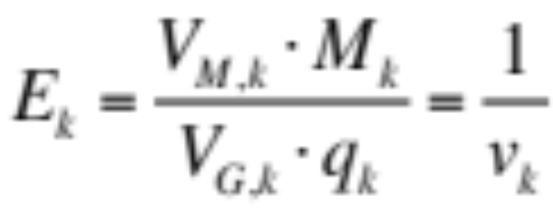
Calculating the Theoretical Scope of the Entitlement
We can calculate the scope of the monetary base E_{k} as follows. At announcement date, base money is M_{k} , the absolute market value of money is V_{M,k} , the general value level is V_{G,k} and real output for the “defined period” is q_{k}. The scope of the collective entitlement E_{k} is fixed as the percentage of real output that the entire monetary base claimed at the announcement date:
The scope of the collective entitlement for the entire contract period, (the period the implied Moneyholders Agreement is valid), is simply the reciprocal of the velocity of money at announcement date (v_{k}).

Slide 14
The Baseline Proportion &
The Realized Proportion
Once the scope of the collective entitlement is fixed, economic agents can begin to make a critical calculation: the baseline proportion of real output that a unit of money can claim in a given future period. The baseline proportion (“β”) represents the “in principle” or “approximate” proportion of output that a unit of money should claim in a given future period.
The baseline proportion is not the actual or realized proportion of output (“α”) that money will claim in that future period for reasons we shall discuss shortly. However, the expected baseline proportion for a given future period does provide the best unbiased estimate of the expected realized proportion of output that one unit of money might claim in that given future period.

Slide 15
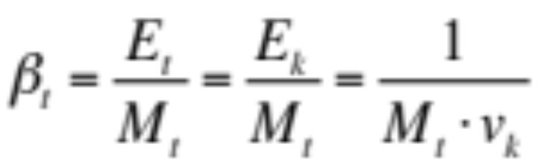
Calculating the Baseline Proportion
Let’s denote the scope of the collective entitlement (the entitlement to real output of the entire monetary base) at time t as E_{t} . As discussed, this scope was fixed at announcement date, therefore E_{t} = E_{k} . If the monetary base at time t is M_{t} , then we can calculate the theoretical or baseline proportion of output that each unit of money can claim at time t as:
The thesis of The Enigma Series is that money is a proportional claim on the output of society. The equation above provides us with our first description of the “in principle” proportional entitlement of one unit of money in a given future period.

Slide 16
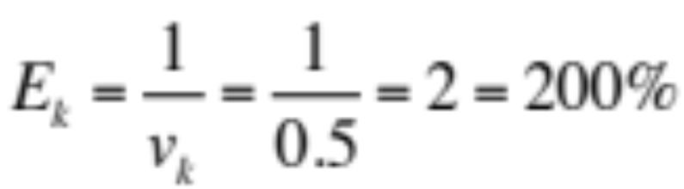
Simple Example:
Scope of Collective Entitlement
Let’s put some numbers around this to explain how the baseline proportion works in practice. Let’s assume that at announcement date there are 1,000 units of base money outstanding, M_{k} = 1,000. Let’s also assume that the velocity of base money at announcement date is v_{k} = 0.5. This implies that, at announcement date, one turn of the monetary base can claim 200% of real output. This is the “scope of the collective entitlement” of base money.
The baseline proportion at announcement date is simply the collective entitlement divided by the money base (see next slide).

Slide 17
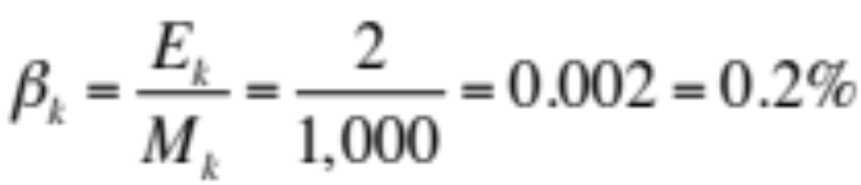
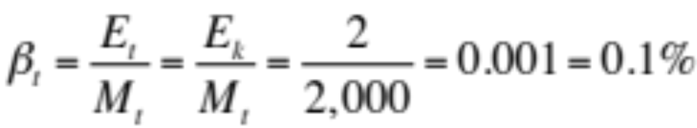
Simple Example:
Baseline Proportion
The baseline proportion at announcement date β_{k} is equal to the the collective entitlement of the monetary base divided by the outstanding monetary base at t=k:
In other words, at announcement date, the theoretical entitlement of each unit of output is 0.2% of real output. Now, let’s roll this forward. Suppose the monetary base has doubled and at current time t, M_{t} = 2,000. The current baseline proportion is equal to:

Slide 18
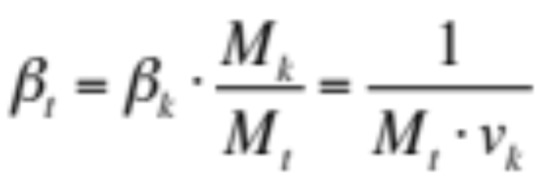
Quantity Theory of Money:
“Baseline”=“Realized” Proportion
In our example, as the monetary base doubles from its level at announcement date, the theoretical proportion of output that each unit of money can claim falls by 50%. In general terms:
The quantity theory of money effectively interprets this “baseline proportion” to be the “realized proportion” of output that money can claim at time t. In other words, the quantity theory of money predicts that the baseline proportion represents not some theoretical or “in principle” proportion of output that money should claim in a given period, but rather the actual proportion of output that it will claim in that period.

Slide 19
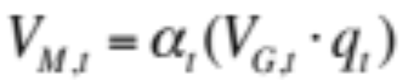
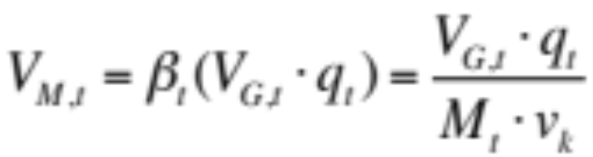
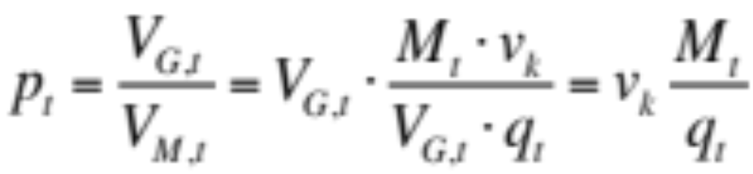
Illustrating the Math Behind
The Quantity Theory of Money
Let’s assume the “realized” or “actual” proportion of real output that a unit of money can claim at time t is denoted as α_{t} . The absolute market value of one unit of money at time t can be calculated as:
In effect, quantity theory assumes that the realized proportion is equal to the baseline proportion (α_{t} = β_{t} ). Therefore:
And:
Note: v_{k} is a constant

Slide 20
Quantity Theory of Money vs Proportional Claim Theory
In essence, the quantity theory of money is a simplistic version of “proportional claim theory”. The quantity theory of money effectively assumes that the baseline proportion in any given period determines the realized proportion of output that a unit of money can claim in that period.
While quantity theory works well over long periods of time, it is a very poor model in the short run. Why? Because the realized proportion and the current baseline proportion will often diverge significantly. Quantity theory can not accurately capture this phenomenon because it fails to recognize the importance of expectations and the role of intertemporal equilibrium in the determination of the absolute market value of money.

Slide 21
Proportional Claim Theory:
Expectations are Critical
The quantity theory of money allows no role for expectations. In contrast, the view of proportional claim theory is that the equilibrium absolute market value of money in the current period depends critically upon expectations of the proportion of output that each unit of money will claim in future periods: it depends upon the future set of “expected realized proportions”.
Furthermore, the “expected baseline proportion” in a given future period provides the best unbiased estimate of the “expected realized proportion” in that future period. Hence, expectations regarding the future path of the baseline proportion are critical in the determination of the absolute market value of money and the realized proportion in the current period.

Slide 22
Expected Baseline Proportion as
Best Unbiased Estimate
The expected baseline proportion in a given future period represents the “in-principle” proportional entitlement to output of one unit of money in that future period. While there is no specific contractual obligation upon society to deliver the baseline proportion of output in any given period, there is an implied contractual agreement between members of society that recognizes the expected baseline proportion in any given future period as the “in principle” or “approximate” proportional entitlement for each unit of money in that future period.
For this reason, the expected baseline proportion represents the best unbiased estimate of the expected realized proportion for a given future period, particularly for a distant future period.

Slide 23
Expected Baseline Proportion & The Chain of Expected Future Values
The baseline proportion plays a critical role in the determination of the absolute market value of money. In effect, it acts as the critical link between the past, present and future of fiat money.
More specifically, the path of expected baseline proportions (for the n future periods in the “spending horizon”) is determined, in part, by the original entitlement of money (the initial baseline proportion) at announcement date. This set of expected baseline proportions provides the best estimate for the set of expected realized proportions. This set of estimates for the realized proportion provides the basis for the chain of expected future values of money which, in turn, determines the equilibrium absolute market value of money in the present period.

Slide 24
The Present Value of Money and the Chain of Expected Future Values
The equilibrium absolute market value of money depends upon a chain of expected future values. When expectations change regarding the future market value of money, it has a cascading effect all the way down along the chain of expected future values until it reaches the present market value of money.
The simple reason for this phenomenon is that any change in the expected future absolute market value of money creates a incentive to act now. In other words, an intertemporal equilibrium (a state of indifference) that previously existed is disturbed. In order to restore intertemporal equilibrium, the current absolute market value of money must adjust to reflect these new expectations. This is best illustrated by example.

Slide 25
Using Examples to Explain
Intertemporal Equilibrium
The second section in the main part of this paper, “A Basic Theory of the Velocity of Money”, provides some highly simplified examples of how a change in expectations regarding future levels of the baseline proportion and/or real output may impact the current equilibrium absolute market value of money.
In particular, the section highlights how changes in those variables disrupt a state of intertemporal equilibrium and explain how the market value of money must adjust to restore intertemporal equilibrium. These simplified examples help to explain concepts used in the following sections of the paper. Moreover, they provide some basic insight into the nature of the enigmatic velocity of money.

Slide 26
Impact of Expected Permanent Increase in the Monetary Base
Let’s quickly explore one simple example. Let’s assume that the monetary base has been stable for a long period of time and the market expects it to remain stable. Suddenly, there is a change in policy: in one year from today, the monetary base will double and stay at that level permanently. What is the likely impact on the current absolute market value of money?
The expected baseline proportion in all future periods, beginning one year from now, will fall by 50%. As a result, the expected realized proportion in that set of future periods falls 50%. Therefore, all else equal, the economic value of output that each unit of money is expected to obtain in those future periods falls by 50%. What is the impact on the current value of money?

Slide 27
Equilibrium Absolute Market Value of Money Falls
This shift in expectations (an expected permanent increase in the monetary base) disrupts an intertemporal equilibrium. If people expect the value of money (the purchasing power of money) to be significantly lower in future periods, then there is an incentive to spend money now and vendors of goods will be less willing to accept money as payment.
In essence, a deadlock is created where everybody wants to spend money but nobody wants to receive it. How is this deadlock broken? The current absolute market value money must fall to the point that balance is restored (people are indifferent between spending the marginal unit of money now or in any future period).

Slide 28
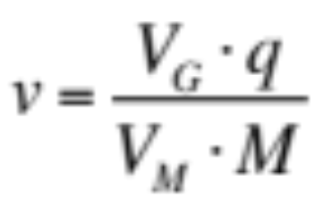
Price Level Rises
Velocity of Money Rises
Despite the fact that there has been no change in the current level of the monetary base, the market value of money falls due an expected permanent increase in the monetary base. If the market value of money falls roughly 50%, then, all else equal, the price level will double. Moreover, the velocity of money must double.
The velocity of money must solve for the change in the absolute market value of the monetary base (V_{M} M) vs the absolute market value of goods (V_{G} q). Note: when the monetary base doubles (in one year), the velocity of money will fall back to its original level.

Slide 29
Temporary vs Permanent Change in the Monetary Base
What would happen in the previous example if the increase in the monetary base was expected to be temporary, not permanent? The simple answer is that there would be very little change in the absolute market value of money. Why? Because the present value of money discounts a long chain of expected future values, only a few of which are impacted by a “temporary” shift in the monetary base.
Now imagine what happens if a “temporary” increase in the monetary base suddenly becomes a “permanent” increase in the monetary base. Suddenly, the absolute market value of money falls and the price level rises. It seems as though there was a “lag” between the increase in the monetary base and inflation.

Slide 30
The “Lag” Between Base Money Expansion and Inflation
The often observed and much discussed lag between base money expansion and inflation is traditionally explained by some form of “inefficient markets” arguments. Traditional monetarists argue that there is a lag between base money expansion and inflation because people don’t understand its ultimate impact on the price level and, short-term, are fooled by “money illusion”.
The view of this paper is that “monetary lag” can be explained by efficient markets and rational expectations. If an increase in the monetary base is perceived to be temporary, then there will be little impact on the value of money and the price level. However, over time, if people realize that the increase is permanent, then the value of money will decline and the price level will rise.

Slide 31
A Valuation Model for Money
While the high level and rather simplified examples regarding the determination of the equilibrium absolute market value of money may be interesting, the ideal outcome from a theoretical perspective is to develop a comprehensive mathematical model for the equilibrium absolute market value of money.
This paper develops a “valuation model” for money by leveraging some of the notions already discussed (specifically, the role of the baseline proportion and the importance of intertemporal equilibrium in determining the equilibrium absolute market value of money) and applying these concepts to a “discounted future benefits” model that one might use to value any financial instrument.

Slide 32
Building the Discounted Future Benefits Model for Money
The Discounted Future Benefits Model for Money attempts to calculate the equilibrium absolute market value for money by discounting the future benefits that someone in the possession of money might reasonably expect to receive from its future use.
Building a discounted future benefits model for money requires a number of special adaptions to the familiar “discounted future cash flow model” used to value most financial instruments. Firstly, the model for money must be expressed in terms of “units of economic value”, not “dollars”. Secondly, money is a claim on real output, not cash flows: the present absolute market value of money depends on the discounted future absolute market value of the real output that it is expected to claim.

Slide 33
Building the Model Requires Creating a Probability Distribution
The third challenge in adapting the standard discounted future benefits model is that money represents a claim to a slice, not a stream, of future output. We can spend money now, in the near future, or invest it and spend it in the distant future. If the value of money could be any one of a number of discounted future values, then how do we determine the current equilibrium value for money?
Mathematically, the question becomes one of probability: what is the probability that the marginal unit of money is spent in any one of the n future periods in the spending horizon? The key to the answer lies in the basic question we are trying to solve: how do we calculate the equilibrium absolute market value for money?

Slide 34
Intertemporal Equilibrium and
The Probability Distribution
“Equilibrium” is a state of indifference where all forces come to rest. It will be argued that if the economy is in a state of intertemporal equilibrium, then the current possessor of money is indifferent between spending the marginal unit of money now or in any of the n periods in the spending horizon. They are also indifferent between spending the marginal unit of money in one future period or another future period. If someone is indifferent between all n future periods, then the probability that they spend the marginal unit of money in any one of those periods is equal to “1/n”.
This simple probability distribution allows us to weight (1/n) each of the expected discounted future values of money.

Slide 35
Role of Expected Nominal Investment Returns
Another challenge in building the valuation model relates to the role of expected nominal investment returns. All else equal, as the nominal interest rate rises, the expected future benefits received from money rise and hence the present absolute market value of money rises. A rise in interest rates makes money more valuable and increases the demand for money. Liquidity preference theory fails to understand this relationship because it does not appreciate the simple fact that we demand money to use it, not to hold it.
Whereas most assets must be “held” in order to receive the benefits that accrue to them, money does not have to be “held” in order to receive its future benefits. Rather, money can be invested before it is spent. These investment returns must be included in the expected discounted future benefits model.

Slide 36
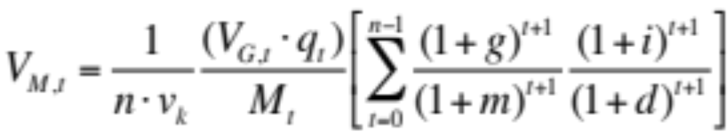
The Discounted Future Benefits Model for Money
The end result of the analysis that follows in this paper is to produce the following “constant growth” version of the valuation model for the absolute market value of money:
The equilibrium absolute market value of money depends on a large number of factors. Firstly, it depends on the value of money at announcement date: this is carried through the model by v_{k} (the velocity of money at announcement date). Secondly, and not surprisingly, it depends on current levels of real output q_{t} , base money M_{t} and the general value level V_{G,t} .

Slide 37
The Value of Money and the Role of Expectations
In addition to these current period and historical factors, the Discounted Future Benefits Model indicates that the equilibrium absolute market value of money also depends upon expectations.
In particular, the absolute market value of money will rise if expected long-term output growth (g) rises, if expected long-term base money growth (m) falls, if long-term expected (risk adjusted) nominal investment returns on the diversified portfolio of assets (i) rises, or if the real discount rate applied by consumers to their future consumption (d) falls.

Slide 38
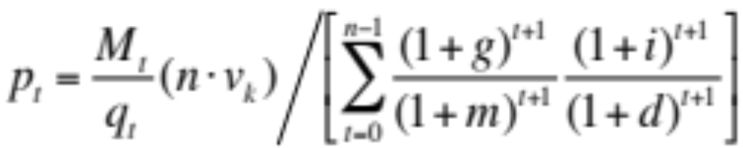
The End Goal:
A Model for the Price Level
We can then apply Ratio Theory to the Discounted Future Benefits Model to create an expectations-based solution for the price level:
The price level can be considered to be composed of a “baseline component” and an “expectations component”. The baseline component should look familiar. The baseline component implies that the price level depends on current levels of money supply M_{t} and real output q_{t} , as long-term empirical evidence suggests.
Baseline Component
Expectations Component

Slide 39
An “Expectations Adapted” Quantity Theory of Money?
Readers will not be familiar with the second component in the price level model, the “expectations component”:
This expectations-based solution for the price level can explain why quantity theory works in the long run, but not in the short run. In the long run, the baseline component (the ratio of base money to real output) is the key to price level determination. However, in the short-term, shifts in expectations can easily overwhelm the impact of any change in the money/output ratio.
Baseline Component
Expectations Component

Slide 40
The Important Role of
Very Long-Term Expectations
One of the key points of this paper that can not be emphasized enough is that long-term expectations matter to the determination of the market value of money and the price level. The expected rate of base money growth over the next few years is, in and of itself, largely irrelevant. What matters are perceptions of the expected 30-40 year annualized growth rate in base money and real output (the very long-term path of the money/output ratio).
It has hard to put an exact number on the spending horizon variable (“n”) in our models. Theoretically, it is the average of what adults in our society believe is their remaining life expectancy (life expectancy measured from today). The best guess on this figure is 30-40 years (we are all “optimistic”).

Slide 41
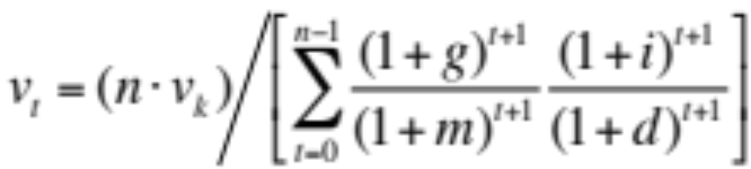
A Solution for
The Velocity of Money
We can also use the discounted future benefits model to create a solution for the velocity of money:
The velocity of money is anchored by the initial velocity of money v_{k} (the velocity of money at the time the implied Moneyholders’ Agreement came into effect). Although we need to be careful not to interpret this “constant growth” model too literally, we can say that changing expectations regarding the long-term growth rates of real output and base money are a major factor in determining the velocity of money.

Slide 42
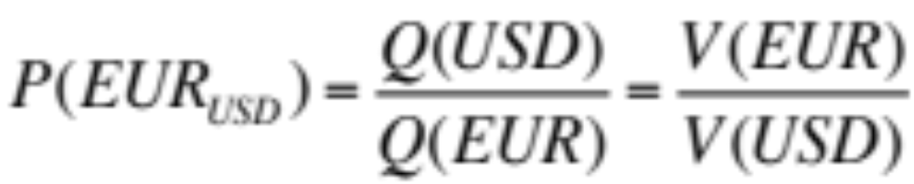
Foreign Exchange Rate Model
There is one final and rather obvious application for the Discounted Future Benefits Model. We can use it to create a model for foreign exchange rate determination. As discussed in The Inflation Enigma, a foreign exchange rate, in this case the USD/EUR exchange rate, can be calculated as:
We can use the DFB Model to create solutions for each of the V(EUR) and V(USD) terms and substitute them into the equation above. The foreign exchange rate model and a related model for the gold price will be the subject of another paper.

Slide 43
What Causes Inflation?
The final section of this paper begins the process of reconciling the models developed in The Enigma Series with the views of Keynesianism, Monetarism and Fiscal Theory of the Price Level.
All of these schools of thought have made important observations regarding the nature of inflation which are supported, at least to some degree, by the models developed in these papers. We will use the DFB model and the Goods-Money Framework to show that it is (arguably) the case that “too much demand” can lead to a rise in the price level. “Too much money” is another cause of inflation, but expectations of base money growth play a more critical role than commonly believed. Finally, “too much debt” (excessive government debt) can lead to a rise in the expected future path of the money/output ratio, also contributing to inflation.

Slide 44
Monetary & Fiscal Policy
Transmission Mechanisms
The Velocity Enigma concludes by challenging some of the traditional notions regarding monetary and fiscal policy transmission mechanisms. In particular, it will be argued that lower interest rates shift both the aggregate demand and aggregate supply curves to the right (largely negating the relevance of the output gap). This creates a dangerous confidence game: the significant increase in output fuels confidence regarding long-term growth prospects and the view that the increase in the monetary base is largely “temporary”, thereby somewhat “artificially” supporting the value of money and containing inflationary pressures.
It will also be argued that “excessive” levels of government debt play a critical role in shaping expectations regarding the future path of the money/output ratio and hence the value of money.

Slide 45
The Moneyholders’ Agreement
An Attempt to Ascertain the Exact Nature & Terms of the
Implied-in-fact “Moneyholders’ Agreement”

Slide 46
The Challenge: Creating a
Valuation Model for Money
The main goal of The Velocity Enigma is to develop a valuation model for money called “The Discounted Future Benefits Model for the Market Value of Money”.
If money is a financial instrument, then it should be possible, at least theoretically, to build a “valuation model” for money just as one might build a valuation model for a share of common stock (or some other financial instrument). More specifically, it should be possible to determine the equilibrium market value of money (as measured in units of economic value) by constructing a model that calculates the present value of the future economic benefits that are expected to be derived from the marginal unit of money demanded.

Slide 47
Determining the Exact Nature of the Proportional Claim
Adapting the standard “discounted future cash flow” model to create a valuation model for money faces a number of non-trivial complications. Some are relatively simple, even if a little abstract: for example, the valuation model for money needs to be expressed in terms of “units of economic value” and we need to recognize that money is a claim to a slice of future output, not a stream of future cash flows (to be discussed in more detail later).
Other challenges are more difficult and require a degree of speculation. One of these challenges is determining the precise nature of the proportional claim. In order to determine this, we need to decipher the terms of the implied “Moneyholders’ Agreement”. This section of the paper attempts to unravel the terms of that agreement.

Slide 48
The Value of Money
A Review of Discussion So Far
Before we launch into this process, let’s briefly review the key concepts presented to date. In The Money Enigma, it was argued that money is a financial instrument: it is both an asset and a liability. Money has value as an asset because it is an equity instrument of society, issued on its behalf by government as trust and trustee. In particular, money is a proportional claim on the output of society.
In The Inflation Enigma, we used Ratio Theory to derive the “Simple Model for the Market Value of Money”. The Simple Model states that the value of money is positively related to the absolute market value of current output (“V_{G} q”) and negatively related to money supply (“M”) and the velocity of money (“v”).

Slide 49
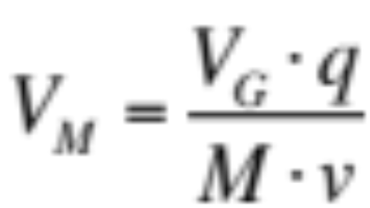
The Weakness of the Simple Model:
No Explicit Role for Expectations
The key weakness of the Simple Model is that the absolute market value of money remains expressed as a function of the velocity of money. Moreover, it doesn’t explicitly describe the role of expectations in the determination of the market value of money.
The view of The Enigma Series is that expectations play a critical role in the determination of the value of money. Money is more than a “temporary abode of purchasing power”. Money is a financial instrument and the value of a financial instrument is determined by the expectation of future economic benefits.

Slide 50
The Value of a Financial Instrument Depends on Expectations
A financial instrument, by its very nature, creates a series of future economic obligations to its issuer which, in turn, represent a series of future economic benefits to its holder. The value of a financial instrument is highly dependent on expectations regarding the level of these future economic benefits and the likelihood that they will be received.
Money is a financial instrument. Possession of money makes its holder a party to an implied contract between the holder and society that promises the holder a possible set of future economic benefits. The value of money, as per any financial instrument, is highly dependent upon expectations of the future level(s) of this possible set of economic benefits.

Slide 51
Valuation Determined by Expectations of Future Benefits
It is worth repeating this point because it is so fundamental. If money is a financial instrument that entitles its holder to a future economic benefit (or even the option of a future economic benefit), then its value must depend, at least to some degree, upon expectations regarding that future economic benefit.
In order to argue that this is not the case, one must argue that money is unique among all financial instruments, a special class of financial instrument, the value of which is not determined by expectations of future economic benefits. Furthermore, even though money clearly entitles the holder to the option of a future economic benefit, it must be argued that the value of money does not depend upon this potential future benefit.

Slide 52
The Precise Nature of the Claim?
The observation that “money is a financial instrument and, therefore, its value depends upon expectations of future economic benefits to which the holder may be entitled” is a fundamental point, but, in and of itself, it does not explain how money is valued.
In order to understand how money is valued we need to understand the precise nature of the claim. In particular, we need to understand the exact nature of the liability that money represents to its issuer (society itself). If we understand the exact nature of the liability, then we can begin to build a valuation model for money that discounts the future expected economic benefits that a holder might expect to receive.

Slide 53
Deciphering the Exact Terms of the “Moneyholders’ Agreement”
The first step in creating a valuation model for money is, perhaps, the most difficult: ascertaining the exact terms of the implied-in-fact “Moneyholders’ Agreement”. In order to understand the “asset nature” of a financial instrument, we need to understand the exact nature of the liability it represents.
In the case of most financial instrument this is a relatively straightforward process: we can read the express written contract (technically, the contact is the financial instrument). In the case of money, the task is made more difficult by the fact that there is no express contract (or certainly not a meaningful express contract). Rather, non-asset backed fiat money is issued pursuant to an implied-in-fact contract, the Moneyholders’ Agreement.

Slide 54
Money as a Financial Instrument
Fiat money is not a “real asset”; rather, it is a financial instrument. The value of money is derived “contractually” from an implied agreement between the moneyholder and society. In order to build a valuation model for money, we must ascertain the exact terms of that agreement.
MONEYHOLDERS’ AGREEMENT
SPECIAL-FORM EQUITY
INSTRUMENT
SOCIETY
{GOVERNMENT
AS TRUST &
TRUSTEE}
MONEYHOLDER
ASSET
MONEY
LIABILITY

Slide 55
A Proportional Claim on
The Output of Society
It is the contention of The Enigma Series that money is a special-form equity instrument of society, issued on its behalf by government as trust and trustee. The trust structure of government allows society to finance current expenditures on communal activities/projects by issuing claims against its future output. Put simply, rather than pay for government expenditures with current output (taxes), society can issue claims against future output (government debt and money).
Money represents a variable entitlement to the future output of society. Money does not provide the holder with an entitlement to a fixed amount of future output, but rather provides the holder with a claim to a proportion of future output.

Slide 56
Money is a Claim on the
Future Output of Society
In order to finance public projects, society can authorize government to issue liabilities against the future economic output of society. Money represents a variable entitlement to that future economic output.
AUTHORIZES
SOCIETY
“BENEFICIARY”
PRODUCES
FUTURE ECONOMIC OUTPUT OF SOCIETY
TO ISSUE CLAIMS ON
GOVERNMENT
“THE TRUST”
GOVERNMENT
LIABILITIES
“LEGAL LIABILITY”
“ECONOMIC LIABILITY”

Slide 57
Understanding the Evolution of the Value of Money
In order to understand the precise nature of the proportional claim and how the absolute market value of fiat money might be determined, we will follow the evolution of a typical currency over time. In particular, what was the process that set the market value of money in its early life and what subsequent events changed the way the market value of money was determined? Furthermore, how does the notion that fiat money is a proportional claim on output fit with this experience?
Rather than reviewing the history of one specific fiat currency, we are going to use a hypothetical or “stylized” example that draws on the historical experience of many of the fiat currencies that we are familiar with today.

Slide 58
A Society Introduces
Fiat Money
Let’s suppose that we live in a society with no fiat money that has recently decided to issue fiat currency (paper notes called “dollars”) for the first time. For the last one hundred years or so, our society has primarily used gold as the medium of exchange. The government has aided the use of gold by providing a “minting service” that produces gold coins of standard weights.
As the our society approaches the date of the launch of the new currency, what is the first and most obvious question that any potential recipient of the new paper currency might ask? Clearly, the first question any of us would ask is “what is the new paper money worth?” In particular, what is the value of money relative to the value of items we are already familiar with?

Slide 59
What is Each Unit of the
New Currency Worth?
Let’s reflect for a moment on nature of the question “what is the new paper money worth?” When the new currency is introduced, our natural response is to try and figure out exactly what it is worth in exchange. “Should I accept one dollar in payment for this orange or should I ask for more? Should I offer ten dollars for that book or offer more/less dollars?”
We can only answer these questions by acquiring a sense of the absolute market value of each unit of the new money and, therefore, the exchangeable value of each unit of the new currency (the price of goods in terms of the new paper money). So, how does government establish the market value of the new paper currency? It uses an existing benchmark.

Slide 60
Finding the Right Benchmark
In order to successfully introduce the new currency, the government needs to set the initial market value of money relative to some benchmark, the market value of which is relatively stable and widely recognized by the community. The government can not issue the money and say that each dollar is worth “8 units of economic value”. However, the government can issue the new money by proclaiming that “each new dollar will be worth one ounce of gold”. Why? Because one ounce of gold already has a widely recognized/understood market value.
It is important to note that this initial “benchmarking” exercise is completely arbitrary. New money is simply “deemed” to have a certain market value, a value that is understood by benchmark.

Slide 61
An Arbitrary Initial Value
It may seem strange to some readers that the initial value of something that is so important to the operation of our society is set “arbitrarily”, but it makes sense when you think about why fiat money was often issued in the first place.
If the government in our hypothetical society wants to spend more gold coin than it is willing/able to collect in taxes, then it can either (i) drawdown on Treasury reserves of gold, (ii) issue government debt (raise taxes in the future), or (iii) it can create something “as good as gold” which it can use to fund the difference. By proclamation, government can simply declare that the value of one new dollar is equal to one ounce of gold. If this promise is “credible”, then the new money is accepted.

Slide 62
The Market Value of the
New Paper Currency
The government in our hypothetical society issues the new paper money and declares that each new dollar is redeemable for one ounce of gold. The absolute market value of our new currency is now tied to the absolute market value of gold.
From a contractual perspective, every holder of the new paper currency is a party to an express written contract that states that the government (on behalf of society) will deliver to that holder one ounce of gold per dollar on request. Hence, each dollar is “as good as an ounce of gold”. The market value of each new dollar is equal to the market value of one ounce of gold. As the market value of gold rises and falls, so the market value of one unit of new currency rises and falls in lockstep.

Slide 63
The Benefits and Problems of a Gold Backed Fiat Currency
The great advantage of linking the value of the new paper currency to gold is that it provides confidence in the value of the new money (the new money is “as good as gold”, a commodity that has demonstrated the attribute of possessing significant market value for hundreds of years). In turn, this greatly enhances the likelihood that the new money will be accepted by the public at large as the new primary medium of exchange.
The great disadvantage of this approach (or, depending on your philosophical bias, the great advantage of this approach) is that it severely limits the potential expansion of the monetary base. The monetary base can only be expanded to the point that the promise to redeem paper money for gold remains “credible”.

Slide 64
Removal of Gold Convertibility
Let’s suppose that after twenty years of living successfully with our gold backed paper money, the government decides to remove the gold convertibility feature. For twenty years, the absolute market value of one dollar has risen and fallen in lockstep with the absolute market value of one ounce of gold. How will the market value of one dollar be determined now?
Previously, money was a simple financial instrument, a written contract between the holder and the issuer that stated that it could be redeemed for something of “tangible value” (gold). Now, the government is tearing up that express written contract. So, what is money now and how is the absolute market value of each unit of money determined?

Slide 65
Money Must Remain
A Financial Instrument
If money is no longer backed by gold, then how does it derive its value? Why is it worth anything in exchange? Indeed, what is the nature of money once the gold convertibility feature is removed? Is it still a “financial instrument”?
It may be tempting to believe that our hypothetical fiat money is no longer a financial instrument (the express contract is nullified so there is no contract). But this creates a problem. Paper money (“the dollar”) is not a real asset. Unlike gold, it does not derive any significant economic value from its physical properties. If money derives no value from its physical properties (it is not a real asset) and it derives no value from its contractual properties (it is not a financial instrument), then it has no value.

Slide 66
A New Implied Contract
If money is a financial instrument (which it must be in order to have any value in an absolute or relative sense), then every holder of money is a party to a contract (the “Moneyholders’ Agreement”) between themselves and the issuer of money (government as trust and trustee on behalf of society).
Some type of “contractual arrangement” must exist for money to have any market value. Although the express contract has been nullified (the dollar is no longer backed by gold), a new contract between the same parties must exist, even if that new contract is implied. Furthermore, this new contract must create an economic liability for the issuer of money (society), in order for money to be regarded as an asset by its holder.

Slide 67
Parties to the Agreement
So, what is the substance of the new implied-in-fact “Moneyholders’ Agreement”? The next few slides attempt to outline the substance of the agreement. Once we have outlined the substance of the agreement, we will explore why the agreement is structured in the suggested manner, in particular, we will explore the critical role of the “baseline proportion”.
Firstly, we need to recognize the true nature of “the parties” to the agreement, “society” and the “moneyholder”. In essence, every adult member of society is a party to the agreement in their joint role as both the issuer of money (a member of society) and a holder of money. In effect, the “Moneyholders’ Agreement” represents a tacit understanding between all of us.

Slide 68
The Substance of the
New Agreement
The Moneyholders’ Agreement states that each unit of money represents a proportional claim to the output of society. A holder may exercise their claim at any time. In order to exercise the claim, the holder of the claim must present the claim to another counterparty to the agreement. The other party, at their discretion, may accept the claim in exchange for goods, assets or the satisfaction of liabilities.
The parties to the Agreement acknowledge that money is a proportional claim on the future output of society and that the “in principle” proportion of output that each unit of money should claim at any future point in time is the expected “baseline proportion” for that given future period.

Slide 69
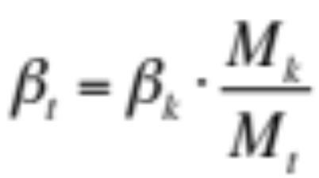
The Baseline Proportion
The “baseline proportion” at time t, denoted “β_{t}”, shall be determined with reference to the initial baseline proportion of output that each unit of money could claim at the time the Moneyholders’ Agreement came into effect (the “announcement date”, or time k), adjusted for the increase/decrease in the number of claims outstanding since that time.
It is acknowledged by all parties to the Agreement that the expected baseline proportion in a given future period provides the best unbiased estimate of the realized proportion of output that each unit of money will claim in that future period.

Slide 70
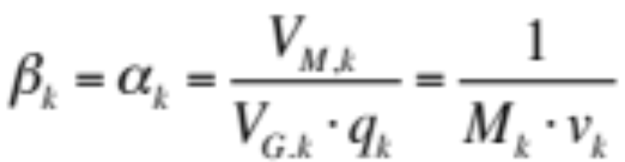
Initial Baseline Proportion is Set by Initial Realized Proportion
The “initial baseline proportion”, denoted “β_{k}”, is set equal to the “initial realized proportion”, denoted “α_{k}”. In other words, the “in principle” proportion of output that money can claim at announcement date is that actual proportion of output that money did claim at announcement date (the day the new implied Agreement came into effect).
In effect, the proportion of output that money did claim at the time of the introduction of the new agreement sets the benchmark for the future variable entitlement of money.

Slide 71
The “In Principle” vs “Realized”
Proportional Entitlement
All parties to the agreement acknowledge that the expected “baseline proportion” for a given future period represents the “in principle” proportion of output that a unit of money should claim in that given future period. However, the expected baseline proportion is not the actual or realized proportion of output that money will claim in that future period.
The “realized proportion” in the current period is determined by an expectations driven market process that incorporates the expected future path of the realized proportion. The future path of the realized proportion is, in turn, best estimated by the expected future path of the baseline proportion. Why? Because the expected baseline proportion for a given future period represents the “in principle” entitlement in that future period.

Slide 72
The Essence of the
Moneyholders’ Agreement
It is the contention of The Enigma Series that the last four slides capture the essence of the implied “Moneyholders’ Agreement”.
Money is a proportional claim on the output of society. The proportion of output that a unit of money can claim at this current point in time depends upon expectations of the future market value of each unit of money. The expected market value of a unit of money in some future period is calculated with reference to the expected realized proportion of output that each unit might claim in that period. The expected baseline proportion, the “in principle” entitlement of one unit of money, provides the best unbiased estimate of the expected realized proportion of output for that given future period.

Slide 73
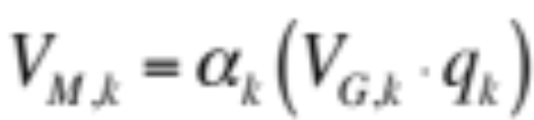
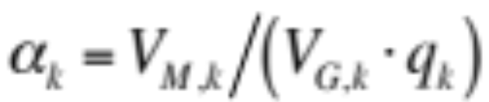
Explaining By Example
Let’s return to our example regarding the evolution of fiat money and discuss the details of the Moneyholders’ Agreement in this context. In the case of our example, the absolute market value of money has fluctuated in lockstep with the absolute market value of gold for twenty years. The day the new Moneyholders’ Agreement is announced (the day the removal of gold convertibility is announced), the absolute market value of each unit of money happens to be V_{M,k} .
The actual proportion of output (α_{k} ) that each unit of money can purchase at that time can be calculated as follows:
Hence,

Slide 74
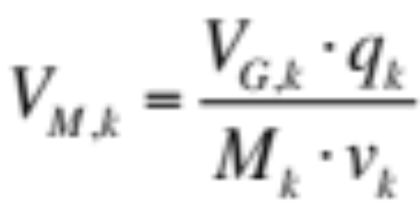
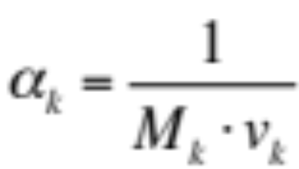
Initial Realized Proportion in Terms of Money & Velocity
The realized proportion of output at announcement date is given by:
The Simple Model states that the absolute market value of money at announcement date can be calculated as:
Therefore, the actual or realized proportion of output (α_{k} ) that each unit of money can purchase at announcement date can be stated as:

Slide 75
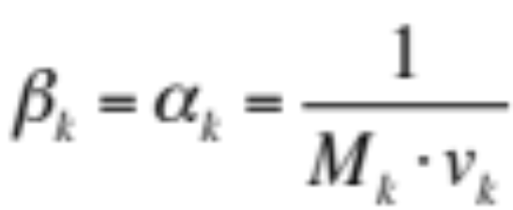
Calculation of the
“In Principle” Entitlement
By agreement, the initial baseline proportion (β_{k} ) is set equal to the realized proportion of output at announcement date.
The initial baseline proportion is then used as the reference point for subsequent calculations of the “in principle” proportion of output that money can claim. If the money base doubles from its initial level (at announcement date), then the “in principle” entitlement of each unit of money halves.

Slide 76
The Baseline Proportion is the Link Between the Past, Present & Future
The baseline proportion provides a contractual, or some may prefer to argue a “psychological” benchmark for the calculation of the “in principle” proportion of output that one unit of the monetary base should claim at a given future point in time.
The baseline proportion plays a critical role in the determination of the value of money. The “baseline proportion” is, in essence, the link between the past, present and future of any fiat currency. As discussed, every fiat currency begins life with an arbitrary value (V_{M,k} ). The value of a fiat currency is always tied back to this initial arbitrary value (unless the currency is completely reissued). The baseline proportion provides the link between this initial arbitrary value and any subsequent value.

Slide 77
The Creation of a
Proportional Claim
In order to understand why the baseline or “in principle” proportion is so fundamental, we need to step back and think about how any proportional claim is defined when it is first created. For the purposes of simplicity, we shall use the most common example of a proportional claim: common stock.
Whenever a unique set of proportional claims are created, there are two decisions that must be made:
  What is the nature and scope of the economic benefit to which the set of claims are entitled? (What is the economic benefit to which the outstanding shares of the company are collectively entitled to?)
  How many claims will initially be issued? (How many shares of common stock will be issued?)

Slide 78
The Scope of the Collective Entitlement Must be Fixed
For a unique set of proportional claims to be defined and hence, have value, the nature and scope of the collective economic entitlement of those claims must be fixed.
In order for shares of common stock to have value, the shareholders’ agreement must define the nature of the collective entitlement (residual cash flows) and the scope of the collective entitlement (100% of residual cash flows). The scope of the entitlement is not variable: the outstanding shares of common stock don’t claim 100% of residual cash flows this week, then 8% of cash flows the next and 73% of cash flows the week after. The scope of the collective entitlement is fixed and can only be changed by an amendment to the shareholders’ agreement.

Slide 79
Common Stock:
The Scope of the Entitlement
A key part of defining any proportional claim is defining the scope of the economic benefit to which the set of claims are entitled. In the case of common stock, the answer is relatively easy. Collectively, the outstanding shares of the company are entitled to 100% of the residual cash flows generated by the company in each and every period. The shares can’t claim 120% of residual cash flows. (The scope of the collective entitlement can drop to less than 100%, but only if shareholders approve the issuance of a new class of stock.)
The key point is that the scope of the entitlement is defined and fixed by the shareholders’ agreement. The agreement can not be mute on this point, nor is the scope of the claim variable or random in nature.

Slide 80
Money:
The Scope of the Entitlement
Money is a proportional claim on the output of society: that is the nature of the claim. However, in order for the claim to be defined and have a “predictable” value, the scope of the collective entitlement needs to be determined and then the scope needs to be fixed at that level by the Moneyholders’ Agreement.
In simple terms, when the new currency is launched (at announcement date) the monetary base represents a claim against some percentage of real output within a defined period. The collective entitlement of the monetary base may be 150% of output within the defined period or 20% of output, or any other non-negative percentage. But once the scope of the claim is determined, it is fixed for all future periods.

Slide 81
Defining and Fixing the Scope of Collective Entitlement
In order for a set of proportional claims to have an “understood” or “predictable” value, the nature and scope of the collective entitlement of those claims must be defined and it must be fixed. Typically, common stock represents a claim to 100% of residual cash flows. Money represents a claim to x% of output in each defined period, where x is a non-negative number that is determined at announcement date.
If the scope of the collective entitlement of a set of proportional claims is not fixed, then the value of each claim is indeterminate. If the proportional claim of a share of common stock is indeterminate, then there is no way to determine its value and you can’t issue shares to raise funds. Similarly, if the proportional claim of one “dollar” is indeterminate, then the dollar has no determinable value and you can’t use it as a medium of exchange.

Slide 82
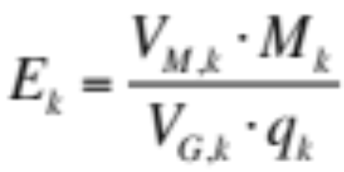
Calculating the Scope of the Entitlement
In practice, the scope of the collective entitlement of the outstanding monetary base is set by default at the announcement date.
At announcement date k, the monetary base can be denoted by M_{k} , the economic value of the currency is V_{M,k} , the general value level is V_{G,k} and real output for the “defined period” is q_{k}. The scope of the collective entitlement E_{k} , the portion of total output that the entire monetary base can claim at the announcement date, can be calculated as:

Slide 83
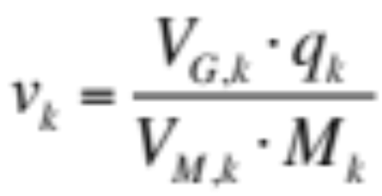

Scope of Entitlement is Inverse of Initial Velocity of Money
The scope of the collective entitlement is merely the inverse of the velocity of money at announcement date. The Simple Model states that the velocity of money at announcement date k can be calculated as:
Furthermore, we stated the initial scope of the collective entitlement is equal to:
Therefore, E_{k} = 1/v_{k} and the initial velocity of money is merely the reciprocal of the scope of the collective entitlement.

Slide 84
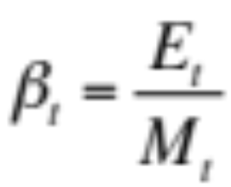
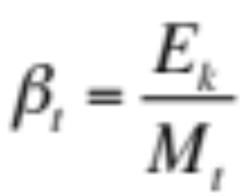
Calculating the Baseline Proportion Using Scope of Entitlement
If we know the scope of the collective entitlement at time t is E_{t} and we know the outstanding monetary base is M_{t} , then we can calculate the “in principle” or baseline proportion of output that each unit of money can claim at time t as:
Under the terms of the Moneyholders’ Agreement, the nature and scope of the collective entitlement of the monetary base is fixed at the level that existed at the announcement date. Therefore, E_{t} = E_{k} , and:

Slide 85
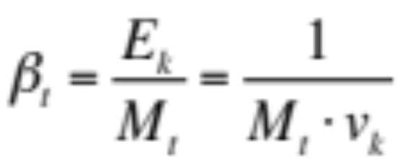
Baseline Proportion Restated in Initial Velocity Terms
If E_{k} = 1/v_{k}, then the baseline proportion of output at time t can be restated as:
In summary, the scope of the collective entitlement sets the baseline proportion of output, the “in principle” entitlement of the money unit. The baseline proportion can be expressed as a function of only two variables: the monetary base at that time M_{t} and the initial velocity of money at the announcement date v_{k} (the velocity of money at the time the implied “Moneyholders’ Agreement” came into effect). Let’s use a quick example to illustrate how the calculation works in practice.

Slide 86
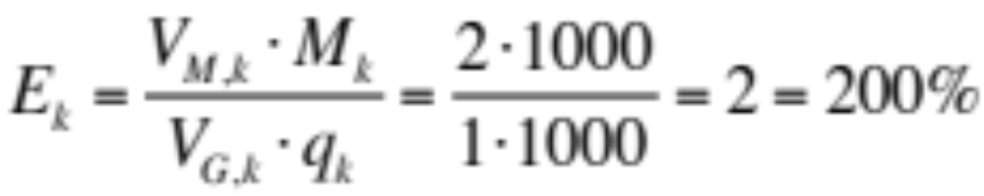
Example: Initial Scope
Let’s assume that at announcement date there are 1,000 individual dollars outstanding, M_{k} = 1,000. Let’s also assume that V_{G,k} = 1 and q_{k} = 1,000. The value of the currency has fluctuated in lockstep with gold for twenty years: at announcement date, the economic value of each unit of currency happens to be V_{M,k} = 2. Therefore, we can calculate E_{k} as:
The scope of the collective entitlement, at announcement date, is 200% of real output. The initial velocity of money is v_{k} = 0.5. The money base can claim total real output with half a turn.

Slide 87

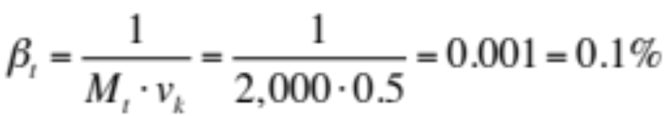
Example Continued: Change in Baseline Proportion
Furthermore, since there 1,000 individual dollars outstanding (the monetary base at the announcement date), the initial baseline proportion of output is calculated as:
At announcement date, each unit of money is theoretically entitled to 0.2% of real output. If at time t, the monetary base has doubled , then the baseline proportion of output falls to 0.1%:

Slide 88
The Role of the Baseline Proportion in
Determining the Value of Money
In summary, for a unique set of proportional claims to be defined and hence, have value, the nature and scope of the collective economic entitlement of those claims must be fixed. Once the scope of the set of proportional claims is fixed, this in turn allows us to calculate the “in principle” entitlement of one of those claims at any point in time (the “baseline proportion”). The “in principle” proportional entitlement of any one of those claim will clearly fall as the number of outstanding proportional claims increases.
In the case of money, the difficult question which we need to address is how does the baseline proportion impact the value of money? The view of this paper is that expectations of the baseline proportion are critical. However, in order to highlight this, let’s begin by examining a theory in which expectations play no role.

Slide 89
Quantity Theory of Money and The Baseline Proportion
Although it is not widely recognized, the concept of the “baseline proportion” represents the intellectual crux of the quantity theory of money.
In essence, the quantity theory of money assumes that each unit of money can claim a certain proportion of the output of society. If the money supply doubles, then the proportion of output each unit of money can claim halves. Therefore, all else equal, the price of output (in money terms) doubles. Furthermore, if the money supply is constant but output doubles, the proportion of output of each unit of money claims is the same, but now each unit of money claims twice as much output and the price of output (in money terms) halves.

Slide 90
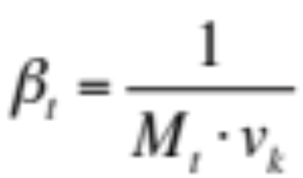
Quantity Theory Assumes “Realized” = “Baseline” Proportion
As a reminder, the baseline proportion determines the “in principle” proportion of real output that each unit of money can claim:
The quantity theory of money effectively interpret this “baseline proportion” to be the “realized proportion” of output that money can claim at time t. In other words, quantity theory predicts that the baseline proportion represents not some “in principle” proportion of output that money is theoretically entitled to, but the actual proportion of output that money does claim in this current period t.

Slide 91
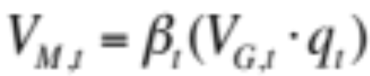
Illustrating the Math Behind
The Quantity Theory of Money (1)
We can illustrate this mathematically as follows. The absolute market value of one unit of money at time t can be calculated as:
Quantity theory assumes that the realized proportion is equal to the baseline proportion (α_{t} = β_{t} ). Therefore:
We know from our earlier discussion that the baseline proportion at t is given by:

Slide 92
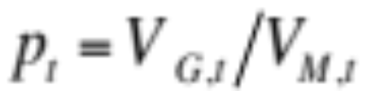
Illustrating the Math Behind
The Quantity Theory of Money (2)
Substituting for the baseline proportion in our earlier equation:
The Ratio Theory of the Price Level states:
Therefore, by assuming “(α_{t} = β_{t} )”, quantity theory calculates that the price level can be determined as follows:
Note: v_{k} is a constant

Slide 93
Quantity Theory of Money vs Proportional Claim Theory
In essence, the quantity theory of money is a simplistic version of “proportional claim theory”. The quantity theory of money effectively assumes that the baseline proportion in any given period determines the realized proportion of output that a unit of money can claim in that period.
While quantity theory works well over long periods of time, it is a very poor model in the short run. Why? Because the realized proportion and the current baseline proportion will often diverge significantly. Quantity theory can not accurately capture this phenomenon because it fails to recognize the importance of expectations and the role of intertemporal equilibrium in the determination of the absolute market value of money.

Slide 94
Quantity Theory:
No Role For Expectations
Before we continue, it is worth stepping back and thinking about the nature of the quantity theory of money. While economics is awash with theories regarding how rational expectations impact all manner of economic variables, the quantity theory of money denies any role for expectations in the determination of the price level. Quantity theory states that the current price level is solely a function of a constant (velocity) and two variables, the current level of the money supply and the current level of real output.
Any economic theory that does not allow a role for expectations in the determination of a key economic variable is going to be compromised in the scope of its application. So, can quantity theory be “adapted” to include an expectations component?

Slide 95
Proportional Claim Theory:
Expectations are Critical
The view of proportional claim theory is that the absolute market value of money in the current period, and hence the realized proportion of output that each unit of money can claim in the current period, depends critically upon expectations of the proportion of output that each unit of money will claim in future periods (the path of the “expected realized proportion”).
Furthermore, the expected baseline proportion in a given future period provides the best unbiased estimate of the expected realized proportion in that future period. Hence, expectations regarding the future path of the baseline proportion are critical in the determination of the absolute market value of money and the realized proportion in the current period.

Slide 96
The Value of Money and
Intertemporal Equilibrium
In order to understand the role of expectations in the determination of the value of money, we need to understand why the current value of money is determined by a chain of expected future values.
In the next section we will discuss the notion that in order for the economy to be in a state of intertemporal equilibrium, the current absolute market value of money must discount a chain of expected future values. This chain of expected future values depends upon the expected path of the future realized proportion which in turn depends upon the expected path of the baseline proportion. As a result, the present value of money is tied to the future value of money which in turn is tied to its past.

Slide 97
A Basic Theory of the
Velocity of Money
Intertemporal Equilibrium, The Chain of Expected Values and the Impact of Expectations on the Equilibrium Market Value of Money

Slide 98
Section Overview
This section of the paper will begin to explore why the absolute market value of money in the current period depends almost entirely upon future expectations of the absolute market value of money. In particular, it will be argued that for the economy to be in a state of intertemporal equilibrium, the absolute market value of money today must incorporate the expected future path of the market value of money which, in turn, depends upon the expected baseline proportion in future periods.
This section will begin with some basic examples of how intertemporal equilibrium is disrupted by changing expectations regarding (i) the future baseline proportion and (ii) real output growth. It will then discuss, at a high level, the impact these changing expectations have on the velocity of money.

Slide 99
A Chain of Expected
Future Values
The value of money today depends upon a chain of expected future values. Every time we acknowledge the value of money by accepting it for our goods and services, we are making an assumption that others, in turn, will accept the money from us, in exchange for their goods and services, at a “similar value”. Furthermore, those people will only accept our money at/near that value because they believe that the next set of people will accept money at/near that value and so the process continues.
The flip side of this observation is to say that the proportion of output that money can claim today depends, among other things, upon a chain of expectations regarding the proportion of output that those further down the chain can claim with the same unit of money.

Slide 100
The Response to a Shift in
Part of the Chain
When expectations change regarding the future value of money (whether it be to due a change in the expected realized proportion of output that money can buy in some future period or some other reason), it has a cascading effect all the way down along the chain of expected future values until it reaches the present value of money. The simple reason for this is that the change in the expected future value of money creates a incentive to act now. In other words, an intertemporal equilibrium (a state of indifference) that previously existed is disturbed.
In order to restore equilibrium, the absolute market value of money today must adjust to reflect these new expectations. Let’s explore a few simple examples of how this process might work.

Slide 101
Chain of Values Example with Asymmetric Information
Let’s imagine a scenario where you have perfect information about the future trajectory of the monetary base and real output; you have information that no one else has. The general value level, real output and the monetary base have all been stable for several years and the market expects all three to remain stable for the foreseeable future. However, you learn that the monetary base will double in the near future and then remain at this new higher base for the foreseeable future (a permanent increase), while the other two variables will remain stable.
What actions would you take in light of this new information? In particular, how would you alter your planned spending patterns over the next few years?

Slide 102
Expectations Create Incentive to “Pull Forward” Spending
Clearly, this scenario presents you with an opportunity. If you know that the monetary base will double, then you should expect the proportion of output each unit of money can obtain to fall by 50%. If you also know that the general value level and real output remain will constant, then the absolute market value of money should fall by 50% and the price level should double.
What action would you take? Clearly, the rational choice is to “pull forward” as much of your anticipated future spending as you can, before the value of money (its purchasing power) collapses. Others will be happy to accept your money at the current prevailing value because they are not aware of what is about to come (the dramatic increase in the monetary base).

Slide 103
Change in Expectations Creates Incentive to Act
The baseline proportion of output is expected to fall 50% as the monetary base doubles. Therefore, given constant expectations for real output and the general value level, the absolute market value of money should fall by a corresponding 50%. This creates an incentive to “pull forward” spending.
Baseline Prop’n
Expectations
Value of Money
Expectations
Price Level
Expectations
E(β)
E(V_{M})
E(p)
Time
Time
Time

Slide 104
All Economic Agents Have Perfect Information
Now, let’s relax the assumption that you and you alone have perfect information. Rather, let’s assume that everyone in our society receives this new information at the same time. If everyone knows that the monetary base is about to double and stay at this new higher level for the foreseeable future (a long period), then what might occur?
According to our model, every person should realize that the value of money is about to decline sharply and everyone should attempt to spend their money now. But what happens when everybody tries to take advantage of the fact that the value of money is expected to decline? The value of money declines, even before there is any actual increase in the monetary base.

Slide 105
No One Wants to Be Left
“Holding the Bag”
A naïve view of this process would suggest that everybody spends all their money at once, the velocity of money surges and the price level rises. In fact, this is not the correct sequence of causation (at least theoretically).
The first step in the process is a “stand off” between buyers and sellers. Everyone wants to convert their money into goods (given the expected path of the value of money), leaving no one who is prepared to convert their goods into money. In simple terms, no one wants to be left “holding the bag” of paper notes that are about to lose 50% of their market value. How is this deadlock between buyers and sellers resolved? The market value of money must decline to a point that a new equilibrium is reached.

Slide 106
Intertemporal Equilibrium
In simple terms, the introduction of the new set of expectations (the expected increase in the monetary base) disrupts an intertemporal equilibrium in the economy. Previously, the marginal holder of money was indifferent as to whether to spend the marginal dollar in their possession now or at some time in the future. The sudden change in expectations upsets this intertemporal equilibrium as the marginal holder of money prefers to spend the marginal dollar now.
Intertemporal equilibrium will be restored when the value of money falls to a level that the marginal holder of money is once again indifferent between spending the marginal dollar now at any other point in their “spending horizon”.

Slide 107
Convergence Towards an Average of Expected Values
How far must the absolute market value of money fall in order to restore intertemporal equilibrium? If the value of money falls only slightly, it probably won’t restore balance (the marginal holder of money will still strongly prefer to spend the marginal dollar now). If it falls too far, the economy will move from a situation where everyone wants to spend now, to a situation where nobody wants to spend now.
So, what is the new equilibrium value of money? The most intuitive answer to this question is that the absolute market value of money must converge towards some sort of “average” of its expected absolute market value over some foreseeable and economically relevant period of time (the “spending horizon”).

Slide 108
Equilibrium is Restored by
Sudden Drop in Value of Money
A shift in expectations regarding the monetary base (and hence the future path of the baseline proportion) disrupts an intertemporal equilibrium. The absolute market value of money will fall sharply to restore equilibrium and then converge towards an expected average of future values.
Baseline Prop’n
Expectations
Expectations of
“In Principle”
Value of Money
Equilibrium Path for
Value of Money
E(β)
E(V_{M})
V_{M}
Time
Time
Time

Slide 109
Money: it’s only worth what it’s worth to the next person
In the context of our example, this convergence is relatively easy to understand. If money is a proportional claim against the output of society and everyone in that society expects the number of claims to double in the near future and remain at that new level indefinitely, then we might expect that people may only accept money in exchange for goods once the value of money falls such that the proportion of output it can claim now approaches the proportion of output that it can claim in the future.
In other words, the value of money will have to fall by nearly 50% before the marginal holder/receiver of money is indifferent between spending/receiving money now or in a later period.

Slide 110
What Happens to the
Velocity of Money?
Let’s just assume for the moment that this model is correct (the value of money falls by nearly 50% and intertemporal equilibrium is restored). What happens to the velocity of money and the price level?
In the short-term, the velocity of money must nearly double. Why? The market value of money has fallen by nearly 50%. However, the money supply has not increased (the market merely expects it to increase). Therefore, the economy now has to conduct the same total absolute market value of transactions (the general value level and real output are constant) with the same number of dollars on issue, but the absolute market value of each unit of money has dropped.

Slide 111
The Velocity of Money Rises
We can use the Simple Model to illustrate what just happened. We can rearrange the Simple Model to solve for the velocity of money:
In our example, the absolute market value of each unit of money V_{M} has fallen in reaction to an expected increase in the money supply. However, all the other variables in the equation above are constant. The money supply has not increased at this point in time, therefore every unit of money must change hands more times in order for the total market value of transactions (as measured in “units of economic value”) to be concluded.

Slide 112
A Shift in Expectations Drives Both Price Level & Velocity
What happens to the price level? It nearly doubles. Why? The general value level V_{G} is constant, while the value of the currency V_{M} nearly halves, hence the relative market value of goods in terms of money (the price level) nearly doubles.
It is important to note that the velocity of money has not increased because of a speculative frenzy where everyone spends all their money at once as some authors have suggested in the past (see Hazlitt, 1968), nor does the price level increase because of a surge in aggregate demand. Rather, both variables increase because a change in expectations (in this particular case, a change in expectations regarding the future path of the monetary base) has reduced the absolute market value of money.

Slide 113

Velocity Falls as the Expected Monetary Base Increase Occurs
Now, what happens to the velocity of money as the monetary base increases over the next few months/years (the monetary base doubles as predicted)? The velocity of money falls. Again, we can apply the Simple Model to see why this is the case.
All else equal, as the monetary base rises, the velocity of money falls. In this example, we have assumed the general value level and output are constant. Furthermore, there is very little change in the absolute market value of money as the monetary base increases. Why? Because the absolute market value of money has already discounted the increase in the monetary base.

Slide 114
An Expected Temporary Increase in the Monetary Base
The previous example considers the likely market response to an expected permanent increase in the monetary base. But what is the market response likely to be if it expects that an increase in the monetary base will only be temporary?
Once again, we can think about the value of money as part of a chain of expected future values. If the monetary base increase is only temporary, then the fall in the baseline proportion of output that each unit of money should claim will only be temporary. Hence, the expected value of money in most of the future periods in the spending horizon will be unchanged. Therefore, everyone down the chain will accept money at/near its current value and the impact on the current value of money is small.

Slide 115
Temporary Adjustment as
Two Stage Process
We can think of the temporary increase as a two stage process. In the first stage (point “A” on the next slide), everyone wants to get rid of money as its “in principle” entitlement to output (the baseline proportion) is about to fall significantly, However in the second stage (point “B” on the next slide), everyone wants to hoard the “cheap” money, the value of which is about to rise. (This second stage is simply the reverse of our first example: this time, a permanent reduction in base money is about to occur).
In practice, it doesn’t work like this. Rational economic agents “look through” the two stage process. There is no point “dumping” money (or any other asset) today if you believe that everyone will be “scrambling to obtain it” the next day.

Slide 116
Response to Expected Temporary Increase in Money
If the market expects a temporary increase in the monetary base, then there is only a small drop in the value of money required to restore equilibrium. Economic agents will largely “look through” the temporary drop in the “in principle” entitlement of money.
Expectations of
“In Principle”
Value of Money
Baseline Prop’n
Expectations
Equilibrium Path for
Value of Money
E(β)
E(V_{M})
V_{M}
A
B
Time
Time
Time

Slide 117
Velocity of Money Response to Temporary Increase
What happens to the velocity of money and the price level in this scenario? Clearly, there is very little change in the price level. The general value level is constant and there is only a small drop in the absolute market value of money. Therefore, we should expect only a small rise in the price level which is slowly reversed as time passes.
In contrast, we should expect some wild swings in the velocity of money. At first there is little change in the velocity of money (only a small increase to reflect the small drop in the value of money). However, as the monetary base increases, the velocity of money will fall significantly. Then, as the monetary base falls (the temporary increase is reversed), we should expect the velocity of money to rise significantly.

Slide 118
A Temporary Increase Becomes a Permanent Increase
Let’s consider one more possibility. What happens if what the market expects is a temporary increase in the monetary base turns out to be a permanent increase in the monetary base?
At the point in time when the market thinks the increase in the monetary base is only temporary, we expect the value of money to remain relatively constant (price level is constant) and the velocity of money to fall in response to the increase in the monetary base.
However, if at some point in this process, the market decides that the higher level of the monetary base is permanent, then the expected future value of money will fall. Therefore, the current value of money falls, the price level rises and velocity increases.

Slide 119
Friedman’s “Lag” Reflects a Shift in Expectations
What does the series of events just described look like to someone who is not aware of the impact that expectations have on the value of money? It looks like there was a “lag” between the increase in the monetary base and a higher price level. In other words, it looks like market participants didn’t understand that the higher monetary base would lead to inflation, but then, after a few years, “figured out” the connection between the two.
It is the view of this paper that the often discussed delay between an expansion in the monetary base and inflation, as observed by monetarists such as Milton Friedman, can be explained by a shift in expectations as people realize that a supposed temporary increase in the monetary base is, in fact, a permanent increase.

Slide 120
Efficient vs Inefficient Markets Explanation of the Monetary Lag
In essence, the traditional monetarist view relies on an “inefficient market” explanation for the lag between an increase in the monetary base and inflation. In contrast, the expectations model just discussed provides an efficient market explanation for the often observed monetary lag.
[At the time Milton Friedman was at the height of his academic career, central banking operated in a largely “behind closed doors” manner and it may have seemed reasonable to suggest that the lag between an increase in the monetary base and inflation was due to information inefficiencies or market failure (markets simply didn’t correctly discount the actions of the central bank). Given the Fed’s current communication strategy, it is much more difficult to make that argument today.]

Slide 121
The Value of Money and
Real Output Expectations
Before we conclude this section, it is worth thinking about one more scenario. So far, our scenarios have focused on how changing expectations regarding future levels of the monetary base can impact the current market value of money. Let’s consider a different variable: how might changing expectations regarding future levels of real output impact the value of money, the price level and the velocity of money?
Let’s start with an extreme scenario. Imagine that your society is prosperous and at peace, but then one day you hear word that a catastrophic event that will occur in a few months that will reduce real output permanently by 90%. What happens to the current value of money in your society?

Slide 122
Value of Money Collapses if
Real Output Expected to Collapse
In this scenario, the baseline proportion of output that each unit of money is entitled to is not expected to change. However, if total output is expected to collapse (and remain permanently at these much lower levels), then the amount of real output each unit of money will be able claim in the future will be much lower. In other words, the expected market value of money at most future points in the spending horizon will be much lower.
If you and you alone had knowledge of this, what would you do? Clearly, you would try to take advantage of this fact and pull forward spending. If everyone becomes aware of the impending disaster, then an intertemporal equilibrium is disrupted and the value of money must fall to the point that equilibrum is restored.

Slide 123
A Less Extreme Scenario
In simple terms, if a society collapses (real output falls by 90%), then the fiat currency of that society will lose all or most of its market value, even if it doesn’t resort to printing money (although, evidence suggests that failing nations always resort to printing money). Furthermore, if markets expect a society to collapse, then the value of the money issued by that society will collapse in advance of the actual decline in real output.
Let’s consider another example: what happens to the value of money if real output is expected to fall by 50% and remain at or near these levels for the foreseeable future (there is a permanent fall in real output)? This situation is almost identical to the effect of a permanent doubling in the monetary base.

Slide 124
Equilibrium is Restored by
Sudden Drop in Value of Money
A shift in expectations regarding real output (real output is expected to fall by 50% and then remain permanently at/near those levels) disrupts an intertemporal equilibrium. The current absolute market value of money falls sharply to restore equilibrium.
Real Output
Expectations
Expectations of
“In Principle”
Value of Money
Equilibrium Path for
Value of Money
E(q)
E(V_{M})
V_{M}
Time
Time
Time

Slide 125
Price Level Doubles
Velocity of Money Rises
What happens to the price level and the velocity of money in this scenario (real output is expected to drop by 50%)? While the proportion of output money will buy is not expected to change, the amount of output each unit will be able to claim is expected to fall sharply. The expected fall in the future value of money has a cascading effect down the chain of expected future values and the current value of money falls by approximately 50%. Therefore, the price level doubles.
In the first stage (prior to the expected collapse in output), the velocity of money must also double: each unit of money has lost half of its market value, but the number of claims remains constant, therefore each unit of money needs to “work twice as hard” in order to complete the current level of economic activity.

Slide 126
Velocity of Money Reverts to Previous Level as Expectations are Realized
However, when real output collapses (as predicted by expectations), there is no change in the value of money (the value of money discounted the collapse in real output prior to the event) but now there is a much lower level of economic activity. All else equal, a decrease in real output q will lead to a fall in the velocity of money:
Therefore, in this second stage, the velocity of money will fall back towards its initial levels. Once again, the velocity of money has shifted violently in response to a change in expectations (a sharp fall in expected future levels of real output) and then reversed this course as those expectations have been realized.

Slide 127

A Basic Theory of Velocity
So far, we have analyzed how the velocity of money might react to various economic scenarios by combining the notion that the current value of money is driven by a change of expected future values and then applying this to the Simple Model:
In essence, what our examples highlight is that the velocity of money is a dependent variable. An increase in the velocity of money does not cause inflation. Rather, an increase in the velocity of money is merely a result of an increase in the absolute market value of economic activity “(V_{G} q)” relative to the absolute market value of the monetary base “(V_{M} M)”.

Slide 128
Hazlitt’s View of Velocity
Another author described a similar theory of velocity nearly half a century ago. In 1968, Henry Hazlitt penned an article “The Velocity of Circulation”. In that article, Hazlitt argued that changes in the velocity of money were a “result, not a cause” and that velocity is “commonly a passive resultant of changes in people’s relative valuations of money and goods”.
Hazlitt’s view, a view supported by this paper, is that the velocity of money is not an independent (or casual) variable that drives changes in the price level. Rather, changes in the price level are due to changes in the absolute market value of goods relative to the absolute market value of money and velocity must respond to “solve” for the equation of exchange.

Slide 129
Section Review
The challenge for this “relative value” theory of velocity is producing a mathematical set of predictions that can be tested. In order to do this, we need to develop a valuation model (a “discounted future benefits” model) for the absolute market value of money which, in turn, can be used to develop solutions for the velocity of money and the price level.
So far, we have focused on how the current value of money is dependent upon a chain of expected future values. In the next section, we are going to leverage the notions of intertemporal equilibrium and the baseline proportion to create a discounted future benefits model that can be used to calculate the current market value of money as measured in units of economic value.

Slide 130
The Challenges of Building a Valuation Model for Money
A Discussion of the Assumptions and Principles Underlying the Discounted Future Benefits Model for Money

Slide 131
The First Principle of
Asset Valuation
The process of building an expectations-based valuation model for money begins with a simple first principle: the value of any financial instrument is equal to the present value of the future economic benefits that the current possessor of that instrument might reasonably expect to receive from the nature of the claim or series of claims that the instrument represents.
In the case of most financial instruments (stocks/bonds), the present value of the expected future economic benefits is “easy” to calculate, at least in a theoretical sense. One share of common stock is a proportional claim on the residual cash flows of a business: its present value is equal to the sum of those discounted future cash flows.

Slide 132
Valuation Model for Money is Built in Absolute Market Value Terms
The same general principle holds true for determining the value of money, but there are several complications involved in building a valuation model for money that are not encountered in the construction of traditional valuation models.
Firstly, nearly all existing asset valuation models express the value of an asset in “money terms”: in other words, the value of the asset is expressed relative to the value of money (for example, dollars per share). Clearly, a valuation model for money can not express the value of money in terms of itself. The solution is to calculate the value of money in absolute market value terms (the model is built in terms of our invariable measure of market value, “units of economic value”).

Slide 133
Money is a Claim on Output (not Cash Flows)
Secondly, most financial instruments (stocks/bonds) represent a claim on future cash flows. In other words, they are a claim to money (a claim to a claim on the output of society). Clearly, money is not a claim to itself. Rather, it is a proportional claim on the output of society. Therefore, the absolute market value of one unit of money (one dollar) is equal to the discounted absolute market value of the output that it is expected to claim.
The absolute market value of money is determined solely by the absolute market value of the output that is expected to acquire. Somewhat ironically, this is a sentiment expressed by the words of John Maynard Keynes “Money is only important for what it will procure.” (Keynes, 1924, opening sentence).

Slide 134
“Liquidity” is Not a Source of Value, It is a Discount Factor
The value of an asset, any asset, is determined solely by the discounted value of expected future benefits. Keynes’ earlier quote is completely correct in this regard. In contrast, no asset derives value from its “liquidity” per se. Rather, liquidity is a risk factor that alters the discount rate used to discount those future benefits (the lower the liquidity, the higher the discount rate).
US Treasury Bonds are an extremely liquid asset. Fund managers and investors may own them to provide their portfolios with some liquidity. But these bonds do not derive value from their liquid nature. The value of a bond is determined by the sum of the discounted future cash flows the holder expects to receive.

Slide 135
Value of Money is Derived Solely from the Liability it Represents
While we have discussed this before at length (in both The Money Enigma and The Inflation Enigma), we will repeat the point here again: money does not derive value from its “functions” as a medium of exchange and store of value, rather money can only perform its functions because it is a financial instrument and has value as a proportional claim on the output of society.
Money may be a “liquid, temporary abode of purchasing power”, but that is not the source of money’s market value. (Lots of financial instruments match that expansive definition). The market value of money is derived solely from its status as a liability of society (a proportional claim on output).

Slide 136
Entitlement to a Slice, not a Stream, of Future Benefits
The third major difference between a traditional asset valuation model and a valuation model for money relates to the rather unique nature of the financial instrument that is money. Most financial instruments (stocks/bonds) entitle the holder to a stream of future economic benefits. In mathematical terms, their valuation models are “and” functions: they represent a claim to this benefit and the next benefit and the next one and so on.
In contrast, money represents a claim to one slice of a series of possible future economic benefits. A holder of money can choose to spend the money now, in the near future or invest it and spend it in the more distant future. In mathematical terms, a valuation model for money is an “or” function.

Slide 137
A Comparison of Money and a Traditional Equity Instrument
Readers may remember a version of this slide in The Money Enigma. One share of common stock provides the holder with a proportional claim to a stream of residual cash flows (“FCF/S”). One unit of money provides the holder with a claim to a slice of output “β(V_{G} q)” in this period or in some future period. To its holder, money is an “or” function asset.
One Share of
Common Stock
CLAIMS
FCF₁/S₁
FCF₂/S₂
FCF₃/S₃
Etc.
One Unit of Money
(One Dollar)
CLAIMS
β₁(V_{G} q)₁
OR
β₂(V_{G} q)₂
OR
β₃(V_{G} q)₃
Etc.

Slide 138
Valuation Model Relies on a Probability Distribution
This presents us with an interesting challenge: if the value of money could be any one of a number of future values, then how do we determine the current equilibrium value for money? Mathematically, the question becomes one of probability. The possible outcome of a dice roll is any of the set {1,2,3,4,5,6}. The expected value of a dice roll is equal to each of the values in this set multiplied by their probability of occurrence (3.5).
In order to build a valuation model for money, we need to create a probability distribution. If we can determine the probability of the marginal unit of money being spent in each of the “n” future periods in the spending horizon, then we can weight each value accordingly to determine the current market value of money.

Slide 139
Intertemporal Equilibrium and
The Probability Distribution
How do we create a probability distribution for determining the equilibrium absolute market value of money? Fortunately, the key to the answer lies in the question itself: “equilibrium”.
As discussed in the last section, when one or more of the future expected values of money changes, an intertemporal equilibrium is disrupted. The intertemporal equilibrium is only restored once the marginal holder of money is indifferent between spending the marginal unit of money now or in any one of the other future “n” periods in the defined spending horizon. If the holder is indifferent between spending the marginal unit of money in any one of the future “n” periods, then the probability that they spend it in any one of those future periods is “1/n”.

Slide 140
Principle of Indifference
Let’s explain this concept in more detail by working backwards, starting with the mathematical principle of indifference. In mathematics, the principle of indifference is a rule for assigning probabilities. Suppose there are “n>1” mutually exclusive and collectively exhaustive possibilities. If the “n” possibilities are indistinguishable (except in name), then each possibility should be assigned a probability equal to “1/n”.
A state of equilibrium is, by definition, a state of indifference. In simple terms, if someone has a incentive to act, then they have not maximized their utility and the economic system is not in equilibrium (it has not come to a “state of rest”). This principle applies to analysis of both static and intertemporal equilibrium.

Slide 141
Static Equilibrium
In a static (one period) equilibrium (the type of equilibrium most commonly analyzed in economics textbooks), each consumer will maximize their utility by planning their spending (allocating their budget) such that the marginal utility per unit of money spent is equal for each good (the “marginal rate of substitution” theory).
In other words, a static equilibrium is only achieved once a state of indifference is reached where the consumer is indifferent between spending the marginal unit of money on one good or another. Let’s assume a two good economy (A and B). If a consumer is indifferent between two goods, then the probability that they purchase “Good A” is 50% (or 1/n = 1/2).

Slide 142
Intertemporal Equilibrium
Intertemporal equilibrium analysis extends the concept of indifference from indifference between current outcomes to indifference between current and expected future outcomes. The theory assumes that economic agents maximize their expected lifetime utility by planning their lifetime spending subject to an expected lifetime budget constraint. In order for this to be possible, consumers must be able to save and/or borrow (transfer a portion of income from one period to another).
Intertemporal equilibrium is achieved when the consumer is indifferent between spending the marginal dollar in their possession now or investing it and spending it at some point in the future.

Slide 143
Indifference Between Spending Now or Later
Let’s suppose a consumer is deciding whether to spend the marginal dollar in their possession now or in 5 years. In simple terms, if a consumer strongly prefers to spend the marginal dollar they receive in 5 years rather than spend it today, then something is wrong with their prior allocation process. If they strongly prefer one outcome over the other, then they haven’t maximized their utility. (The consumer could have increased their utility by allocating previous dollars to the “5 year” bucket, ie. saving and investing it, as opposed to spending them now).
In simple terms, if the consumer is not indifferent between spending the marginal dollar now or at some point in the future, then this creates an incentive to act now (reallocate between spending and saving) and the economy is not in equilibrium.

Slide 144
Indifference Between
All Future Periods
If this principle of indifference is true between now and a given point in the future, then it is true between now and all points in the future and it is true between any two future points.
For the consumer to maximize utility, they must be indifferent between spending the marginal unit of money now or at any given point in the expected spending horizon. If we denote spending the marginal dollar in the current period as “A”, in 5 years hence as “B” and in 20 years hence as “C”, then to maximize utility, the consumer must be indifferent between “A and B” and must be indifferent between “A and C”. Therefore, the consumer must also be indifferent between “B and C”. Therefore, the consumer is indifferent between spending the marginal unit of money in any of the “n” future periods.

Slide 145
All Market Values are Determined at the Margin
There may be some readers who are looking at their own spending patterns and thinking: “That’s not right: most of the money I earn, most of the cash I have, I spend immediately. Therefore, the probability that I spend any given dollar now is close to 90%, not ‘1/n’ which equates to about 3% (if n=30).”
It is worth reminding readers that economics is the study of the “margin”, not the study of the “average”. All market values (whether they be absolute or relative) are determined “at the margin”. While most of your money might be spent now (the average dollar is spent now), it’s the decision that you make about what to do with the marginal dollar in your possession (the marginal dollar you demand) that determines the absolute market value of money.

Slide 146
Value of Money is Determined by Expected Use of the Marginal Dollar
We can use Bohm-Bawerk’s sacks of grain example to illustrate the point (see Wikipedia, “paradox of value”). The first sack of grain is very valuable (you need it to live), the last sack of grain is not very valuable (you feed it to the pigeons). The market value of a sack of grain is not determined by the utility of the first sack acquired nor the average utility of all sacks acquired: it is determined by the marginal utility of the last sack of grain (the “extra sack”) which reflects the expected use of that last additional sack of grain.
Similarly, the absolute market value of money is determined by the marginal utility of money which, in turn, is determined by the expected use of that last unit of money. In equilibrium, the “marginal holder/buyer” of money is indifferent as to spending that marginal dollar now or at any future “n” points.

Slide 147
Quick Review of Probability Distribution Discussion
In summary, in order to build a valuation model for the equilibrium economic value of money, we need a probability distribution that describes the likelihood of the marginal unit of money being spent in any one of the “n” future periods in the typical individual’s spending horizon. For the economy to be in a state of general intertemporal equilibrium (for the forces in the economy to be at a “state of rest”), the consumer must be indifferent as to whether they spend the marginal unit of money in any one of the “n” periods in their future spending horizon.
If the consumer is indifferent between all “n” periods, then the probability that the consumer spends the marginal unit of money in any one of those periods is equal to “1/n”.

Slide 148
Review of Section:
Discussion So Far
So far we have analyzed three of the challenges involved in creating a discounted future benefits model for money:
  A valuation model for money should be expressed in terms of absolute market value (units of economic value);
  Money is a claim to future output, not future cash flows. The value of that claim depends on the discounted value of that output;
  To its holder, a unit of money represents a claim to a slice of possible future benefits, not a stream of future benefits. Therefore, we need to create a probability distribution regarding the expected use of the marginal unit of money demanded. In equilibrium, the probability the marginal unit is spent in any one of n future periods is “1/n”.
There is a fourth nuance that we need to discuss before we start building the valuation model: money can be invested before its ultimate benefit is received.

Slide 149
Don’t Need to “Hold” Money to Receive the Future Benefit
Previously, we described traditional financial assets such as stocks and bonds as providing a claim to a stream of benefits. In essence, what those financial assets provide is an entitlement to a series of discrete future benefits. However, in order to claim each of the future benefits within that future series, you must hold the asset at each of those future points in time.
In contrast, money entitles you to only one slice of a set of future benefits (output in some future period). If you decide to spend the money in the future (claim the benefit at some future point), you don’t need to hold the money for the entire period until that future point. Rather, you can lend/invest the money, wait, then redeem the investment and use the original claim plus the extra claims earned (interest) to claim the benefit (output).

Slide 150
The Future Benefit of Money Includes Investment Returns
Any person in the immediate possession of money has two basic choices: they can exercise the claim at some point in the near future (“spend it now”) or they can exercise the claim at a point in the more more distant future (“spend it later”). If a person decides to defer the use of the claim, then they can use that claim to generate more claims by lending or investing that claim.
Therefore, if a person has one unit of money today, the amount of real output that unit of money will be able to claim in a future period depends not only on the proportion of output each unit can claim at that future point but also the number of additional claims that have been received as a result of lending/investing that unit of money for the period.

Slide 151
Higher Nominal Returns Drive Higher Future Values
We can think about the value of money in terms of the trade off that we have to make when deciding whether to consume in the near future or in the more distant future. If we consume now, the money is spent (the claim is exercised). If we decide to consume later, then we can earn interest on that money, such that we will have more money at that later date (more claims to exercise).
If expected nominal returns on potential investments increase, then we expect that a claim invested will generate more claims at that future point. All else equal, if we expect to have more claims at that future point, then we expect to purchase more output, the future value of one unit of money today is greater. All else equal, the present value of that unit of money is higher.

Slide 152
Liquidity Preference Theory and the Desire to “Hold” Money
The view of this paper is that, all else equal, higher expected nominal investment returns increase the expected future value of money, increase the present value of money and hence increase the demand for money. While I hope that this view strikes many readers as “common sense”, it sits in direct opposition to one of the core tenets of mainstream economics.
Keynes’ liquidity preference theory states that as the nominal interest rate (a proxy for nominal investment returns) rises, the demand for money should fall. One of the many failures of LPT stems from the fact that it begins by asking the wrong question, namely “what determines the desire to hold money?” The problem is that we demand money to use it, not to hold it.

Slide 153
Money vs Other Assets
Money is an asset and it is fair to say that the demand for most assets is driven by the desire to “hold” those assets. But the demand for money is not driven by the desire to “hold” money.
The reason we must hold most financial assets is because their benefits (coupon payments, dividends) are parceled out in small chunks over long periods of time: if we don’t hold them, we don’t get the benefits.
In the case of money we must obtain it and hold it for a short period whenever we want to (i) spend it, or (ii) invest it. But we don’t need to hold it for years to get the future benefit that it ultimately entitles us to (the output of society).

Slide 154
Money Demand Driven by Desire to Use Money, Not Hold Money
This simple observation has profound implications for calculating the value of money and the demand for money. Since money claims only one slice of a set of possible future benefits, demand for money is driven by the desire to use money, not the desire to hold money. In regard to this characteristic, money is more like a good than a traditional asset.
Demand for money is no more a function of “the desire to hold money” than demand for bananas is driven by “the desire to hold bananas”. Yes, in each case there is an inventory (a stock) that needs to be held. But the demand for each is determined by their perceived usefulness, the utility the acquirer of bananas/money will receive from its future consumption/use.

Slide 155
Choice of Discount Rate
The final issue we need to consider is the choice of an appropriate discount rate for the model. In the standard discounted future cash flow model, a discount rate includes three components:
  A Real Component: reflects the notion that consumption now is more valuable consumption in the future (“time preference”).
  An Inflation Component: reflects the expected fall in the value of money over time (change in purchasing power).
  A Risk Component: default risk, liquidity risk, etc.
In the case of our discounted future benefits model for money, the discount rate only needs to incorporate a real component. We don’t need to adjust future levels of real output for inflation and we will assume that money is a “no risk” asset.

Slide 156
The Discounted Future
Benefits Model for Money
A Discounted Future Benefits Model for the Calculation of the Absolute Market Value of Money

Slide 157
Definition of Variables
Let’s begin by defining some variables:
  V_{M,t} is the absolute market value of money at time t
  V_{G,t} is the general value level at time t
  M_{t} is the monetary base at time t
  q_{t} is real output at time t
  p_{t} is is the general price level at time t
  v_{t} is the velocity of money at time t
  v_{k} is the velocity of money at announcement date k (v_{k} is a constant)
  n is the number of periods in the spending horizon (n is a constant)
  β_{t} is the baseline proportion at time t
  d is the discount rate applied by consumers to future consumption
  i is the expected nominal rate of return on the portfolio of assets

Slide 158
The Discounted Future Benefits Valuation Model for Money
Our goal is to calculate the equilibrium absolute market value of money V_{M} at the current time t where t>k (time k is the “announcement date”). We will rely on the principle that the value of any financial instrument is equal to the present value of the future economic benefits that the current possessor of that instrument might expect to receive as a result of the nature of the claim or series of claims that the instrument represents.
A unit of money represents a claim to a proportion of the output of society in one period within the n future periods that represent the “spending horizon”. Therefore, we need to calculate the present value of each of a possible set of n future benefits and then weight these present values according to the probability that they will be received (as discussed, 1/n).

Slide 159
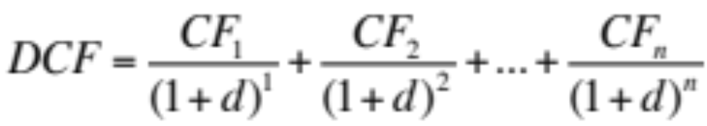
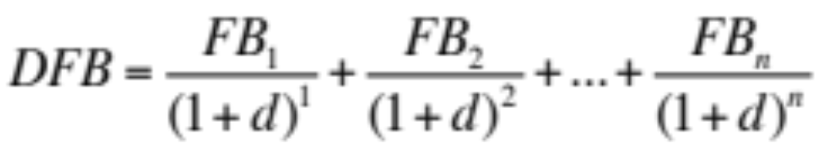
The Basic Structure of a
Discounted Future Benefits Model
Let’s start with the standard discounted cash flow formula:
We can easily adapt this to create a generic discounted future benefits model. The general form of a discounted future benefits model can be expressed as follows:
  Where DFB is the present value of expected future benefits
  FB_{t} is the future value of an expected benefit at time t
  d is the discount rate

Slide 160
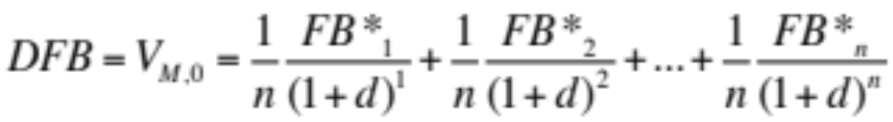
Probability Weight Each
Possible Future Benefit
As discussed, money is a claim to a slice of future benefits, not a stream of future benefits. Therefore, each of the possible future benefits FB* needs to be weighted by the probability of its receipt, “1/n”. Specifically, {FB_{t} = (1/n)FB*_{t}}. Therefore:
For the purposes of simplicity, we will assume that the current time is t=0 and that an individual can not spend in the current period. While this is slightly unrealistic, it makes very little difference to the ultimate result and avoids the issue of “how can the baseline proportion β₀ be the best unbiased estimate in the current period if we know the current realized proportion α₀ ?”

Slide 161
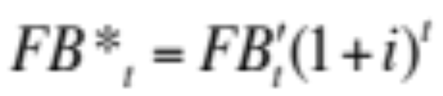
Future Benefit Includes
Expected Investment Returns
Our next task is determining the expected future value FB* of each of the possible “slices”. Firstly, we will assume that a unit of money obtained at t=0 will be invested in a broad portfolio of assets until it is required to purchase output. The expected nominal return of that broad portfolio is assumed to be a constant i % per period (the return is approximated by the long-term nominal interest rate, no term structure of investment returns is assumed).
Therefore, the expected future value at time t of a unit of money held now can be calculated as:
  where FB’_{t} is the expected future value received from one unit of money held at time t and spent at time t.

Slide 162
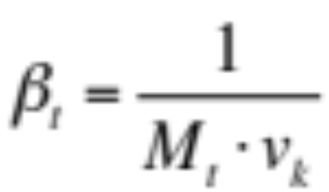
Calculating The Future Benefit of One Dollar Spent at time t
The expected future benefit of one unit of money FB’ spent at time t can be determined by calculating the proportion of output one unit of money is expected to claim at time t and multiplying this by the absolute market value of output at that time.
Proportional claim theory states that the expected baseline proportion in future period t, where t>0, provides the best unbiased estimate of the expected realized proportion of output that a single unit of money will claim in that future period t. As discussed, the baseline proportion at t is calculated as:

Slide 163
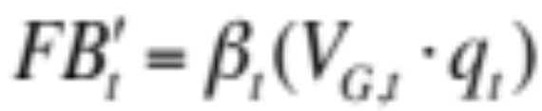
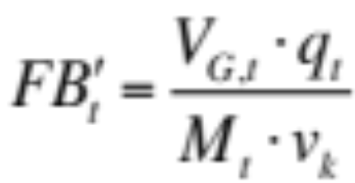
Expected Future Benefit Depends on Initial Velocity
The expected future benefit of one dollar spent at future time t is equal to the total absolute market value of real output (V_{G,t} q_{t}) multiplied by the proportion of output that each unit of money is expected to claim, or βt :
Substituting for βt :
The expected future benefit of one dollar spent at future time t depends upon the expected monetary base at that time and the initial velocity of money at announcement date.

Slide 164
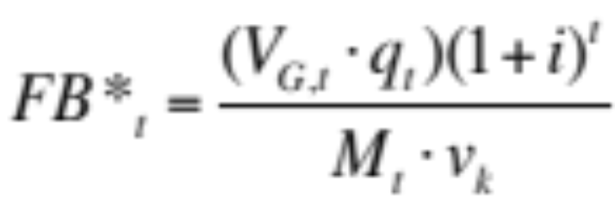
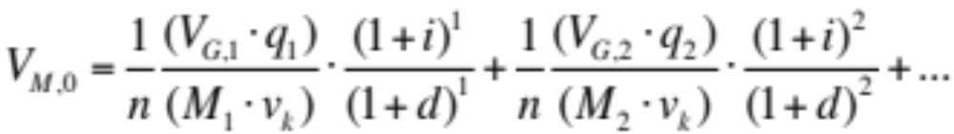
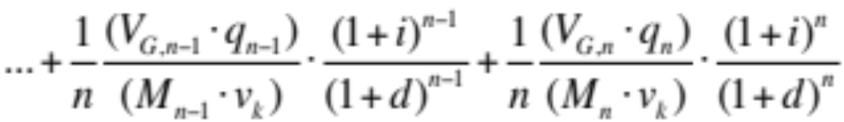
The “Extended Form” Version of The Model for Money
Therefore, the expected future value of a unit of money held now, invested and spent at time t can be calculated as:
Substituting for FB*_{t} creates the “extended form” version of the discounted future benefits model for money:

Slide 165
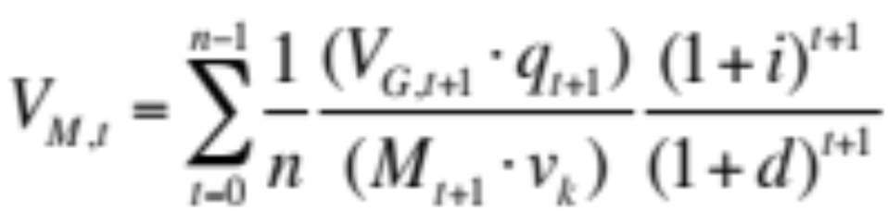
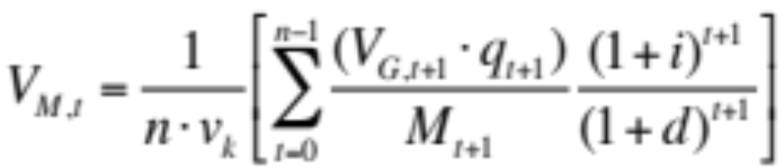
The “Short Form” Version of the Model for Money
We can express the discounted future benefits model for money in general terms (the “short form” version):
Since n and v_{k} are constants, we can further simplify this as:
If we assume that the spending horizon n is roughly 30-40 years (a subject for further discussion), then what we have is a discounted future benefits model for a long-duration asset.

Slide 166
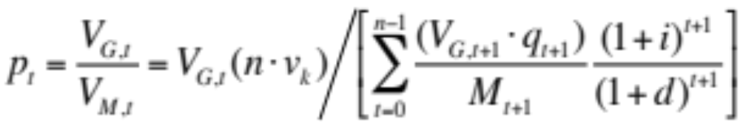
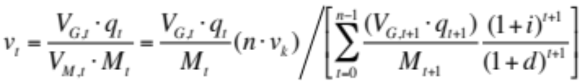
Initial Models for the Price Level and the Velocity of Money
Using the discounted future benefits model, we can calculate the price level as:
Furthermore, we can express velocity of money as:
While these models of the price level and velocity may be useful, they are not very elegant. We can create more intuitive models for both by making a couple of simplifying assumptions.

Slide 167
Simplifying The Model
We can simplify the model by making two assumptions. [There is a risk involved in doing this, namely that it tends to incorrectly imply a diminished role for V_{G} and the left side of the Goods-Money Framework in price level determination.]
Firstly, let’s assume “constant growth” expectations for both the monetary base and real output. Expected monetary base growth will be denoted as m and expected real output growth will be denoted as g.
Secondly, let’s assume that no change is expected in the general value level over the course of the spending horizon (estimated growth rate of V_{G} = 0%). This assumption is not entirely unreasonable given the mean reversion view of the general value level expounded in The Inflation Enigma.

Slide 168
The Discounted Future Benefits Model (Constant Growth Version)
The short form version of the Discounted Future Benefits Model states:
Using our constant growth assumptions for output (g), money (m) and the general value level (zero growth in V_{G} ), we can express the short form version of the model in terms of current levels of V_{G} , q and M:

Slide 169
An Intuitive Model for the
Absolute Market Value of Money
The “constant growth” version of the DFB model provides a far more intuitive picture of the absolute market value of money.
The absolute market value of money depends on the initial value of money (carried through the model by v_{k} ) and current levels of real output q, base money M and the general value level V_{G} . Further, the market value of money will rise if expected long-term output growth (g) rises, if expected long-term base money growth (m) falls, if long-term expected (risk adjusted) nominal investment returns on the diversified portfolio of assets (i) rises, or if the real discount rate applied by consumers to their future consumption (d) falls.

Slide 170
The Price Level
We can use the constant growth version of the model to create a more elegant solution for the price level:
In effect, the price is composed of a “baseline component” (not to be confused with the “baseline proportion”) and an “expectations component”. The baseline component is consistent with the quantity theory of money (price level depends upon current levels of money supply and real output).
Baseline Component
Expectations Component

Slide 171
The Velocity of Money
We can also use the constant growth version of the model to create a solution for the velocity of money:
The velocity of money is anchored by the initial velocity of money v_{k} (the velocity of money at the time the implied Moneyholders’ Agreement came into effect). Although we need to be careful not to interpret the constant growth model too literally, we can say that changing expectations regarding the long-term growth rates of real output and base money supply are a major factor in determining the velocity of money..

Slide 172
Basic Implications (1)
Price Level and Current Conditions
Let’s take another look at the model of the price level and consider some of the basic implications.
The first part of the model (the baseline component) reinforces the basic tenets of the quantity theory of money. All else equal, an increase in the monetary base will lead to a rise in the price level. A decrease in real output will lead to a rise in the price level. (In both cases, the absolute market value of money falls).
Baseline Component
Expectations Component

Slide 173
Basic Implications (2)
Price Level and Expectations
While the model is “consistent” with quantity theory, it also suggests that quantity theory should be a poor predictor of short-term movements in the price level. Why? Because the price level is highly sensitive to shifts in long-term expectations.
All else equal, a rise in long-term real output growth expectations will lead to an increase in the absolute market value of money and a fall in the price level. An increase in the expected long-term rate of base money growth will lead to a fall in the value of money and a rise in the price level.

Slide 174
Basic Implications (3)
Price Level and Nominal Rates
All else equal, a rise in the long-term expected nominal returns from a diversified portfolio of assets will lead to an increase in the value of money and a fall in the price level. If long-term expected nominal returns can be proxied by the long-dated nominal interest rate, then we can say that, all else equal, a rise in nominal interest rates will lead to a fall in the price level.
In contrast, if consumer time preferences change such that future consumption becomes less valuable (d rises), then the value of money will fall and the price level will rise.

Slide 175
The Important Role of
Very Long-Term Expectations
One of the most important takeaways of the model is that very long-term expectations matter to the determination of the market value of money and the price level. The expected rate of base money growth over the next few years is, in and of itself, largely irrelevant. What matters are perceptions of the expected 30-40 year annualized growth rate in base money and real output (the very long-term path of the money/output ratio).
It has hard to put an exact number on the spending horizon variable (“n”) in our models. Theoretically, it is the average of what adults in our society believe is their remaining life expectancy (life expectancy measured from today). The best guess on this figure is 30-40 years (we are all “optimistic”).

Slide 176
Small Changes in Expectations Can Overwhelm Current Conditions
If the Discounted Future Benefits Model is correct, then it is likely that the price level is far more sensitive to long-term expectations than many may believe (the price level is highly sensitive to small shifts in expected money/output growth rates).
Readers can analyze the sensitivity of the value of money to the various inputs by creating a spreadsheet. In rough terms, using the constant growth model, if we assume there n annual periods and n=30, then a 100bp increase in the expected long-term growth rate of base money will entirely offset the impact of a near 15% reduction in the current monetary base. (Build the model then compare price level with the expected annual base money growth for the next 30 years rising at 4% vs 3%).

Slide 177
Foreign Exchange Rate
Determination
Another theoretical application for the Discounted Future Benefits Model is the determination of foreign exchange rates. As discussed in The Inflation Enigma, every foreign exchange rate is a ratio of two quantities of currency exchanged and, therefore, can be expressed as a ratio of two absolute market values. For example:
The Discounted Future Benefits Model creates a solution for determining the absolute market value of a currency (EUR). In order to determine the relative market value of EUR, we can substitute into the equation above for both V(EUR) and V(USD).

Slide 178
Factors Impacting the
Foreign Exchange Rate (1)
Without going into all the math, we can make a number of observations regarding factors that should impact any foreign exchange rate.
Firstly, the expected long-term path of the money/output ratio is critical in determining the absolute market value of a currency. Therefore, a foreign exchange rate should reflect shifts in the market’s assessment of the relative long-term future paths of the money/output ratio for the two countries concerned. All else equal, if the market expects a country to experience weak growth supplemented by lots of money printing, then the value of its currency, relative to that of other nations, will be weak.

Slide 179
Factors Impacting the
Foreign Exchange Rate (2)
The second observation we can make it that shifts in expected relative nominal rates of return on the “portfolio of assets” matter. To the degree that nominal interest rate on government debt are a good proxy for these expected investment returns, we can say that nominal interest rate differentials play a key role in foreign exchange rate determination.
None of this should be terribly surprising to foreign currency traders. However, economics has struggled with the development a comprehensive foreign exchange rate model that can describe why these relationships exist. The empirical support for current theoretical models is poor. Nowhere is this better evidenced than by one recent academic paper: “Exchange Rate Models Are Not As Bad As You Think” (Engel, Mark, West, 2007)

Slide 180
Surveys of Long-Term Expectations May Hold Some Empirical Hope
Nevertheless, “Exchange Rate Models Are Not As Bad As You Think” (Engel, Mark, West, 2007) is an interesting paper, in part because the authors do find some empirical success when they regress exchange rate movements against long-run expectations data gathered from surveys.
While there is general agreement in the academic literature that “expectations matter” to the determination of exchange rates, economics has not had much success finding the right set of expectations. Hopefully, the models contained in this paper might be used to create better theoretical models of exchange rate determination which can be empirically supported by gathering long-term expectations data.

Slide 181
Monetary & Fiscal Policy
The Application of the Goods-Money Framework and the Discounted Future Benefits Model to an Analysis of Monetary and Fiscal Policy Transmission Mechanisms

Slide 182
Application of Enigma Theory to Monetary/Fiscal Policy Scenarios
The goal of this final section of the paper is bring together all the work done so far to analyze the impact of monetary and fiscal policy on inflation. Moreover, we will attempt to reconcile this view of the world with the views of the major schools of economic thought (Keynesianism, Monetarism and Fiscal Theory). It’s a huge task and we are only going to scratch the surface of the issues involved.
The view of this paper is that each school of thought brings some important piece of intuitive insight to the debate: “too much demand”, “too much money” and “too much debt” are all elements that contribute to fluctuations in the price level. The real issue is understanding how these elements fit together.

Slide 183
Need to Analyze Both Sides of the Goods-Money Framework
It is the contention of The Enigma Series that in order to understand the impact of monetary and/or fiscal policy on the price level, we need to analyze the potential impact of policy shifts on both sides of the Goods-Money Framework.
At a high level, both Keynesianism and Monetarism (at least in their strict traditional interpretations) tend to focus on only one side of the framework. Keynesianism tends to focus on the left side of the framework (the impact of policy on aggregate demand), while monetarism implicitly focuses on the right side of the framework (monetary policy changes the absolute market value of money but leaves the left side of the framework, or “real relations”, relatively unchanged).

Slide 184
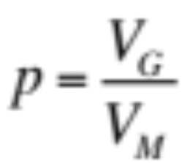
The Goods-Money Framework
The price level is a ratio of two market values. In order to understand the impact of monetary/fiscal policy on the price level, we need to analyze the response of both sides of the framework to policy shifts.
“LEFT SIDE: GOODS”
“RIGHT SIDE: MONEY”
General Value Level (EV)
Value of Money (EV)
AS
Supply
V_{G}
V_{M}
Demand
AD
q
Real Output
M
Base Money

Slide 185
Using the DFB Model to Analyze the Right Side of the Framework
The great advantage of the work just completed in this paper is that we now have a far more powerful and insightful model of how the absolute market value of money is determined. As discussed in The Inflation Enigma, a simple reading of the right side of the framework would suggest that the value of money V_{M} falls in response to an increase in the current level of base money. We know from the Discounted Future Benefits Model that this analysis is far too simplistic.
In all our analysis going forward, we will use the DFB Model to determine the outcome for the absolute market value of money and then discuss how this can be illustrated in terms of the supply and demand for money (the right side of the framework).

Slide 186
Three Basic Scenarios
In order to illustrate the potential impact of monetary and fiscal policy on the price level, we are going to analyze three different scenarios.
In the first scenario, we will assume that there is no central bank and an increase in government spending is directly financed by base money creation (deficits are monetized).
In the second scenario, we will assume there is a central bank and that an increase in base money is used to reduce interest rates via traditional open market operations.
In the third and final scenario, we will analyze the impact on an increase in government spending that is financed by the issuance of government debt (no change in base money).

Slide 187
Scenario One: Printing Money Equals Inflation? Not Necessarily
What is the response of real output and the price level to an increase in government spending that is directly financed by base money creation? The classical view would be that the price level would rise and there would be no impact on real output (there is no money illusion and no change to real economic outcomes). A Keynesian view might suggest that, in the short-term, there would be an increase in real output due to sticky wages/prices: the short-term impact on the price level would depend on whether the economy is at/near full utilization (the output gap).
The view of this paper is that the response of real output and the price level will depend largely upon whether the increase in base money is expected to be temporary or permanent, with the output gap acting as a secondary factor.

Slide 188
Possible Reactions to Money Financed Deficit Spending
The short-term reaction to money financed deficit spending will vary significantly depending upon specific circumstances and expectations. Let’s consider how money financed spending could result in a significant increase in output but only a small change in the price level.
General Value Level
Value of Money
AS
Supply
V_{M}
V_{G}
AD
q
Real Output
M
Base Money

Slide 189
Conditions Required for Limited
Inflationary Response
In order for money financed government spending to have minimal impact on the price level, two things must occur. Firstly, the increase in aggregate demand must have only a small impact on the general value level V_{G} . This is possible if two general conditions are satisfied. Firstly, any increase in the general value level is largely dismissed by labor as a temporary shift and does not provoke a contractionary labor supply response. Secondly, there must be enough “slack” in the economy that a small rise in the general value level can induce a real output response.
The second requirement is that the policy must have minimal impact on the absolute market value of money. This is possible if the increase in base money is considered to be temporary.

Slide 190
Significant Increase in Real Output
Small Change in the Price Level
The diagram below illustrates how, in the short-term, it may be possible for money financed deficit spending to lead to a significant increase in real output and a small increase in the price level. Expectations are stable, hence the value of money V_{M} is stable.
General Value Level
Value of Money
S₀
S₁
AS
Small rise
in V_{G}
No change
in V_{M}
AD₁
AD₀
D₀
D₁
q₀
q₁
Real Output
M₀
M₁
Base Money

Slide 191
Using the DFB Model to Analyze Impact on Value of Money
Let’s use the long form version of the Discounted Future Benefits Model to consider why the market value of money is stable in this particular scenario. In our current scenario, the only terms that might change in the equation below are the “near future” terms.
[Note: while this version of the DFB model is not as intuitively appealing as the constant growth version, it is often the better version to use in macroeconomic scenario analysis.]

Slide 192
“Near Dated” Terms Might Change, But Small Impact on Value of Money
The “near dated” terms in our DFB model are impacted positively by the increase in real output and negatively by the increase in base money. This might lead to a slight increase or decrease in the value of money. However, the key point is that these “near dated” terms have little overall impact on the absolute market value of the long-duration asset (money).
The “far dated” terms in our DFB model are unlikely to change significantly: both the increase in real output and the increase in base money are generally considered to be “temporary”. {There is a possibility here that the rise in current economic activity is extrapolated into higher long-term real output growth rates, an increase in the value of money and a fall in the price level!}

Slide 193
The Populist’s Choice
The outcome just discussed explains why printing money is, at least initially, such an attractive option to many populist politicians. As discussed in The Money Enigma, issuing long-duration variable entitlements to the output of society may appear to be a way of financing public spending “at no cost”: real output increases but there is no increase in taxes, no increase in government debt and no decline in the value of money (at least initially).
We know from repeated experience that this experiment tends to fail eventually. After some period of time, people realize that in order for the higher level of economic activity to be sustained, more and more money needs to be created.

Slide 194
Outcome if Increase in Base Money is Expected to be Permanent
If people believe that money financed deficit spending will lead to a permanent increase in base money (higher future levels of base money), then the absolute market value of money declines. There is an increase in real output but only at the expense of a higher price level.
General Value Level
Value of Money
S₀
S₁
AS
Small rise
in V_{G}
Decline
in V_{M}
AD₁
AD₀
D₀
q₀
q₁
Real Output
M₀
M₁
Base Money

Slide 195
The Trade Off
In simple terms, policy makers face a trade off. Money financed deficit spending can be used to create a “one-off” boost in economic activity with little impact on the price level, but such a boost to economic activity will be transient. (Note that this may be “good policy” in certain scenarios, for example, restoring confidence in the midst of a banking crisis).
However, if policy makers attempt to sustain this otherwise transient boost in economic activity through the use of sustained money financed deficit spending, then the absolute market value of money will decline as expectations for long-term base money growth rise. (The far dated terms in our DFB model fall as expected future levels of base money rise).

Slide 196
The Role of the Output Gap
Using any sort of policy stimulus (monetary or fiscal) to create a temporary boost in real output is more dangerous (more likely to have an inflationary impact) in an environment where the economy is operating near “full capacity”. If the economy is already operating at a steep (near vertical) part of the aggregate supply curve, then a policy designed to increase real output by increasing aggregate demand will not have the desired effect.
We can easily visualize the role of the output gap in the Goods-Money Framework. The next slide illustrates the “worse case” scenario: money financed deficit spending not only devalues the currency (V_{M} falls), but fails to increase real output significantly due to capacity constraints.

Slide 197
Worse Case Scenario: Small Increase in Real Output, Big Rise in Price Level
If the economy is operating near “full capacity” and people believe that money financed deficit spending will lead to a permanent increase in base money, then the “perfect storm” is created. There is a large increase in the price level (V_{G} rises, V_{M} falls), but a small increase in real output.
General Value Level
Value of Money
S₀
S₁
AS
Rise
in V_{G}
Decline
in V_{M}
AD₁
AD₀
D₀
q₀
q₁
Real Output
M₀
M₁
Base Money

Slide 198
Keynesianism:
A “Left Side” View of the World
We can use these multiple alternate versions of our our first scenario (an increase in government spending financed by money creation) to help explain the strengths and weaknesses of both Keynesianism and monetarism.
Keynesianism tends to get “the right answer” when the right side of the model is “not in play”. In other words, Keynesianism can correctly predict the response of real output and the price level to policy actions if the absolute market value of money is stable (economic agents believe that the policy actions are “temporary” in nature). If the absolute market value of money is stable, then it can be argued that the slope of the aggregate supply curve (which is significantly influenced by the output gap) is the key element in the determination of the economic outcome.

Slide 199
Output Gap & Inflation:
Empirical Evidence is Poor
The obvious weakness of Keynesianism is that the empirical evidence suggests that the correlation between the output gap (as measured by unemployment) and inflation is very low (see John Cochrane’s excellent article “Inflation and Debt” (2011) or John Hussman’s “Will the Real Phillips Curve Please Stand Up?”).
The reason that the output gap is a poor predictor of inflation is that it is a minor secondary factor in the determination of the price level. It is the view of The Enigma Series that the primary source of changes in the price level (inflation) are variations in the absolute market value of money. In other words, an analysis of inflation needs to begin with the right side of the Goods-Money Framework, not the left side.

Slide 200
“Inflations Expectations”
A Nebulous Concept
“New Keynesianism” has attempted to compensate for this weakness by adopting an explicit “inflations expectations” term into its model of inflation. The problem with the “inflation expectations” term used by New Keynesianism is that there is no clear formulation for the calculation of “inflation expectations”.
In one sense, this is very convenient for Keynesian theorists who can use “inflation expectations” as an after the fact explanation for almost any change in the rate of inflation. However, in order to be meaningful from a predictive perspective, the inflation expectations term in the expectations augmented Phillips Curve equation must itself be a function of observable economic variables (such as money supply, output, interest rates) or expectations of those economic variables.

Slide 201
Monetarism:
A “Right Side” View of the World?
If Keynesianism is a “left side” view of the world (aggregate demand and “slack” are the keys to inflation), then it may be tempting to argue that monetarism represents a “right side” view of the world (money is the key to inflation). The problem with this view is that traditional monetarism doesn’t really understand the right side of the Goods-Money framework.
Ultimately, money does matter. Monetarism will tend to get the right answer in the long-run or when there is an increase in base money that is expected to be more permanent in nature. However, in the short-term, large swings in the monetary base will often have little impact on the value of money and the price level. Why? Because money is a long-duration asset.

Slide 202
Second Scenario: Impact of
Lowering Interest Rates
Let’s move on to our second scenario: a central bank uses an increase in the monetary base to reduce interest rates via traditional open market operations. It may be tempting to argue that scenario one is identical to scenario two. In both cases, an increase in the monetary base is used to stimulate aggregate demand: the only difference is that in scenario one there is a direct injection of cash into the economy (the “helicopter model”) and in scenario two the mechanism used to stimulate aggregate demand is the interest rate.
The problem with this mainstream view of the world is that the manipulation of interest rates by the central bank impacts not only aggregate demand, but also aggregate supply.

Slide 203
Interest Rates and Aggregate Supply
One of the key tenets of mainstream macroeconomics is that the interest rate has a significant impact on aggregate demand but no or little impact on aggregate supply. In fact, this is a critical assumption of most models. In order to have any chance at explaining how lower interest rates lead to a higher price level (or a higher rate of inflation in the New IS-LM Model), traditional models must assume that the interest rate has no impact on aggregate supply.
If the aggregate supply curve did shift to the right in response to lower rates, then there would be no way for these theories to explain the “link” between interest rates and inflation: a cut in interest rates would simple lead to a boom in real output.

Slide 204
Challenging the Traditional View
Mainstream economics must assume that the interest rate does not impact aggregate supply. On the left hand side, a cut in interest rate leads to an increase in aggregate demand and a rise in inflation. Note that if aggregate supply responds to the interest rate (right hand side), then the relationship between interest rates and inflation, as described by Keynesianism, breaks down.
Price Level/Inflation
Price Level/Inflation
AS₀
AS
AD₀
AD₁
AS₁
Inflation
Rises
No
Change
AD₁
AD₀
q₀
q₁
Real Output
q₀
q₁
Real Output

Slide 205
Aggregate Supply Does Respond to Interest Rates
It is the view of The Enigma Series that there is a strong relationship between the interest rate and aggregate supply. As the interest rate falls, both aggregate demand and aggregate supply curves, as expressed in terms of the general value level and real output, shift to the right.
The interest rate on government debt is part of a continuum of required rates of return on risky assets. When the central bank buys government debt, it not only lowers the interest rate on government debt but also reduces the required rate of return on all investment projects. The price of risky assets rises as the required risk adjusted return from those assets falls. More importantly, the bar for new projects is also lowered, leading to new business investment and an increase in aggregate supply.

Slide 206
Lowering Interest Rates and the
“Goldilocks Scenario”
The central bank creates money and uses it to buy government debt (lower the interest rate). A fall in interest rates leads to an increase in both aggregate demand and aggregate supply. The impact of this policy on the absolute market value of money depends upon expectations, but the big increase in output (and associated surge in confidence) may moderate the decline in the value of money.
General Value Level
Value of Money
S₀
S₁
AS₀
AS₁
Modest
Decline
in V_{M}
No change
in V_{G}
AD₁
AD₀
D₀
D₁
q₀
q₁
Real Output
M₀
M₁
Base Money

Slide 207
Manipulation of Interest Rates &
The Illusion of Prosperity
We can use the previous slide to explain why the modern practice of manipulating interest rates is so popular and “successful” as a policy (the policy seems to have created the “goldilocks scenario”: growth with no/little inflation).
As the interest rate falls, both aggregate supply and demand increase leading to a strong real output response, but little change in the general value level. This policy may have little impact on the value of money if (i) the surge in real output boosts long-term expectations for real output growth, and/or if (ii) the increased economic activity encourages market participants that the policy is only “temporary” and will soon be reversed (base money will revert to its “normal path” in the near future).

Slide 208
The Confidence Game
The practical question which remains unanswered (as at the time of writing) is what happens we reach the zero bound on interest rates and the central bank can no longer use the mechanism of lower interest rates to boost growth and confidence.
The real issue, from the perspective of inflation and the absolute market value of money, is one of confidence. If confidence about the future path of real output relative to base money falters, then the Discounted Future Benefits Model suggests that the absolute market value of money could decline significantly (and in a short period of time) leading to a significant rise in the price level. This is an important issue that requires much more detailed analysis (it is a subject for a future paper).

Slide 209
Interest Rates and The Diminished Role of The Output Gap
There is a reasonable counterargument to this proposition: in the short-term, where the “short-term” is defined as a few months, aggregate demand is likely to be far more responsive to interest rates than aggregate supply. I agree with this proposition, but I don’t think it matters. Monetary policy seldom has a half life of three months.
If interest rates are held low for a few years, then the impact will be to shift both the aggregate demand and aggregate supply curves to the right. If this is correct, then the role of the output gap is diminished even further. The economy never comes close to full utilization because the low interest rate environment encourages continued capacity expansion.

Slide 210
Scenario Three:
Fiscal Policy and Inflation
Before we conclude this paper, let’s discuss the impact that fiscal policy may have on inflation. The traditional (Keynesian) view of fiscal policy is that it only impacts the price level in so far as fiscal policy impacts aggregate demand: if the government boosts spending while holding taxes constant, then this will increase aggregate demand which will lead to a higher price level.
There is little room in the traditional narrative for the role of government debt. The fiscal theory of the price level, developed by Eric Leeper (1991) and championed by Christopher Sims, Michael Woodford and John Cochrane, represents one of the more serious attempts to link the sustainability of government deficits and debts to inflation.

Slide 211
Excessive Government Debt and the Value of Money
The fiscal theory of the price level has been heavily criticized by many “Keynesian” economists (I’ll spare readers the details of this particular debate). Whatever the merits of “fiscal theory” in and of itself, the notion that government debt matters to inflation does have strong intuitive appeal. Historical evidence would suggest that a society that consistently lives beyond its means will almost inevitably debase the value of its currency.
The view of this paper is that debts and deficits do matter to inflation. More specifically, fiscal policy (in particular, the accumulation of “excessive” government debt) plays a critical role in the determination of the absolute market value of money and, consequently, the determination of the price level.

Slide 212
The Relationship Between
Debt and Equity Financing
In order to understand the impact of government debts and deficits on the absolute market value of money, we need to think about the relationship between government debt (the debt of society) and money (the equity of society).
Government debt and money are interchangeable sources of finance for public expenditures, just as debt and equity are interchangeable sources of finance for a company. All else equal, as the government issues more debt, the balance sheet of society becomes more stressed, increasing the likelihood of (i) a fall in real output, and/or (ii) a rise in base money. In other words, as more debt is issued to cover deficits, the expected future path of the money/output ratio “lifts”, even if very slightly.

Slide 213
Value of Money Falls as Fiscal Trajectory Becomes Less Sustainable
As government deficits and debt become (or appear to become) increasingly unsustainable, markets recognize that society faces a simple trade off. Society can choose to reduce fiscal deficits and accept lower levels of real output, or society can attempt to maintain higher levels of real output by raising the rate at which the monetary base grows.
Either way, the absolute market value of money will fall as the expected path of the money/output ratio rises (in the equation above, “m” rises relative to “g”).

Slide 214
Debts, Deficits and the Future Path of the Money/Output Ratio
The expected future path for base money is not known with any certainty. In practice, economic agents can estimate possible ranges for base money at each future point in time and then weight each of the possible outcomes in each of these ranges using some sort of probability distribution. This principle also applies to the expected future path of real output.
As government deficits and debts become (or appear to become) increasingly unsustainable, the market begins to assign higher probabilities to high base money scenarios and lower probabilities to high real output scenarios. In simple terms, the market raises its expectations for base money growth, lowers its expectations for real output growth and the value of money falls.

Slide 215
The Impact of Fiscal Stimulus Funded by Government Debt
Fiscal stimulus (higher net levels of government spending financed by issuance of government debt) shifts the aggregate demand curve to the right. Even though money supply has not changed, the value of money may fall as future expectations of the money/output ratio rise.
General Value Level
Value of Money
S
AS
Decline
in V_{M}
Rise
in V_{G}
D₀
AD₁
AD₀
D₁
q₀
q₁
Real Output
M₀
M₁
Base Money

Slide 216
Fiscal Policy Plays a
Key Role in Preventing Inflation
If this view of the world is correct, then one of the important implications is that fiscal policy makers have a critical role to play in preventing inflation and protecting the value of the currency.
Economics has created a somewhat artificial divide between the liabilities of government and their role in price determination. Ultimately, the future economic prospects of society are beholden to the fixed entitlement liabilities of government (both government debt and unfunded liabilities). In many ways, the absolute market value of money is merely a gauge of market confidence regarding those future prospects and society’s ability to “service” the fixed entitlement liabilities from future output.

Slide 217
Finding the Right Balance
It is important to note that none of this analysis represents an endorsement of the view that fiscal stimulus has no place in our modern society. Monetary and fiscal stimulus both have an important role to play in the lifecycle of any society.
The main issue that concerns many commentators (myself included) is that our modern society appears to place an increasing reliance on both highly stimulatory monetary and fiscal policy. The “balance sheet” (government debt plus money) of many modern societies is being sacrificed in order to keep the “income statement” (GDP) in a range which is deemed “acceptable” by both policy makers and the general population. This deterioration in the balance sheet is not sustainable.

Slide 218
End of Paper
The End of The Enigma Series

Slide 219
References

Slide 220
References
Cochrane, John H., 2011, “Inflation and Debt”, National Affairs, Issue Number 9 – Fall 2011.
Engel, Charles, Mark C. Nelson, Kenneth D. West, 2007, “Exchange Rate Models Are Not as Bad as You Think”, NBER Macroeconomics Annual 2007, Volume 22, University of Chicago Press, pp. 381-441.
Hazlitt, Henry S., 1968, “The Velocity of Circulation”, in “Money, the Market and the State”, edited by Nicholas B. Beales and L. Aubrey Drewry Jr., Athens: University of Georgia Press, pp. 35-44.
Hussman, John P., 2011, “Will the Real Phillips Curve Please Stand Up?”, Hussman Funds, weekly online commentary, posted April 4, 2011.

Slide 221
References
Keynes, John M., 1924, “A Tract on Monetary Reform”, Macmillan & Co. Limited, London.
Leeper, Eric M., 1991, “Equilibria under ‘Active’ and ‘Passive’ Monetary and Fiscal Policies”, Journal of Monetary Economics, Vol. 27(1), pp. 129-147.

